Slide 1
Principles of Furniture &
Joinery Design
Creativity
&
Lateral
Thinking

Slide 2
Creativity
What is “Creativity”
Creativity is being able to generate or recognize ideas, alternatives, or possibilities that may be useful in problem solving.
“ At the simplest level “creative” means bringing into being something that was not there before. In a sense, “creating a mess” is an example of creativity. The mess was not here before and has been brought into being” (De Bono. (1996) pg3)

Slide 3
Characteristics of the creative personality
  Creative people are thought to be smart, intelligent & artistic
  Creative people alternate between imagination and fantasy at one end, and rooted sense of reality at the other.
  Creative people seem to harbour opposite tendencies on the continuum between extroversion and introversion.
  Creative individuals are also remarkable humble and proud at the same time.
  Generally, creative people are thought to be rebellious and independent.
  Most creative persons are very passionate about their work, yet they can be extremely objective about it as well.

Slide 4
Creativity
So can anyone be creative?
The word, "Creativity", has always been associated with artistic people. You often hear people saying “they were born with it” They got that from their Mother/Father. . they were very creative.
But creativity is also a very important part of everyday life - divergent thinking, problem solving, and innovation.
We all have the potential to be creative.
Our job as parents and teachers is to help kids be divergent thinkers and encourage the creativity.

Slide 5
Everyone can be creative thinkers.
“Creative Thinking” is not inherited or in the genes, it is a skill that can be learnt.
Creative Thinking adds to peoples natural abilities and increases their strengths, which improves creativity and innovation.
Traditional thinking uses the processes of logic, sequence or historical way.
Lateral thinking interrupts the normal thinking sequence and arrives at the answer from another angle.
Train track thinking versus spaghetti junctions.
Can you think of another name for Laterial thinking?
Thinking outside of the box.

Slide 6
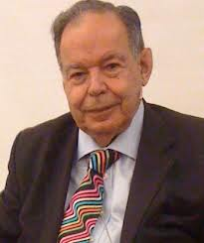
Edward de Bono - Father of Creative Thinking
Edward de Bono born 19 May 1933. He is Maltese physician author, inventor and consultant. He is regarded t by many to be the leading authority in the world in the field of creative thinking and the direct teaching of thinking as a skill
He has written 62 books translated into 37 languages and has been invited to lecture in 54 countries.
Originator of lateral thinking which treats creativity as the behaviour of information in a self-organising information system - such as the neural networks in the brain.
Edward De Bono on Creative thinking
http://youtu.be/UjSjZOjNIJg

Slide 7
Problem solving
Example 1
Add 1 + 2+ 3+ - - - 8+ 9+ 10 =
Answer 55
Add 1 + 2+ 3+ - - 98 + 99 + 100
Answer?
Rearrange numbers underneath original numbers.
1 + 2 + 3 + - - 98 + 99 + 100
100 + 99 + 98 - - - 3 + 2 + 1
Answer is 101 each time divide by 2 Answer 5050.
By re-arranging the numbers this way the task becomes a lot easier …..this is being creative.

Slide 8
Design an expandable table
List what you can do when asked to design an expandable table.
Research – work out an idea
Borrow !– (steal) modify an existing idea
Wait for inspiration!
Get someone else to design table.
Other? . . .
Apply a deliberate technique of “Lateral Thinking”
We will revisit this problem in the next presentation.

Slide 9
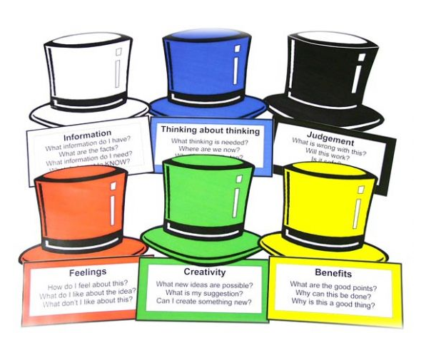
Six Thinking Hats
Six Thinking Hats

Slide 10
Six Thinking Hats
The six hats and the thinking processes that they represent.
White hat Facts & Information
White sheet of paper write down facts, numbers & information.
Focus directly on the information at hand what is missing and what is needed.
Red hat Feelings & Emotions.
Red hot fire, feelings, emotions & intuition.
Gut feelings and hunches that you don’t have to back up at this stage.

Slide 11
Six Thinking Hats
Black hat Logical negative
Black robes of a judge.
Asks the questions about whether idea is legal, ethical or profitable.
Caution hat tries to prevents mistakes.
Yellow hat Logical positive
Sunshine
Optimism and positive viewpoints.
Tries to show how something can be obtained.

Slide 12
Six Thinking Hats
Green hat Creative Thinking & Possibilities
Growth and vegetation.
Creative thinking and new ideas.
Puts forward different possibilities and alternatives.
Blue hat Control of Process & Steps.
Sky and overview.
This hat is used to gain some control over the whole process.
Blue hat sets agendas, monitors ideas and make suggestions towards progress.

Slide 13
Six Thinking Hats
Main benefits of Six Thinking Hats method:
1. Allow to say things without risk
2. Create awareness that there are multiple perspectives on the issue at hand
3. Convenient mechanism for 'switching gears'
4. Rules for the game of thinking
5. Focus thinking
6. Lead to more creative thinking
7. Improves communication
8. Improves decision making
Can you list ways to be or stay creative.
29 ways to stay creative
http://www.youtube.com/watch?v=0eI_QCgA8KQ

Slide 14
Final Takeaways
Everyone can be creative
Creativity is a skill that can be learned
You all have it in you to be creative
You must trust in yourself and don’t be afraid to make mistakes
FAIL stands for First Attempt In Learning
Good reading
De Bono, E.(1996) Serious Creativity. Using the Power of Lateral Thinking to Create New Ideas. London. Harper Collins.
Edward De Bono on Creative Thinking visit
http://edwdebono.com/cavendish/cavendish/pdeblat.htm

