Slide 1
Manufactured
Boards
Manmade
Boards

Slide 2
Manufactured
Boards
Three types of manufactured boards
Core board: Plywood, Block board
Particle Board: Chipboard
Fibreboard: Hardboard, M.D.F.
Advantages:
They are supplied in various sizes
Free from common defects found in solid timber, splits, knots etc.
Most man-made boards are cheaper than an equal amount of solid timber

Slide 3
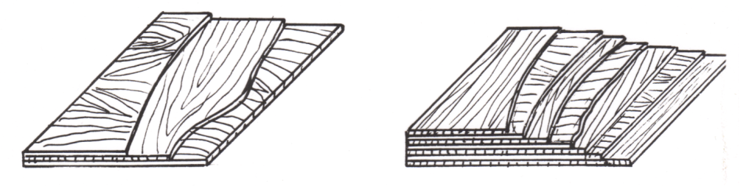
Core Boards
Three Ply Multi Ply
Plywood's are made from rotary cut veneers bonded together with the grain direction in alternate layers. (at 90° to next layer)
Plywood’s are made in different grades and sometimes stamped as such
Marine plywood moisture resistant: Ext
Weather and boil proof plywood: WBP
Boil resistant plywood: BR
Interior plywood: Int

Slide 4
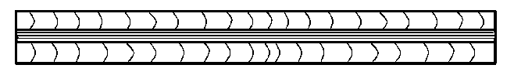
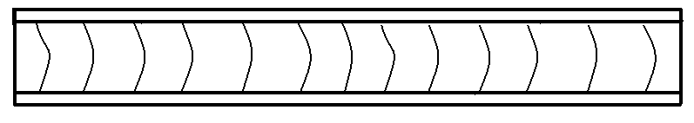
Flexi Ply
Flexi Ply : Built up rims, shaped work. Thick outer layers thin inner layer
Stout Core Ply
Stout Core ply : backs, bottoms, two thin outer layers with think inner core.
Veneered Faced Ply: press backs & drawer bottoms.
Core Boards

Slide 5
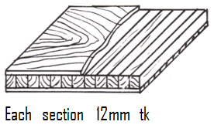
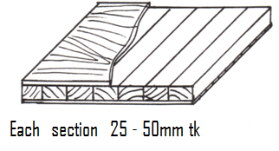
Core Boards
Lamin board is a type of plywood with the core made up of solid strips of wood 12mm thick and an outer layer of thick veneer
Blockboard same as above strips are between 25mm – 50mm wide
Battenboard same as above except battens are between 50mm-75mm wide
Modern boards do not have Veneer sold as solid boards used for stairs window boards etc.

Slide 6
Phenolic Plywood
Phenolic-surfaced plywood is Baltic –birch plywood with a thin coating of phenol resin on its faces.
Used mainly for electrical panels because of its stability & strength at high temperatures.
Phenolic Plywood is very resistant to heat, moisture & Chemicals.
It has a non-stick glass like finish so it is also used to make concrete moulds & form work.
It is great for making jigs, saddle beds & false fences etc. less friction.
Glue can be easily cleaned off the surface when dry so it is also ideal for veneering etc.

Slide 7
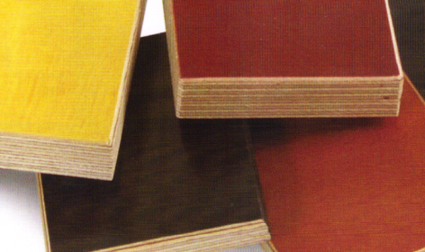
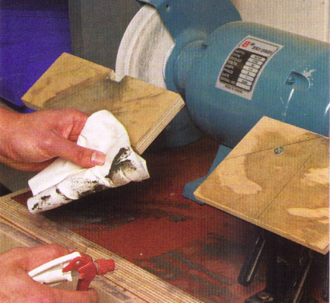
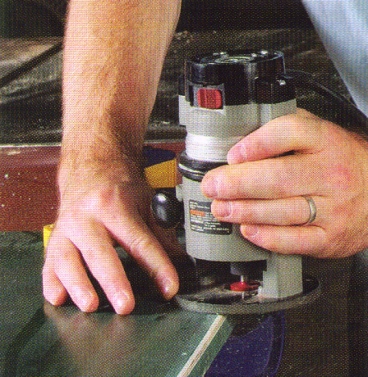
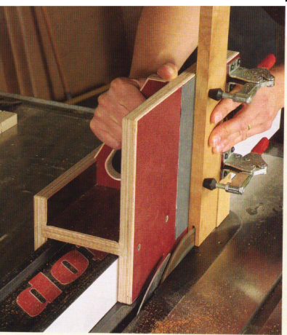
Phenolic Plywood
Brown, red, black,
white, yellow,
green or clear
Easy to clean
Easy to machine
Edges are very sharp
Easy friction free jigs.
Above cutting tenons
on a bench saw

Slide 8
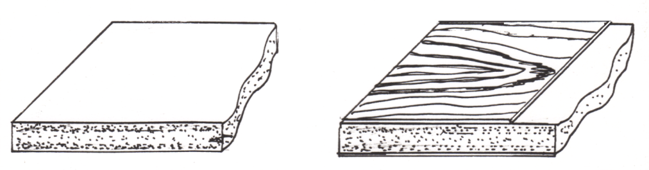
Particle Board
Plain Chip Oak Veneered chip
Material taken from forest thinnings, sawmill waste etc.
Chipboard: Resin coated wood chips bonded together to make this board. Different grades of chipboard are made by using different resins, sizes of chips & pressing conditions.
Chipboard: plain finish, melamine (cream or white) wood veneer or laminated.

Slide 9
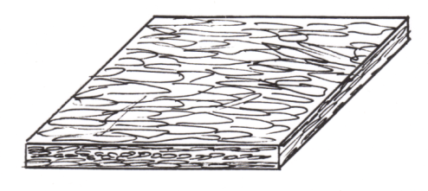
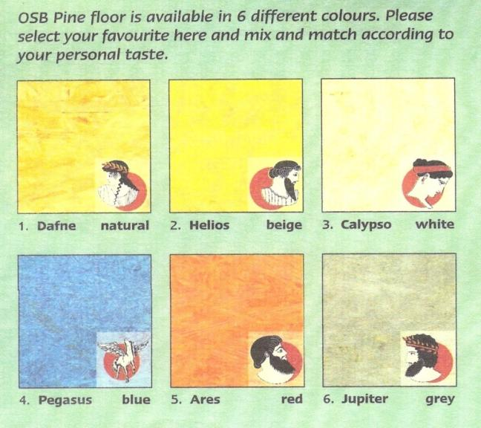
Particle Board
O.S.B.
Oriented Strand Board: a three layer flake board. The long flakes run along the outer layers while they run across the middle layer for strength. Top grade used for flooring & furniture.

Slide 10
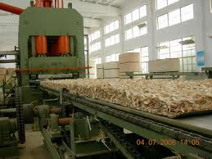
O.S.B. Manufacturing
The layers of flakes or strands mixed with glue travel along big conveyor belts.
They pass through a series of rollers that flatten them down to the required thickness.

Slide 11
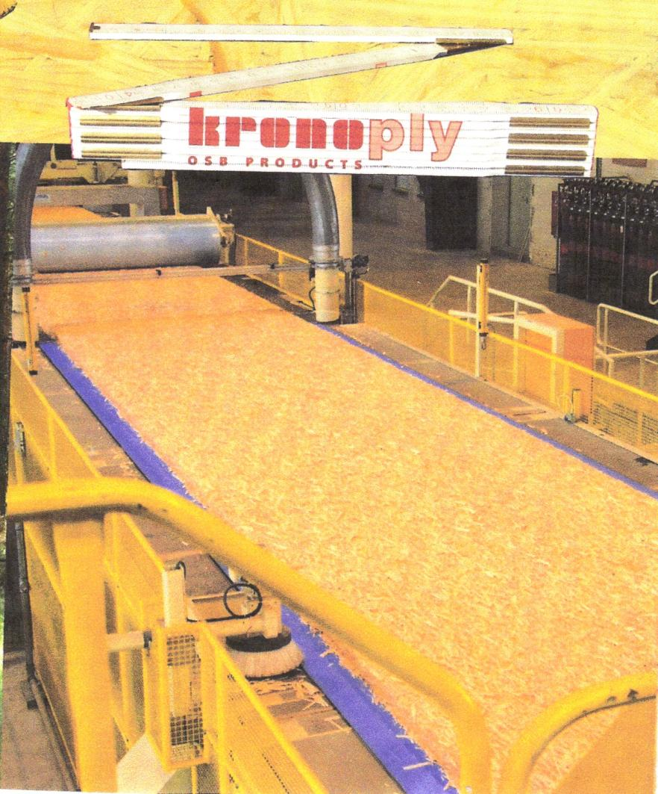
Kronoply

Slide 12
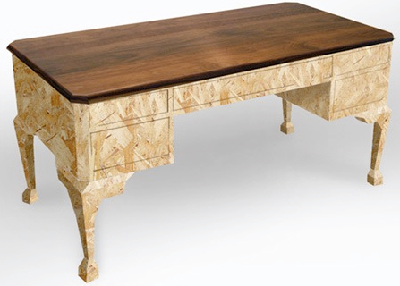
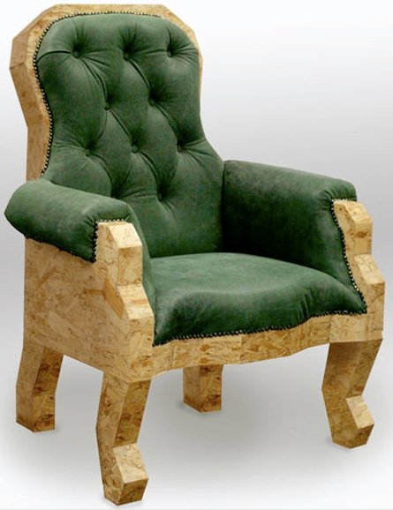
O.S.B. Furniture
Furniture created
by Lloyd Alter
Sustainable Product
Design

Slide 13
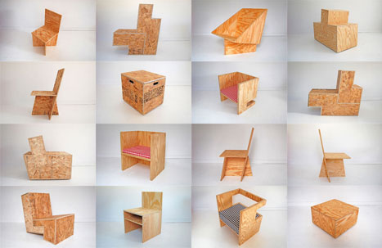
O.S.B. & Plywood Furniture
Series of O.S.B. & plywood chairs designed
by ROLU, exhibited at “Art In General” in
NYC in Sept 2010
ROLU founders Matt Olson, Mike Brady,
and Joe Mollen.

Slide 14
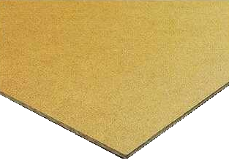
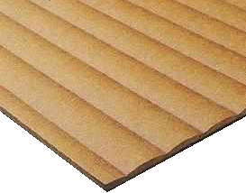
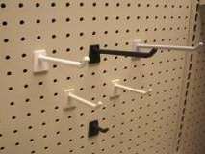
Fibre Boards
Hardboard: made from pulped wood fibres. The pulp is put under pressure until the fibres bond to produce a board that is smooth on one side and rough on the other. It is not very strong used as press backs & drawer bottoms. Also available with melamine or painted finish on face only.
Different types of pressing conditions are used to produce textured hardboards such as profiled boards and peg boards which have a serious of small holes in it.

Slide 15
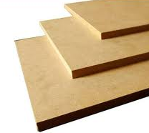
Medium Density Fibre Boards
M.D.F. Medium Density Fibreboard Shredded wood fibres are mixed with glue and bonded together in a hot press under high pressure to give a strong dense board.

Slide 16
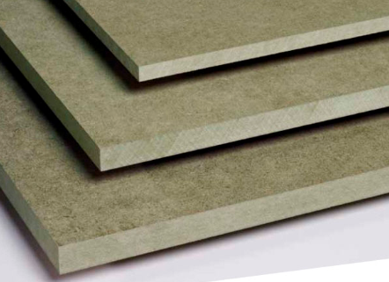
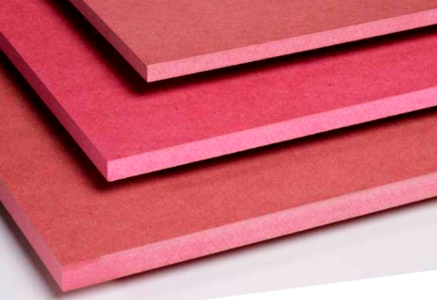
Medium Density Fibre Boards
Different pressing methods and glues are used to produced different grades. Water proof (Green) & Fire resistant (Pink)
Plain finish, melamine (cream or white) wood veneer or laminated.

Slide 17
M.D.F.
Advantages:
M.D.F. can be routered and does not need to be edged.
Super smooth surface, no seasoning required.
No warping, cracking, splitting, knots.
Free from termites & fungus.
Moisture and fire resistant.
Good dimensional stability
Disadvantages:
Edges have to be sealed.
Very dusty material.
M.D.F. wears down cutters quickly

Slide 18
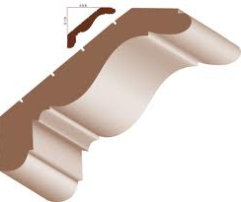
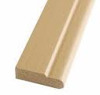
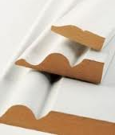
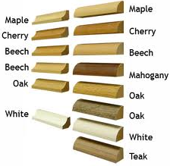
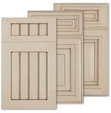
Other M.D.F. Products
Also available are moulded & veneered cornices & pelmet, skirting's & architraves

Slide 19
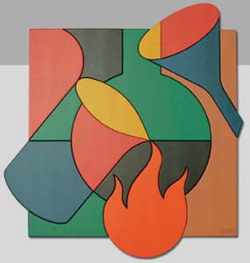
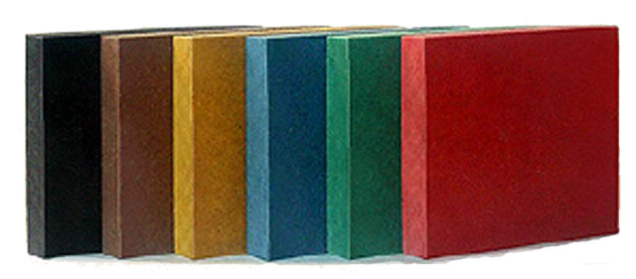
Coloured M.D.F./ H.D.F.
High Density Fibreboard has a super smooth finish and available in a range of colours.
Advantage: colour is the same throughout the board so scratches blend in.
B.A.S.F. Germany

Slide 20
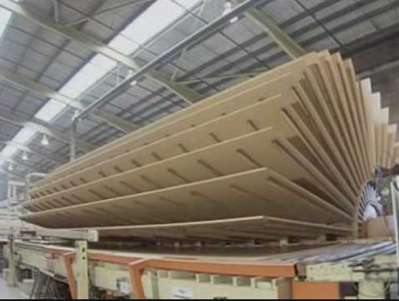
Manufacturing M.D.F.

Slide 21
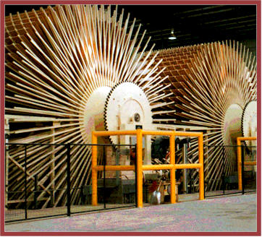
Manufacturing M.D.F.

Slide 22
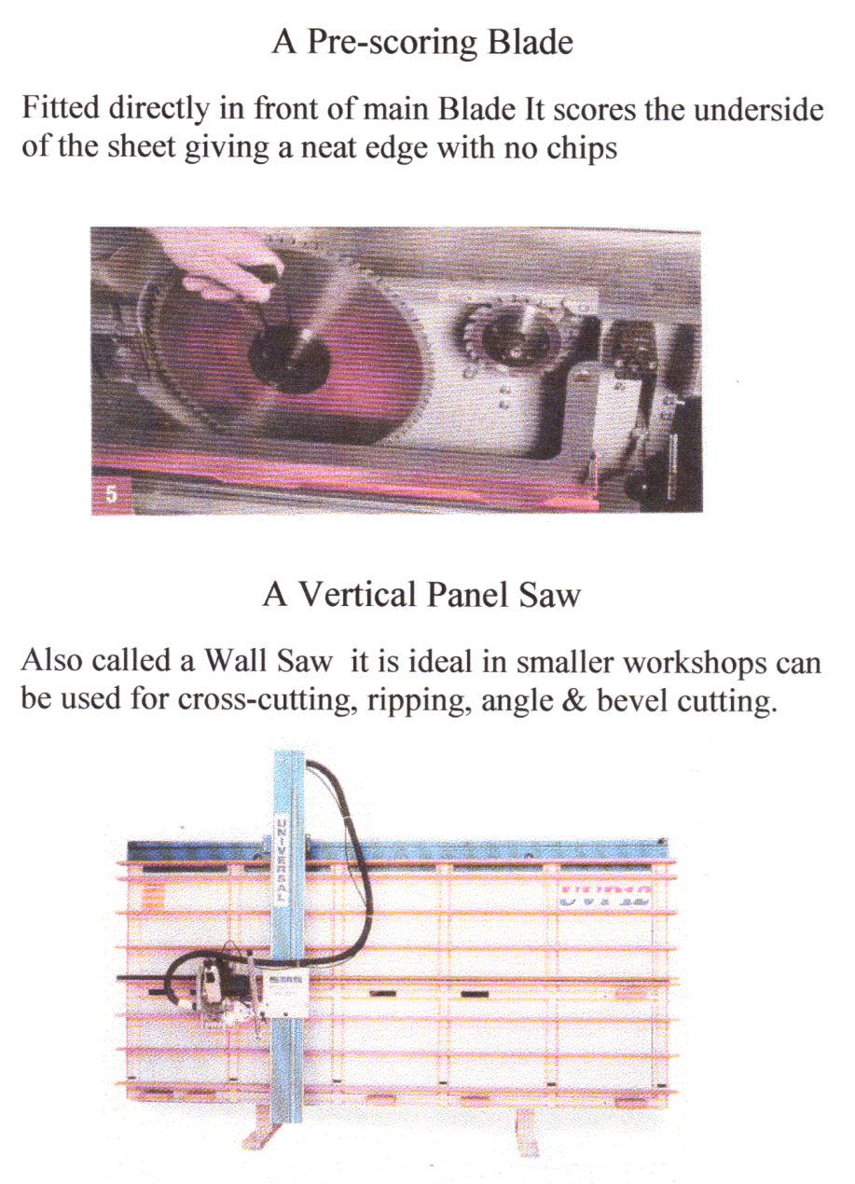

Slide 23
References
http://www.treehugger.com/sustainable-product-design/classic-furniture-designs-from-cheap-sustainable-materials.html OSB Furniture

