Slide 1
Georgian
Furniture
Thomas
Chippendale

Slide 2
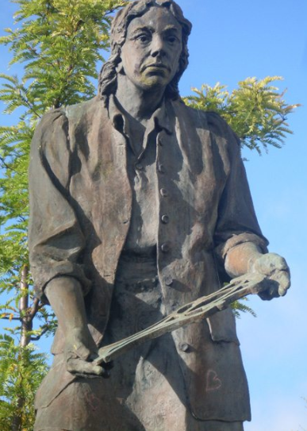
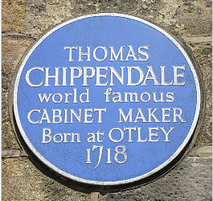
Thomas Chippendale
( 1718 – 1779 )
Born in Otley Yorkshire England.
Statue made in his likeness
Commemorative Plaque in Otley.

Slide 3

Thomas Chippendale
( 1745 – 1780 )
Established well before 1745 he became one of the most influential furniture makers of the time.
Workshop was at 60 St. Martins lane, London.
His book was called “ The Gentleman and Cabinetmakers Director ” 1754 & a larger 2nd edition in 1762
His book gave detailed designs with measurements along with instructions on how each piece should be finished

Slide 4
Thomas Chippendale
( 1745 – 1780 )
His main influences were French, Chinese & Gothic.
His Chairs : Ladder backs, Carved splats, Ribbon backs and Chinese style.
Moulded, fretted, grouped pillar and cabriole legs along with bracket feet.
Glazed bar doors,13 pane barred doors
Harewood house http://harewood.org/explore/art/artist/thomas-chippendale/

Slide 5
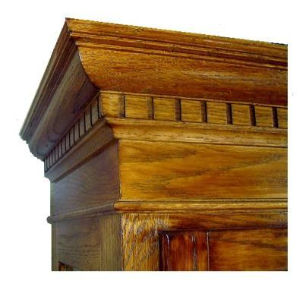
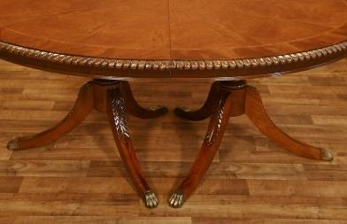
Chippendale
Dentil Moulding
Rope
Edge
Carving

Slide 6
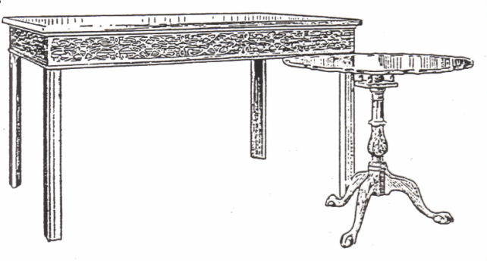
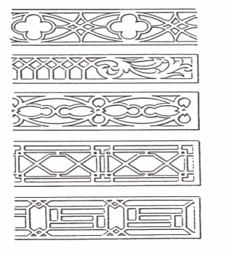
Chippendale
Pie Crust
Fret work
Tripod Table
Fret work

Slide 7
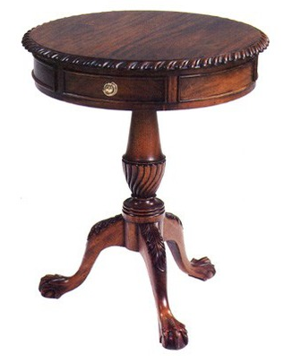
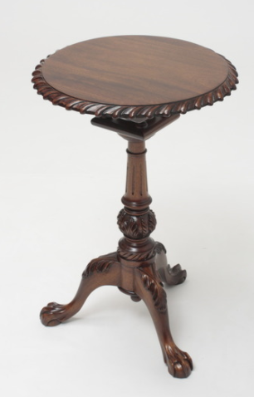
Chippendale Drum Table
Chippendale Tilt Top Table

Slide 8
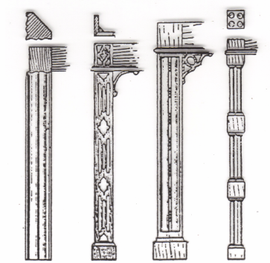
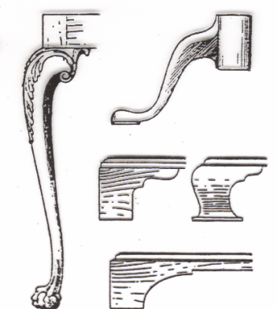
Chippendale
A B C D
F
E
G

Slide 9
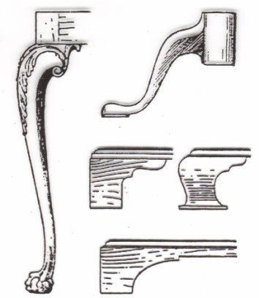
Chippendale
A.
Moulded
triangular
leg
B. Fret Legs
C. Moulded &
Carved legs
D. Grouped
Pillar legs
A B C D
Acanthus
leaf
F. Pod leg
F
E.
Cabriole leg
G. Bracket feet
Ball & claw
E G

Slide 10
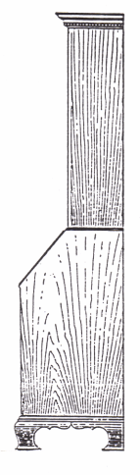
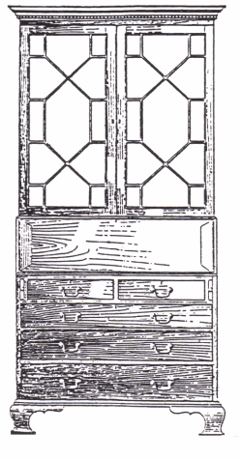
Chippendale
Cornice
13 Pane
Bar Door
Fall flap
Lopers
Bracket feet

Slide 11
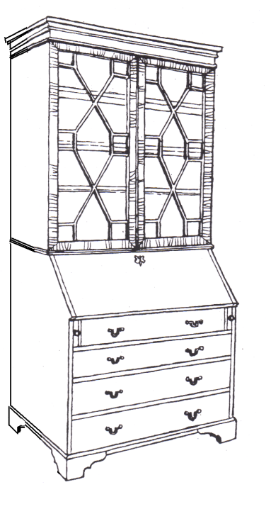
Chippendale Bureau

Slide 12
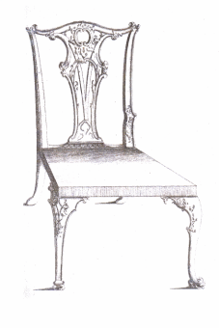
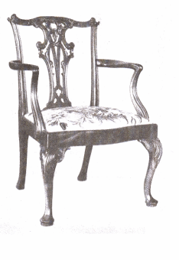
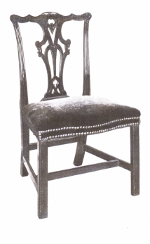
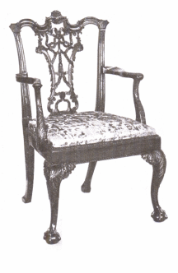
Chippendale Chairs
Chair designs from book
Carved splat backs

Slide 13
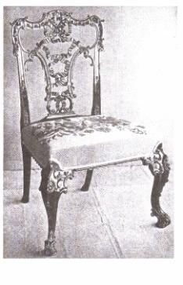
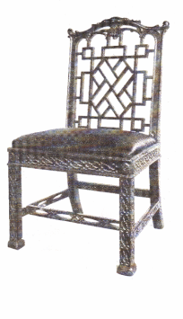
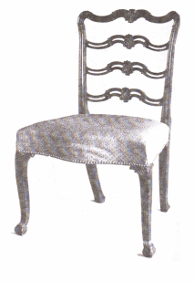
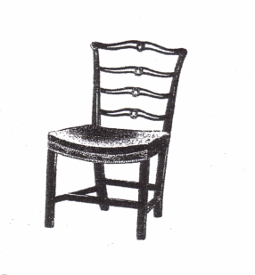
Chippendale Chairs
Ribbon back
Chinese style
Ladder back

Slide 14
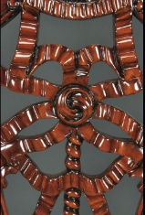
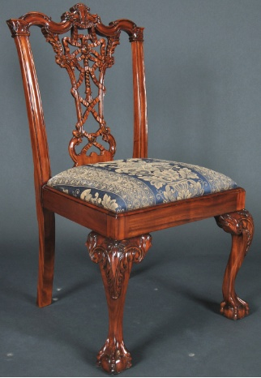
Ribbon Back chair
Image from Mill House Antiques

Slide 15
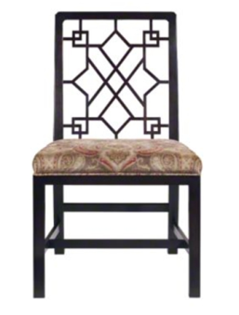
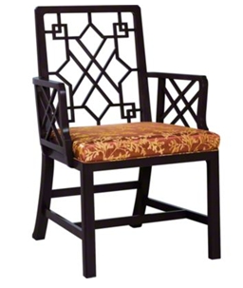
Chinese Chippendale Style Chair
A replica of Chinese style chair .
English circa: 1760.
Baker Dining Room Chinese Chippendale Side Chair 5246 at Hickory Furniture Mart
Baker Dining Room Chinese Chippendale Arm Chair 5247 at Hickory Furniture Mart

Slide 16
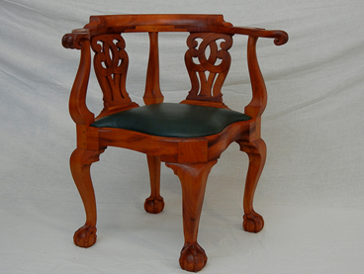
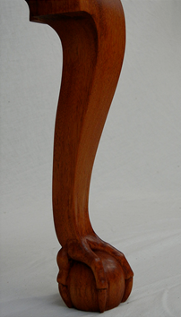
Chippendale style
Corner Chair
Detail of Ball & Claw
Images taken from website of Doucette & Wolfe

Slide 17
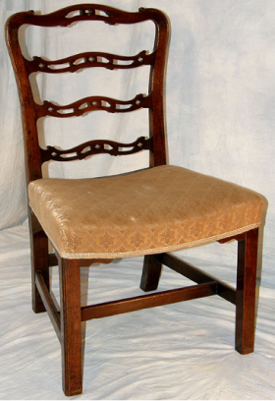
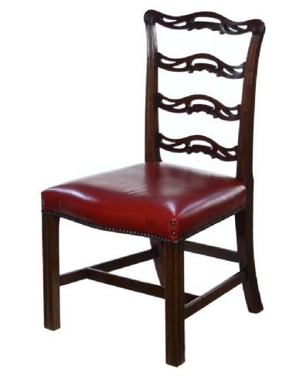
Ladder Back Chairs
Example of Chippendale Ladder back chair
replicas circa 1900

Slide 18
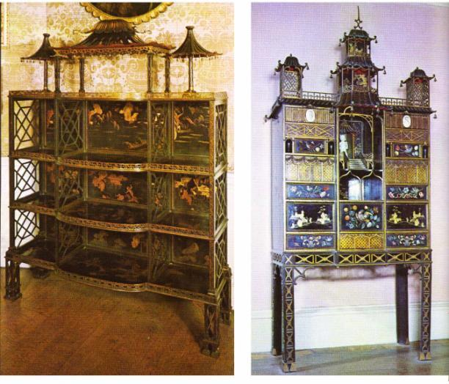
Chippendale Designs
Standing Shelves Pagoda Cabinet

Slide 19
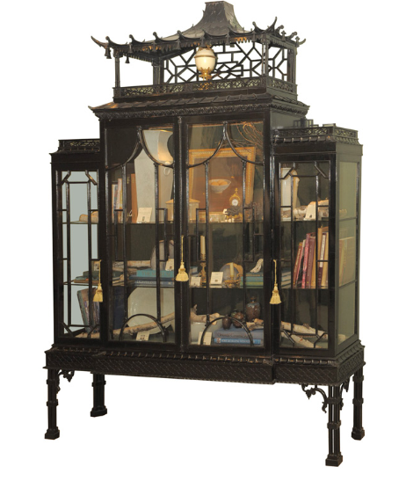
Chippendale Designs

Slide 20
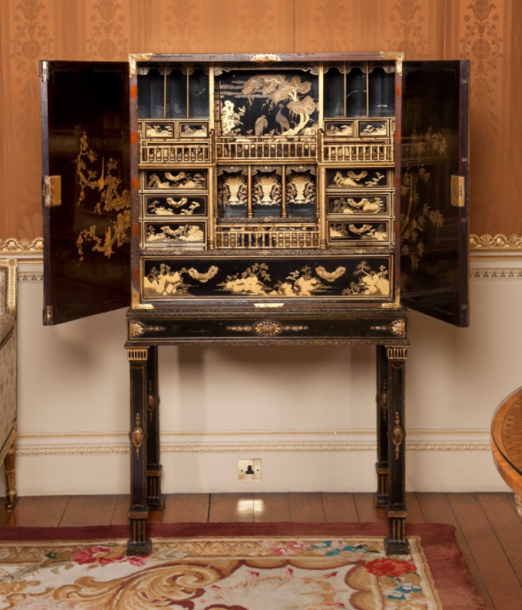
Chippendale Cabinet
Japanned Cabinet Harewood house

Slide 21
References
Doucette & Wolfe Furniture makers
http://www.doucetteandwolfefurniture.com/Portfolio.html

