Slide 1
Knock Down
Fittings

Slide 2
Knock-down fittings (K.D.) were originally designed for ease of packaging and transport, but nowadays their main function is the quick assemble and disassemble of furniture.
This includes furniture made from both solid and manufactured boards.
The fittings are made from metal and plastic.
Fittings are connected using basic tools like screwdrivers or spanners etc.
Manufacturers who’s main of business is making and selling flat pack furniture can sell furniture cheaper because they don’t have labour costs of assembly and fitting.
The best K.D. fittings remain firm and stable and distribute the load evenly throughout structure.

Slide 3
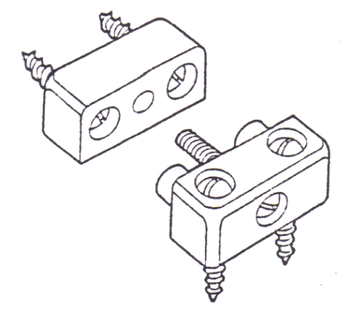
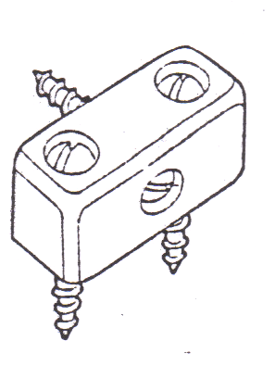
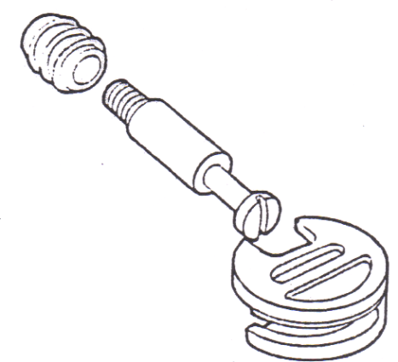
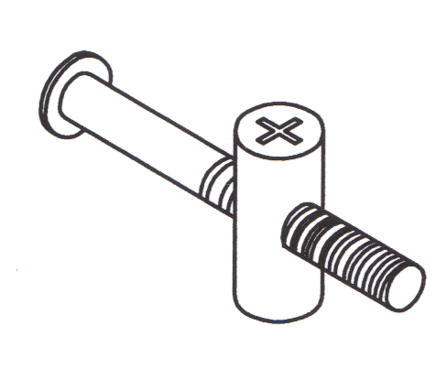
Block Joint : Hard plastic
Surface fitting, side to end
Modesty Block : Hard plastic. Surface fitting, side to end
Bolt & Cam : Metal & plastic
Recessed & concealed,
carcase and solid furniture
Bolt & Dowel: Metal
Recessed & concealed,
carcase and solid furniture

Slide 4
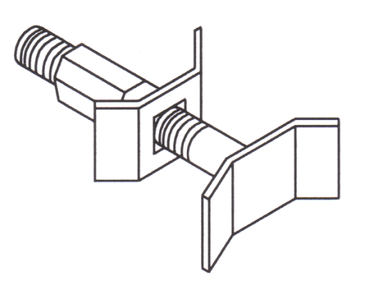
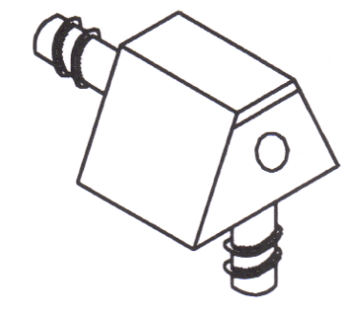
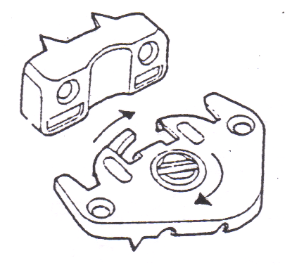
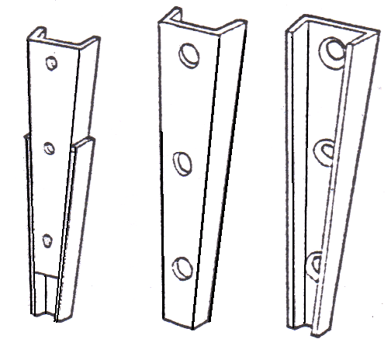
Panel Bolt Connector : Metal
Recessed, used for joining
two work tops end to end
Knock Down Dowel:
Hard plastic
Surface fitting, side to end
Hook Cam: Metal. Surface,
used for carcase work
on larger furniture
Taper connector:
Metal
Recessed used for
connecting
Bed ends, larger
furniture

Slide 5
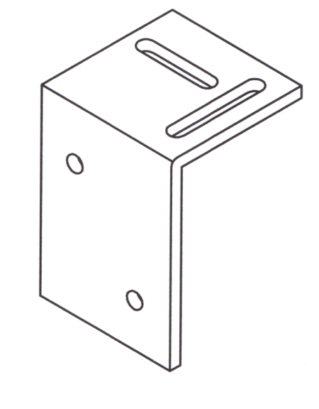
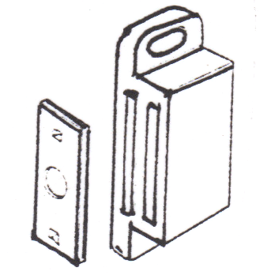
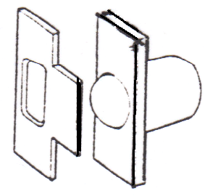
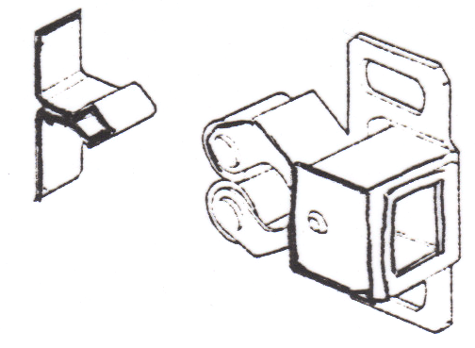
Shrinkage Plate: Metal
Surfaced or recessed used for connecting solid timber
Magnetic Catch: Metal &
plastic. Surface, used to
keep door closed
Ball Catch: Metal & plastic.
Surface, used to
keep door closed
Roller Catch:
Metal & plastic.
Surface, used to
keep door closed

Slide 6
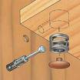
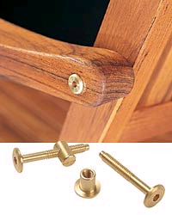
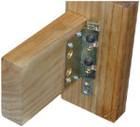

(Mini-fix) Bolt & Cam:
Recessed & concealed,
carcase and solid
furniture
Brass Bolt & cross dowel:
Recessed & concealed,
carcase and solid furniture
Metal corner connector: Slotted screws

Slide 7


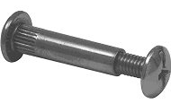
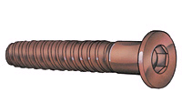
Slotted recessed
connectors
Keyhole Hangers
Connecting Screws:
Metal or plastic used for
joining carcases using
pre-drilled holes
Comfit Screws

Slide 8

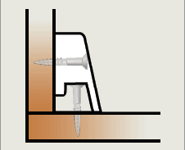
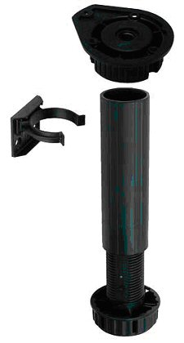
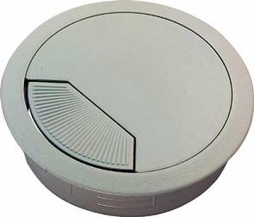
Lay on Hinges
Knock- Down Fitting
Insert for cable cut out
Carcase Legs

Slide 9
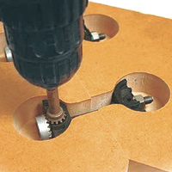
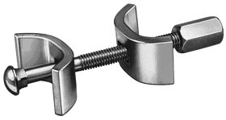
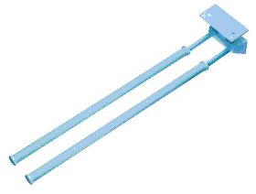
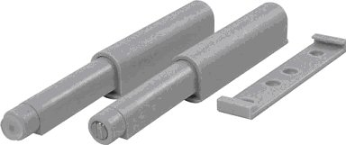
Panel Connecter
Push to open
Plastic Towel holders

