Slide 1
Capstone Artefact
The Proposal

Slide 2
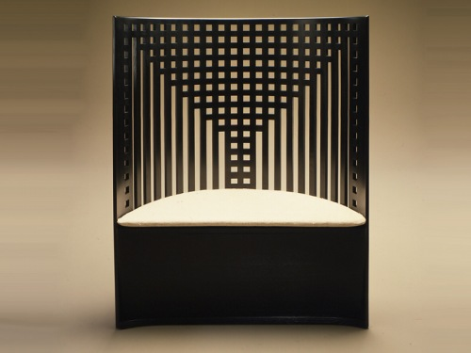
The willow chair
Willow Chair

Slide 3
The willow chair
Made in 1904
Designed by Mackintosh.
Dates from the Art Nouveau period.
Manufactured from Ash.
The chair was painted/lacquered black.

Slide 4
Manufacture of Artefact
Wont be an exact reproduction.
Copying the style.
Modern methods of joinery will be used.
Will look as much like the original as possible.
The materials used will be different.
MDF, Flexi ply and veneers will be used.
Method for creating the willow effect will be different as I don’t know how it was done originally.
The colour of the upholstery will probably change.

Slide 5
Name five Features of your Artefact
Mortise & Tenon Joints
Halving Joints
Bent work
Lamination
Veneering
Upholstery
Hinging
Finishing

