Slide 1
Principles of
Furniture & Joinery Design
Design process in a Word Cloud

Slide 2
Words associated with Furniture Design
Can you list some?
Concept sketches
Rough drawing
Design
Sketch
Proportions
Scale
Design
Concepts
Ideas
Furniture
Joinery
Style
Contrast
Complement
Plan
Golden Rectangle
Period
Style
Ergonomics
Construction Techniques
Finish
Function
Proportion
Customize
Location
Visual impact
Timber

Slide 3
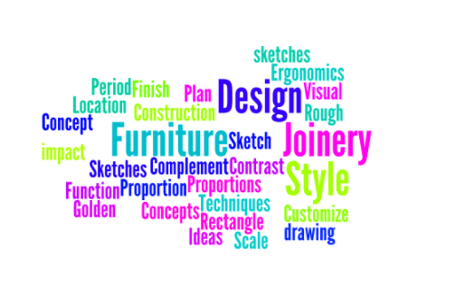
Words associated with Furniture Design
Wordle http://www.wordle.net/
Task: Google “Word Cloud Generator”
Create your own word cloud from words that you now associate with furniture design and email the final image to me.

