Slide 1
Georgian
Furniture
Robert
Adam

Slide 2
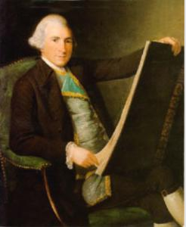
Robert Adam
( 1745 – 1780 )
British architects Robert (1728-1792) and James (1730-1794) Adam were leaders in the neoclassic style in the late 18th century.
Robert Adam
Image courtesy of
Wikimedia commons
Their graceful, elegant work is based chiefly on ancient Roman and Renaissance motifs.
The Adam brothers hired workers such as cabinetmakers, painters and sculptors to carry out their designs.
A firm of cabinet-makers called "Adam Furniture“ produced furniture from Adams designs

Slide 3
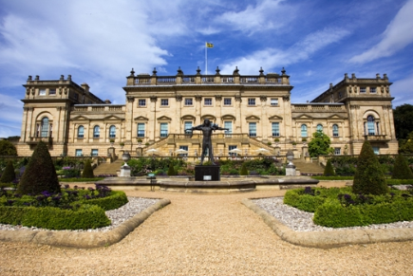
One of their most noted works is Harewood house Yorkshire England.
Build in the late 18 century by John Carr of York, Adams was responsible for the interiors he commissioned cabinet-maker Thomas Chippendale to make most of the furniture.
Harewood House
Image courtesy of Historical geographies

Slide 4
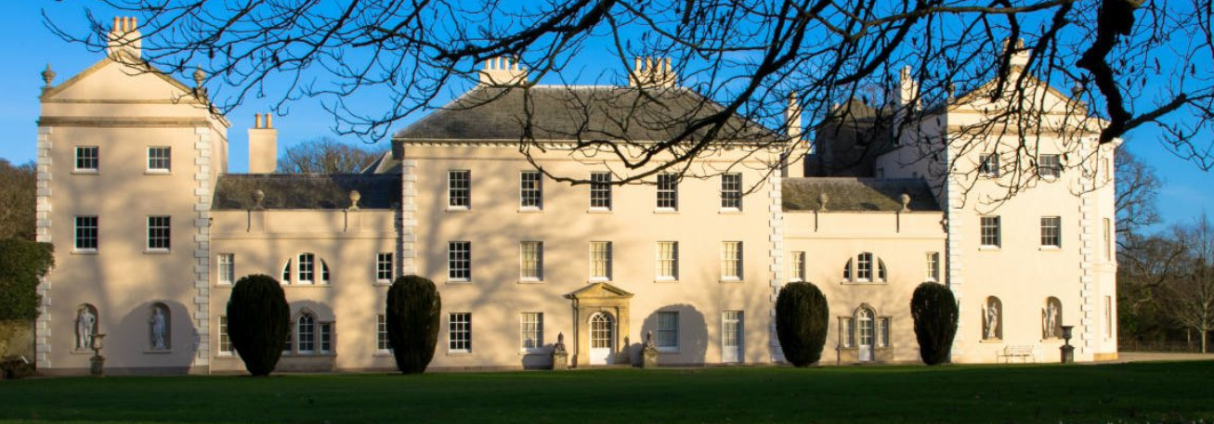
Adam spent some time studying in Italy. The excavations of Pompeii and findings of the 1750′s had a large influence on his work.
Adam started the neo-classical style of sleek, straight lines and simple mouldings
Adam developed his own style which later became known as ‘Adamesque’
In 1768 he refurbished part of Saltram House in Devon.
http://www.vam.ac.uk/content/articles/r/robert-adam-neo-classical-architect/
Saltram House Devon

Slide 5
Adam Style or Adamesque
Adam used lots of fans, urns, honeysuckle, patera, swags & leaves, bells & husks as decoration.
His later designs had gilding, marquetery, ormolu ornaments.
He designed lots of mirrors and wall furniture also fire surrounds and is credited with inventing the sideboard.
Chairs : Adam's chairs were simple and gracious. The legs for the most part were straight, wide chairs with pierced splats wheel backed chairs

Slide 6
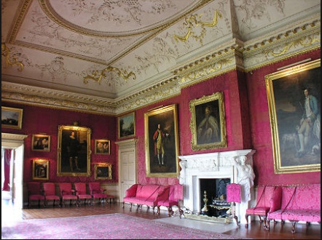
The Red Drawing Room at Hopetoun House
Image courtesy of undiscoveredscotland.co.uk
Hopetoun House

Slide 7
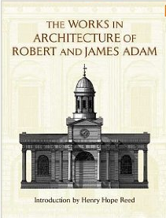
Robert & James Adam Book
Image courtesy of Amazon .com
Guttenberg press

Slide 8
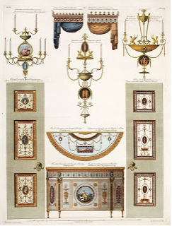
Design page from Adam
Some 3000 drawings by Robert Adam and
other members of his firm are preserved at
Sir John Soane's Museum in London.

Slide 9
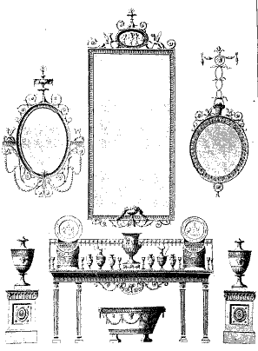

Slide 10
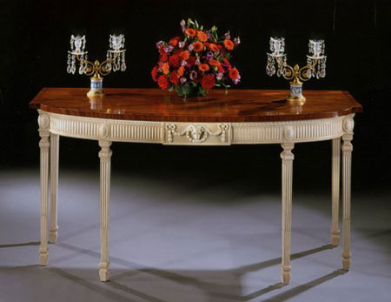
Robert Adams
Adams side table
Image courtesy of museumfurniture.com

Slide 11
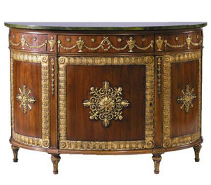
Robert Adam Style Commode
A Commode first appeared in the 1700’s it comes from the French word for convenient.
They were small decorative cabinets or chest of drawers usually with marble tops.
Bedroom commodes were often used to sit washing facilities on.

Slide 12
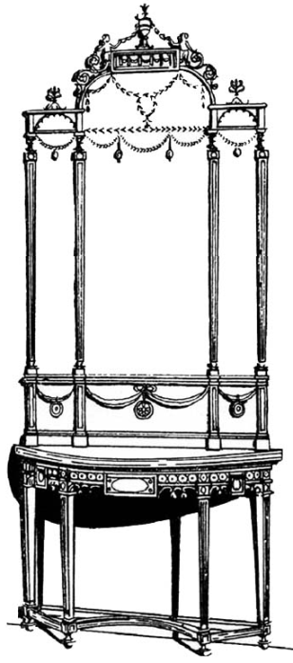
Typical Adam Style hall table & mirror
Image courtesy of colonialfurniture.us

Slide 13
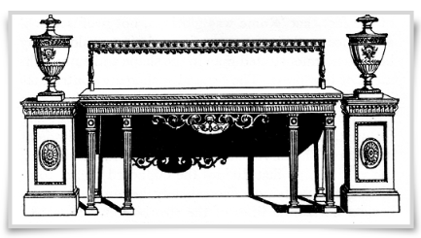
Typical Adam Style Sideboard
Image courtesy of colonialfurniture.us
Sideboard with pedestals,
later these pedestals were transformed
into cupboards and later still removed
altogether

Slide 14
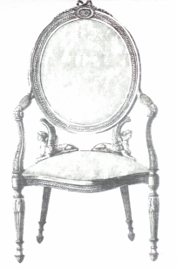
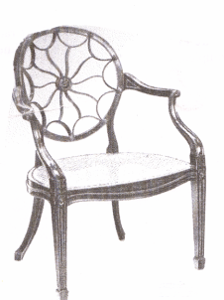
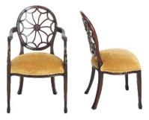
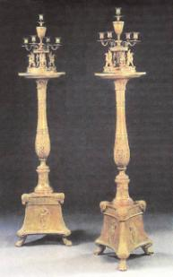
Robert Adams
Wheel back chairs
Candle stands

Slide 15
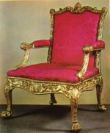
Robert Adams
Adams Chair

Slide 16
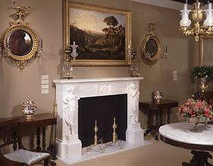
Robert Adams
Adams Style room

Slide 17
References
http://www.harewood.org/house
http://www.encyclopedia.com/topic/Robert_Adam.aspx
http://www.museumfurniture.com/adam/
http://www.amazon.com/
http://www.undiscoveredscotland.co.uk/usbiography/a/robertadam.html
http://www.colonialfurniture.us

