Slide 1
Mastics & Sealants
Overview
Information obtained from
FOXDIY.CO.UK

Slide 2
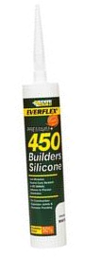

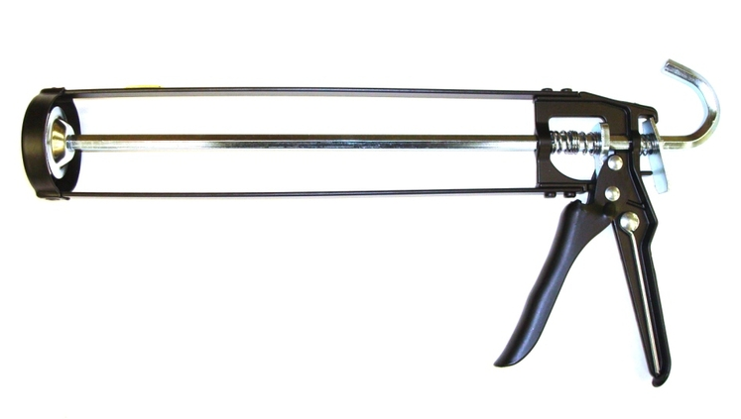
Application
Mastics & sealants come in a hard plastic tube C3
They fit into a standard Mastic Gun

Slide 3
Application
They are produced for all sorts of different applications by hundreds of different manufactures.
Preparation of the surface would be the same for nearly all of them.
Clean the gap or area to be sealed and make sure that it is free from dust.
Some mastics you clean off surplus while still wet some after they have cured.
Make sure you read instructions on tube.
Some sealants will expand when exposed to air this are used to seal wider gaps.

Slide 4
Types
Acrylic based sealants: Frame sealants flexible seal can be painted over when cured available in clear, white, brown & black
Flexible Decorators fillers: Caulk can be painted over whey dry, remains permanently flexible
General Purpose Silicone: This sealant adheres to most smooth and non-porous materials. Forms a permanently flexible rubber seal.
Some contain an anti-fungal compound to prevent mould growth in areas of high humidity.
Suitable for glass, ceramics, metals, laminates.
Interior or Exterior uses.
Some have a 20 year life expectancy.

Slide 5
Types
Multi Purpose Building Adhesive: lots of different standards the better and quicker the adhesion the more expensive they are.
Gun A Nail Standard is a high strength, gap filling multi-purpose adhesive that can be used for fast nail free fixing of items such as to fix skirting boards, wall panels, cladding, PVCu trims, framework, battens, floorboards, carpet edges, window sills, ceramics, mouldings and much more.

Slide 6
Types
Multi Purpose Building Adhesive:
PinkGrip : this would probably be one of the most popular due to its revolutionary initial grip, which outperforms every competitor's adhesive tested.
Grips instantly - No slip - No pins, it will stick just about anything on a building site that needs sticking.
Its amazing grabbing strength not only removes the need to pin under the work piece to prevent slumping, but its revolutionary initial 'Direct Bond' eliminates the need for double stick methods.

Slide 7
Type
Black Roof & Gutter Sealant : is a premium quality butyl based sealant and adhesive that provides instant, permanent weather-proofing to a wide variety of roofing applications.
Adheres to most common roofing materials such as bitumen, asphalt, felt, metals and wood.

Slide 8
Type
Colour Match Timber & Laminate Sealant : is a polymer rich, permanently flexible sealant and gap filler designed for sealing around laminate flooring, fitted furniture and kitchen worktops.
Formulated using high clarity lightfast colour pigments, the 5 colour range offers a near or exact match to many board finishes.
It is silicone and solvent free, however, unlike conventional matt finish water-based sealants, it leaves a satin finish which will not pick up dirt and can be easily cleaned with normal household
If desired the product can be painted, varnished or wood stained.
Cherry, Oak, Beech , Mahogany & Pine

Slide 9
Type
Silicone Eater : Removes all types of silicone sealant from baths, kitchen worktops, basins, showers, door & window frames.
Always test a small area prior to full coverage
Fits in standard mastic gun
100ml pack , sufficient to remove sealant from 3 sides of a standard bath.

