Slide 1
More Lateral Thinking
Exercise your brain

Slide 2
Lateral Thinking
Minds are like Parachutes; they are only useful when they’re open. Thomas Dewar
Most people only use the left side of their brain which is the logical thinking side.
Lateral thinking involves using the right side of the brain.

Slide 3
Left brain functions
Uses logic
Detail oriented
Facts rule
Words and language
Present and past
Math and science
Can comprehend
Knowing
Acknowledges
Order/pattern perception
Knows object name
Reality based
Forms strategies
Practical
Safe

Slide 4
Right brain functions
Uses feeling
“big picture” oriented
Imagination rules
Symbols and images
Present and future
Philosophy & religion
Can “get it” (i.e. meaning)
Believes
Appreciates
Spatial perception
Knows object function
Fantasy based
Presents possibilities
Impetuous
Risk taking

Slide 5
Creativity & Lateral Thinking
The right side of the brain is associated with creativity and lateral thinking.
Our logical left side of our brains creates structures that can act as barriers to alternative solutions and perspectives.
The left brain plays a crucial role in creativity by seeing logical associations between seemingly unrelated things .
The left brain is also responsible for the critical-thinking skills necessary to tell a good idea from a bad idea.

Slide 6
Problem 1
A man walks into a bar and asks for a glass of water. The barman pulls out a gun and points it at the man’s head, the man thanks the barman and walks out without receiving his drink.
Explain
Answer
The man had hiccups.

Slide 7
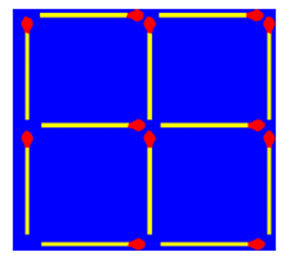
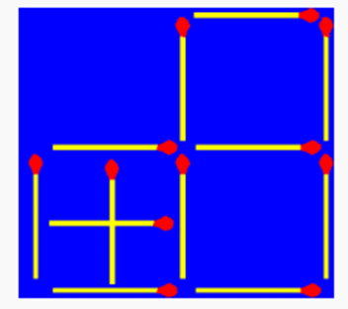
Problem 2
Rearrange 2 matches and make 7 squares.
Answer

Slide 8
Problem 3
A man is about to leave to visit friends, his wife tells him to be back before sunrise. He left clean shaven but returns on time with a real full beard.
How is this possible?
Answer.
He lives in Alaska – where the sun sets in mid-November and doesn’t rise again for two months.

Slide 9
Problem 3
Using any symbols ( X – + ÷) make the formula below correct
10 10 10 = 9.50
Answer
10 T0 10 = 9.50

Slide 10
Problem 4
Charlie stared through the dirty window on the 26th floor. Overcome with depression, he opens the window and jumps through it. It was a shear drop outside, but when Charlie landed he was totally unhurt.
How could this be?
Answer.
Charlie is a window cleaner, he’s sick of his job and jumps in through the window from his cleaning platform outside.

Slide 11
Problem 5
32 teams participate in a competition and the 32 teams are paired off.
The loser is eliminated and the remaining teams play until there is one winning team.
How many games must be played.
Answer
32 -1 =31

Slide 12
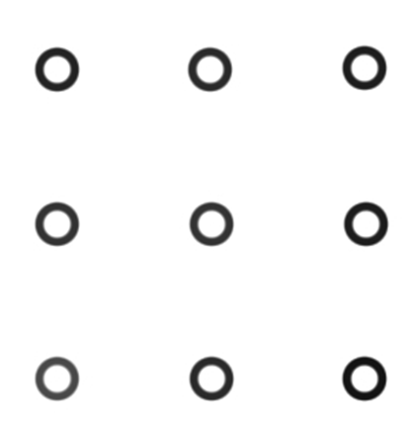
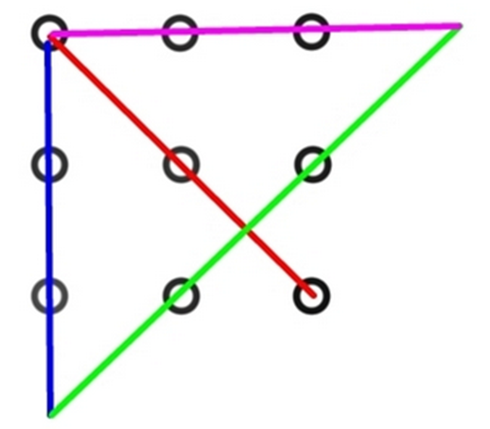
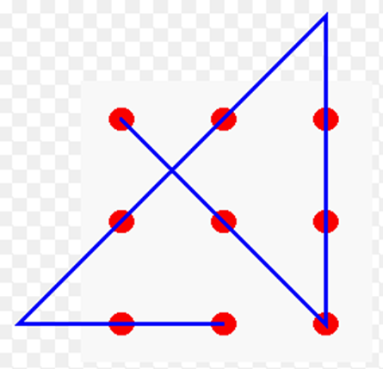
Problem 6
Connect 9 dots with four lines without lifting your pencil.
Answer

Slide 13
Problem 7
How many F’s are in the following text?
Finished files are the result of years of scientific study combined with the experience of years.

Slide 14
Problem 7
How many F’s are in the following text?
Finished files are the result of years of scientific study combined with the experience of years.
Answer 3
Actually it is six
The mind for some reason cannot process the word “of”

Slide 15
Problem 8
Work out the following maths Questions.
15 + 6
3 + 56
89 + 2
12 + 54
Now think of a tool and its colour
A red hammer?
98% of people think of a red hammer nearly all some coloured hammer

Slide 16
Problem 9
A man lives on the top floor of an apartment building. Every morning he takes the lift down to the ground floor and leaves the building.
Every evening when returning home he can only travel in the lift to halfway up the building and has to walk the rest of the way that is unless it is raining.
Explain
He is a short man and cannot reach the button for the top floor unless he has his umbrella with him to push the button.

Slide 17
Problem 10
Acting on a tip off the Guards raid a house to arrest a murder suspect. They know that his name is Thomas but don’t know what he looks like.
In the house they find a carpenter, a truck driver, a car mechanic and a fireman playing cards.
Immediately they arrest the Fireman.
Explain?
He was the only man the other three were women.

