Slide 1
Georgian
Furniture
George
Hepplewhite

Slide 2
George Hepplewhite
1760 - 1790
Very little is know about Hepplewhite apart that he ran his own furniture factory and made furniture for Robert Adam.
He was an apprentice with the firm of Gillow in Lancaster and then moved to London, where by 1760 he was established in Redcross Street, St. Giles', Cripplegate.
Hepplewhite died in 1786, and his widow, Alice, carried on the business as A. Hepplewhite and Company.
It is thought that very little practical pieces were made and that the company thrived on selling the books with drawings on how to make furniture.
Alice published Hepplewhite’s first book 2 years after he had died. Hepplewhite became famous after publishing this design book in 1788 “The Cabinet Maker & Upholsterer’s Guide.

Slide 3
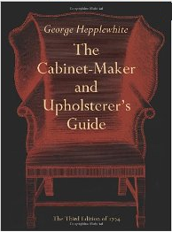
George Hepplewhite
1760 - 1790
The book was published after his death in 1786
by his wife Alice.
The Hepplewhite Style became popular again towards the end of the 19th century.
http://www.furniturestyles.net/european/english/george-hepplewhite.html
Amazon.com

Slide 4


George Hepplewhite
He moved away from the rich carvings of Chippendale and went for sleeker designs.
Wood : Mahogany and Satinwood
Chairs : Shield & Oval and heart shaped backs. Decoration was usually put on afterwards.
Favourite motif was ears of wheat, swags & Prince of Wales feathers.
Prince of Wales feathers

Slide 5
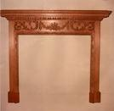

George Hepplewhite
Elegant pieces with delicate tracery, carved fretwork & square, tapering legs.Sometimes round with reeding or fluting
Side boards with cupboards, with apron pieces
Mahogany & Satinwood often with marquetry & inlay, painting, lacquering & gilding.
Swags

Slide 6
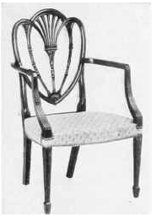
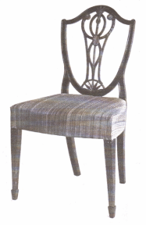
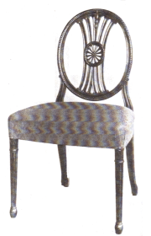
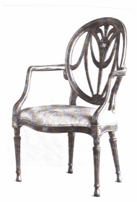
Hepplewhite Chairs
Heart back chair
Shield back chair
Oval back chairs
https://www.1stdibs.com/creators/george-hepplewhite/

Slide 7
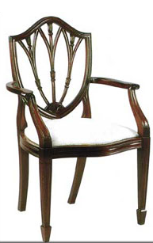
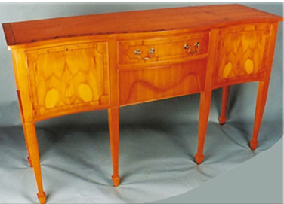
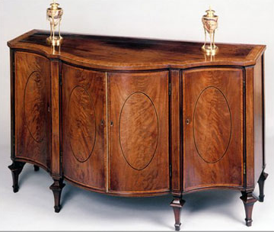
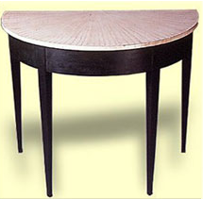
Hepplewhite style furniture from museumfurniture.com
Shield back
Side Board
Side Cabinet
Side Table

Slide 8
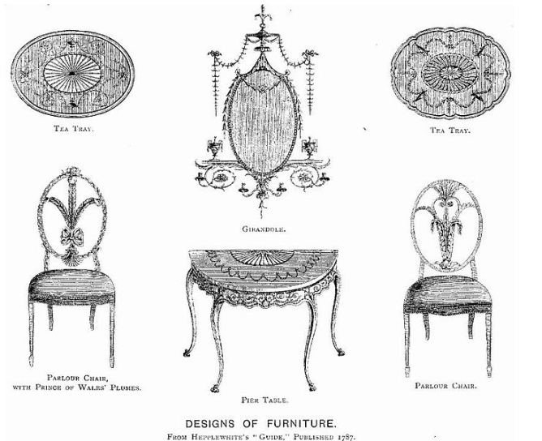
Hepplewhite page from his book
http://www.encyclopedia.com/people/literature-and-
arts/interior-design-and-home-furnishings-biographies/
george-hepplewhite

Slide 9
References
museumfurniture.com
http://www.encyclopedia.com/people/literature-and-arts/interior-design-and-home-furnishings-biographies/george-hepplewhite
https://www.1stdibs.com/creators/george-hepplewhite/

