Slide 1
Kitchen Standard cabinet sizes

Slide 2
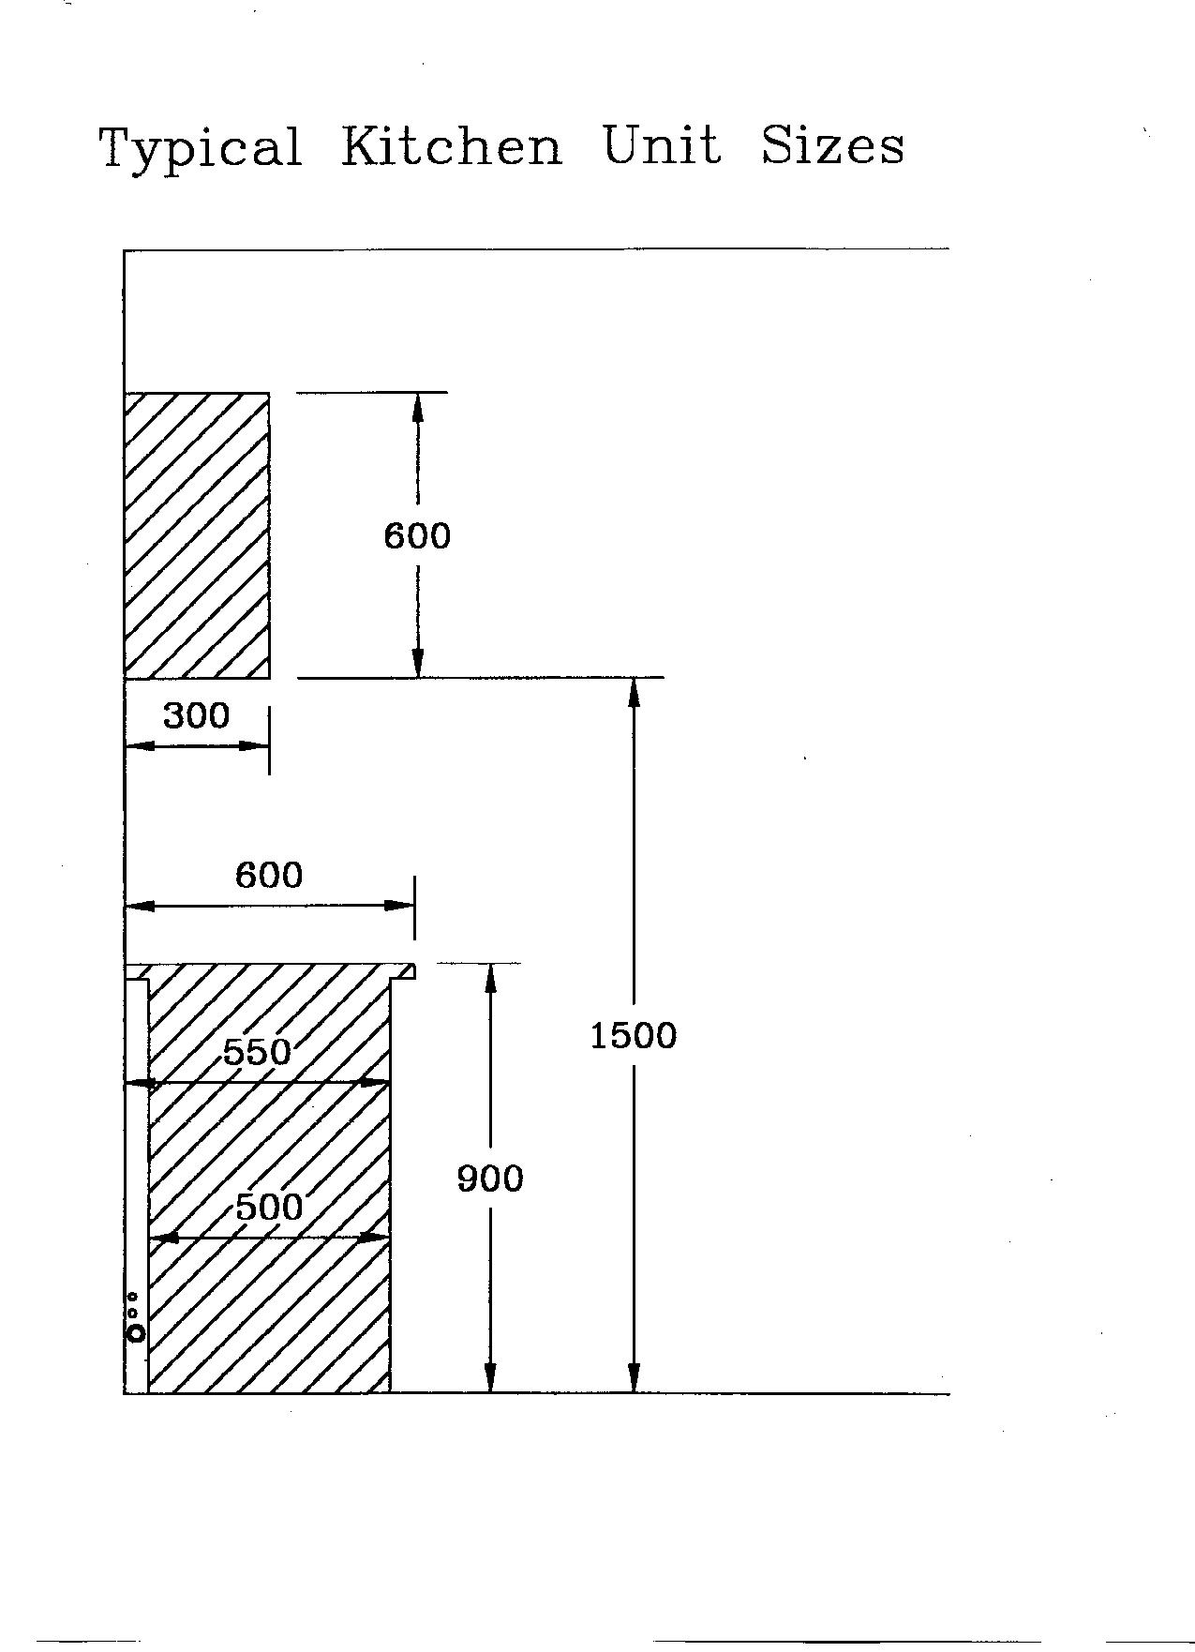
Standard Sizes

Slide 3
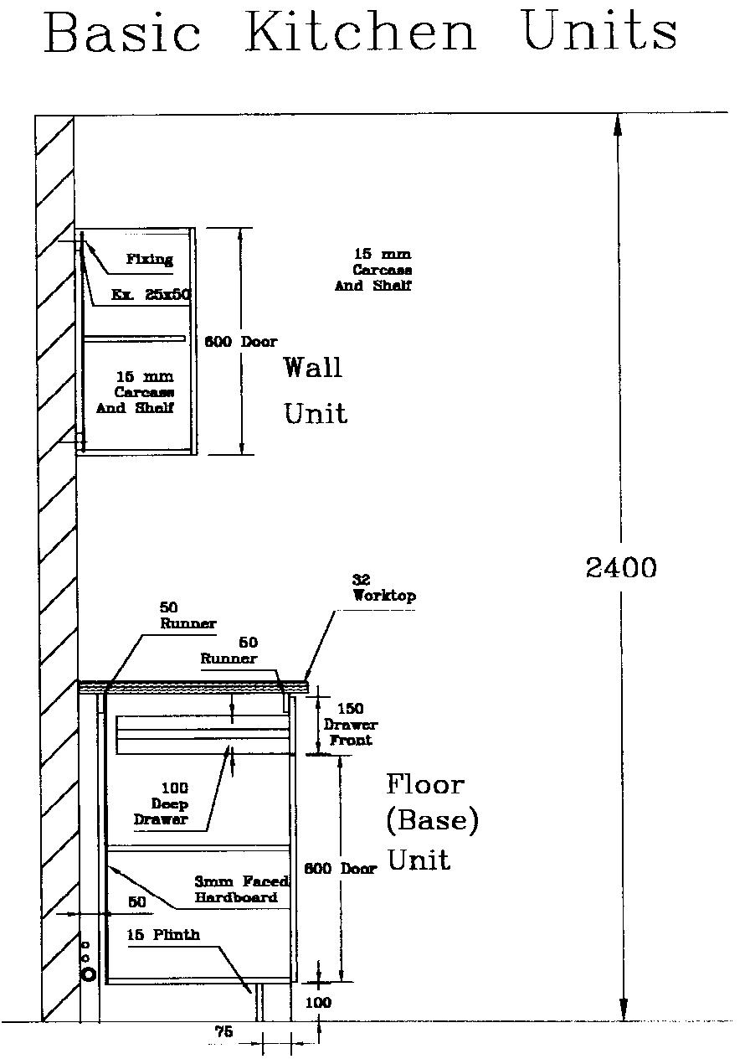

Slide 4
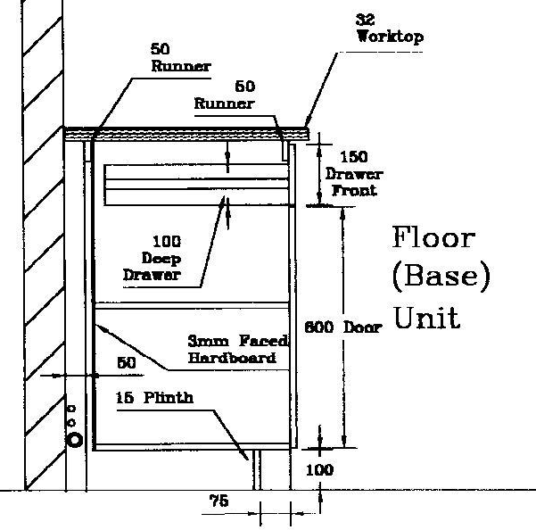
Unit Construction

Slide 5
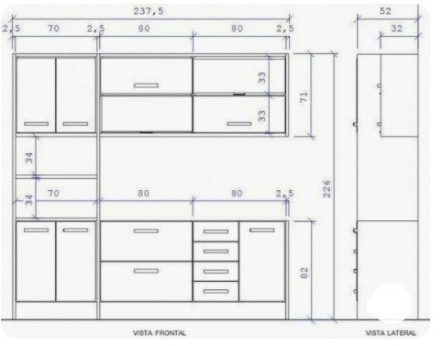
Standard unit sizes
Renomart Australian Kitchens
Cash And Carry Kitchens

Slide 6
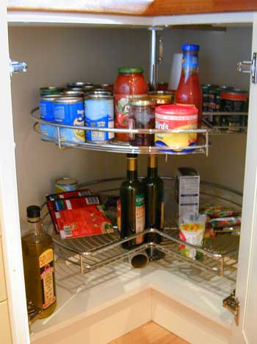
Corner units
Kitchen carousels allow you to store items in the corner cabinets.
Advances is technology now allow for the inner shelving to unfold out allowing easy access to the shelving contents.
This means that you can store items deep into the press and still be able to reach them by means of the revolving carousel mechanism.
Base unit 900x900mm

Slide 7
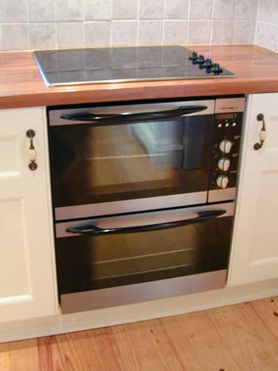
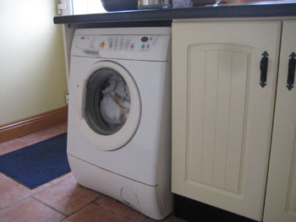
Additional units
Space must be provided for appliance units.
Units either free standing or fitted.

Slide 8
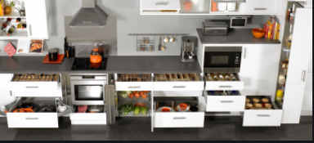
Wirework and accessories
Tierney Kitchens

Slide 9
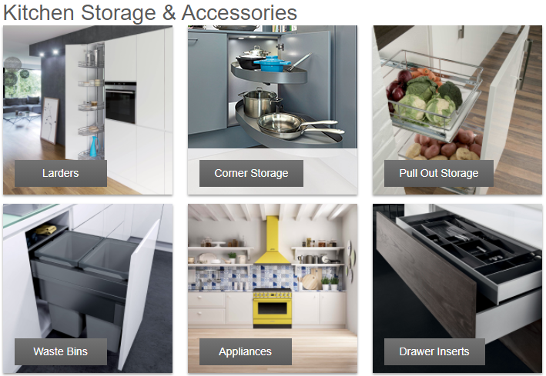
Wirework and accessories
Halfele

