Slide 1
Georgian
Furniture
Thomas
Sheraton

Slide 2
Thomas Sheraton
1790 - 1806
Thomas Sheraton (1751-1806) died fairly young at the age of 55.
Sheraton born in Durham trained as a Cabinetmaker he later he moved to London when he was 40.
In London he set up as a professional consultant and teacher, teaching perspective, architecture, and cabinet design for craftsmen.
He produced “The Drawing Book” between 1791 and 1794 interpreting the neoclassical styles of Adam, which Hepplewhite had also done.
He published 4 volumes of this book it was thought to have being used by many cabinetmakers.

Slide 3
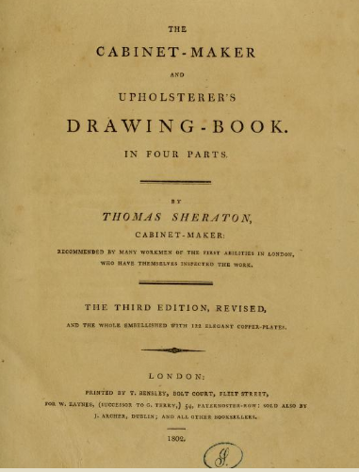
The Drawing Book
http://archive.org/details/cabinetmakerupho00sher
https://metmuseum.org/art/collection/search/700232

Slide 4
Thomas Sheraton
In 1803 he published “The Cabinet Dictionary”, a compendium of instructions on the techniques of cabinet and chair making.
In 1805 he published the first volume of “The Cabinet Maker, Upholsterer and General Artist's Encyclopaedia” a year before he died.
No pieces of furniture have been thought to have been made by Sheraton himself, therefore all Sheraton furniture refer to being made from his designs.
https://www.britannica.com/biography/Thomas-Sheraton

Slide 5
Thomas Sheraton
Sheraton furniture was of light proportions with much use of cross bandings and fine inlay.
Narrow tapered legs, slight splay at the bottom, square tapered legs with spade toes. Seldom used stretchers.
Chairs: Lyre & lattice backs.
Often using the lyre and other musical instruments to paint or veneer on his work.
The late Victorian & Edwardian periods saw lots of furniture being made in the “Sheraton Revival” style
https://en.wikisource.org/wiki/Sheraton,_Thomas_(DNB00)

Slide 6
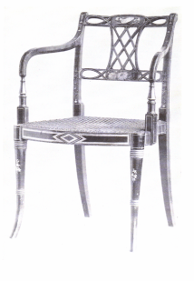
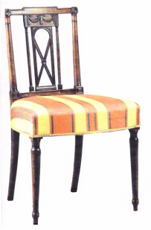
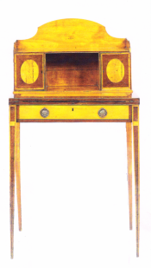
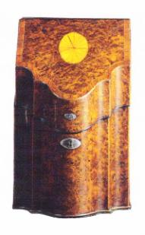
Sheraton
Lattice back chair
Lattice back chair
Bonheur –Du Jour
Ladies writing table
Cutlery box

Slide 7
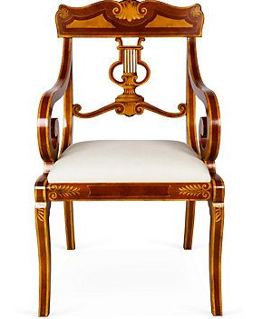
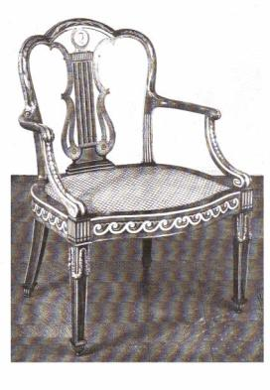
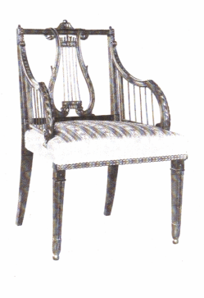
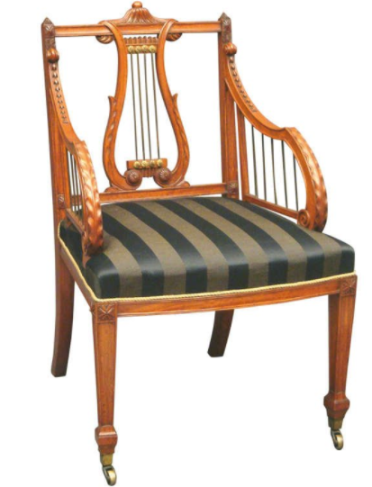
Sheraton
Lyre chairs

Slide 8
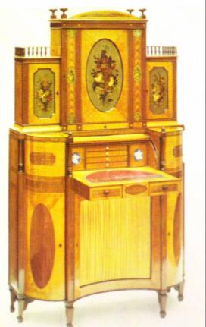
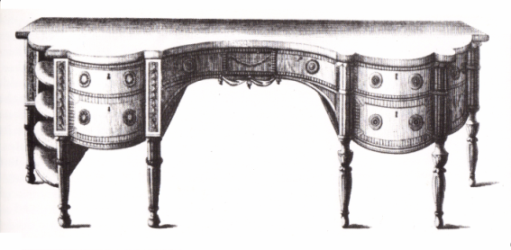
Sheraton
Ladies writing table
Sheraton desk

Slide 9
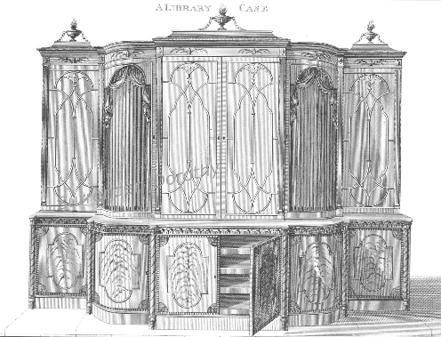
A Library Case
Image Courtesy of www.esty.com

Slide 10
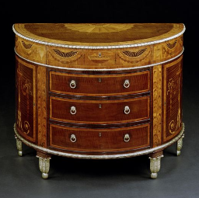
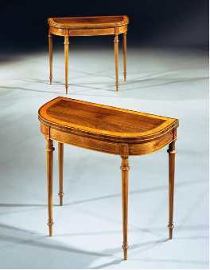
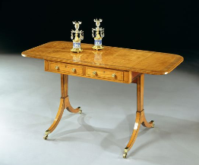
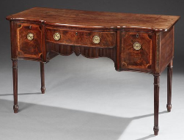
Ronald Phillip’s Antiques
Sheraton style Furniture 1750- 1806

Slide 11
Useful Sites
http://www.ronaldphillipsantiques.com/DesktopDefault.aspx?tabid=5&categoryID=7778
http://antiques.about.com/od/furniture/a/SheratonStyle010710.htm
http://www.buffaloah.com/f/fdesigners/sher/sher.html
https://metmuseum.org/art/collection/search/700232
Online British Museum

