Slide 1
Kitchen Styles

Slide 2
Style?
What style of kitchen do you want.
1 Country: Rustic and homely
2 Modern: Sleek and industrial
3 Contemporary: Crisp and clean.
4 Futuristic: Out of this world.
They all have one thing in common they all have a cooker sink & fridge and are usually the hub of the house.
They also have a vast array of expensive appliances so careful thought and planning must go into designing what is probably the most expensive room in the house.

Slide 3
Hidden value of a kitchen
The style and layout of a Kitchen and bathroom can determine whether a house will sell or not.
People when buying a house must like both of these rooms as they can’t afford to be spending more money on redesigning these rooms.
The overall style of the house should continue through the kitchen.
Imagine a country style cottage with stainless steal worktops and glass doors or a sleek shiny open plan apartment with a knotty pine kitchen smack bang in the centre of the room.
Neither would look well!

Slide 4
Country Style
Relaxed and Comfortable
Country styled kitchens are difficult to define exactly as they have an eclectic feel, which means that they have all sorts of bits and pieces from differing styles and periods combined to create the country look.
There are also regional styles that are probably more well known like French Provincial Country Style or Old English Country Style, Colonial American Country Style.
They all bring a similar feeling to the style, that of a safe, warm and comfortable homely ambience to the kitchen.

Slide 5
Country Style
Usually constructed in timber.
Worktops are either timber or tiled.
Finish is left natural, stained or painted in shades of off whites or pastels.
In some styles the timber is limed or waxed to give a distressed look. This ages the look of the kitchen.
Most country styled kitchens have room for a kitchen table & chairs or benches & table.
The preferred timber types are pine, maple or the local wood in plentiful supply such as beech, oak or ash.

Slide 6
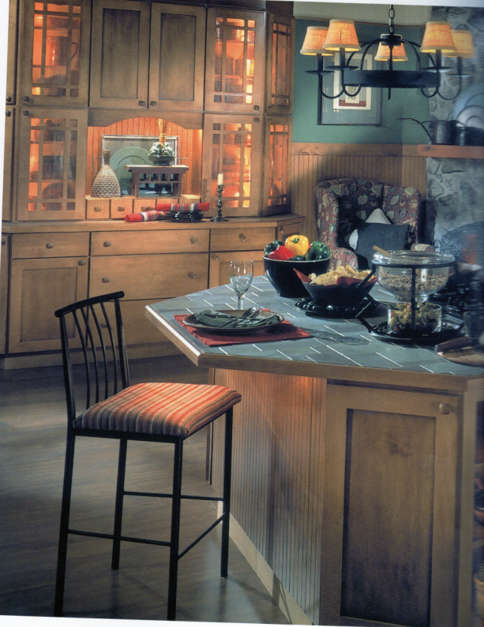
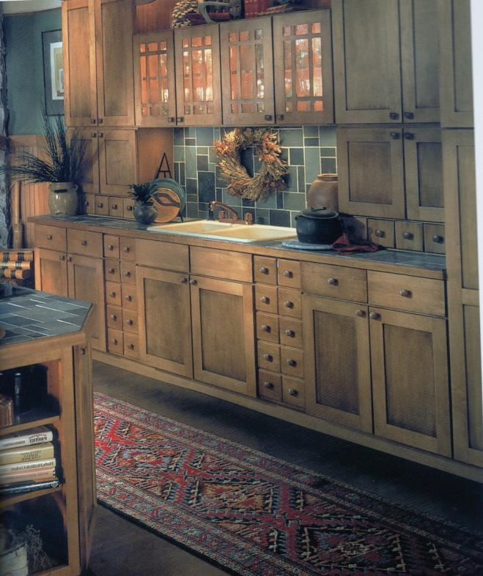
Country Style
Image from Practical Ideas for Kitchens & Bathrooms

Slide 7
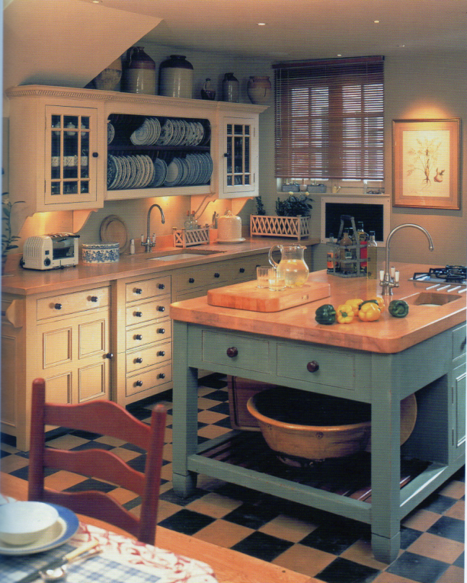
Country Style
Image from Practical Ideas for Kitchens & Bathrooms

Slide 8
Modern Style
In the art and design world “modern” refers to a period of time from 1920’s to 1950’s.
Materials used during this time were wood, leather, linen & moulded plywood.
Plastic and polished metal were also very poplar.
Furniture was very open and off the floor.
This period is often referred to nowadays as retro.
The Modern Style started back during World War 2 when Bauhaus designers left the country and spread their design styles across the world.

Slide 9
Modern Style
The Bauhaus modern design style emphasized on minimalism, simplicity, and function when compared to traditional design.
Modernism referrers to a time when things moved away from traditional.
Modern Style refers to a simple functional design, not to current or recent design.
Why are modern and contemporary styles often confused?
Modern style has been very much in fashion in recent years, so blends well with currents styles.
The materials introduced then are still in use.

Slide 10
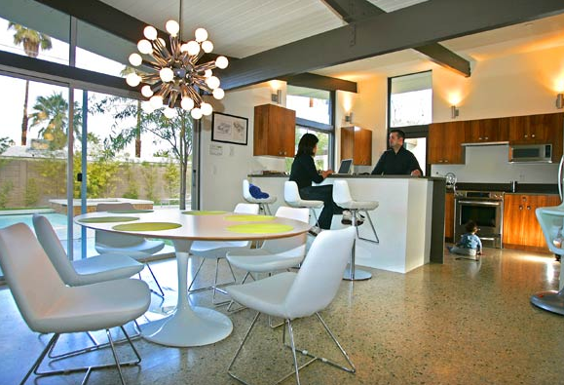
Modern Style

Slide 11
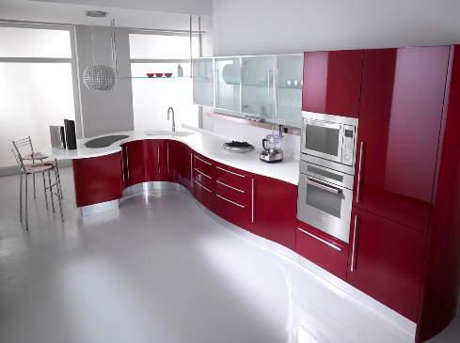
Modern Style
Images from houzz.com

Slide 12
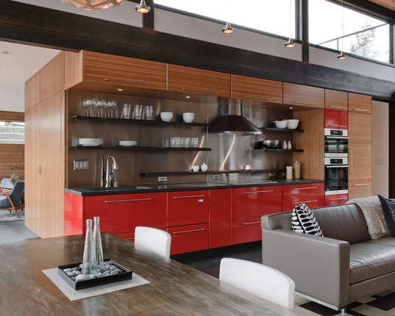
Modern Style
Images from houzz.com

Slide 13
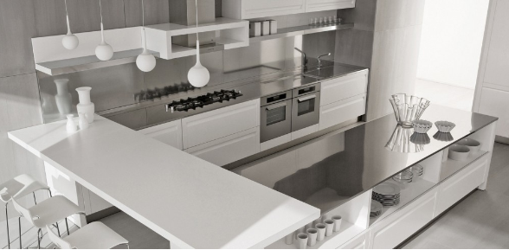
Modern Style
Images from houzz.com

Slide 14
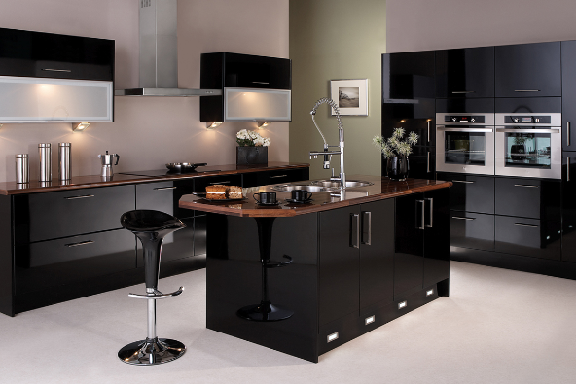
Modern Style
Images from houzz.com

Slide 15
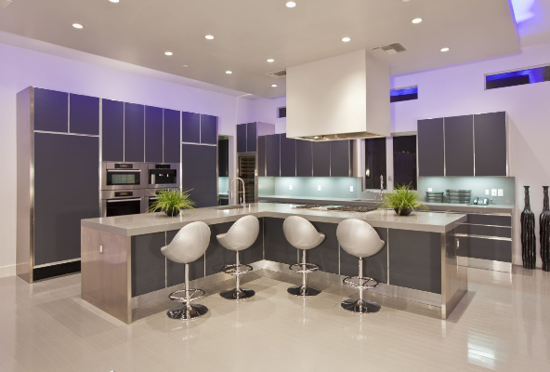
Modern Style
Images from houzz.com

Slide 16
Contemporary Style
Contemporary Means "Today" or "Recent"
Contemporary designs or contemporary furniture refers to furniture designs of the 21st century.
In 50 years contemporary will still mean most current or recent but modern will mean over 150 years ago.
The contemporary style kitchen is easy cleaning and low maintenance.
Surfaces are specified for easy cleaning and low maintenance.
Vinyl flooring is popular for it’s easy clean and hygienic properties as well as cost effectiveness

Slide 17
Contemporary Style
Tiles are still poplar with people opting for natural stone or vitrified stone tiles.
Laminate timber flooring made a brief appearance but water and timber don’t go well together.
Some opt for a more expensive solid timber or semi solid flooring but these need regular maintenance.
During boom years poured resin floors were poplar but very expensive.
Normally used in industry became very poplar for open plan houses.

Slide 18
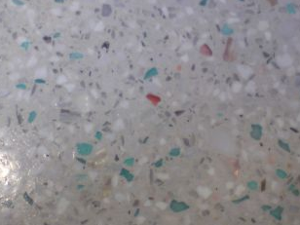
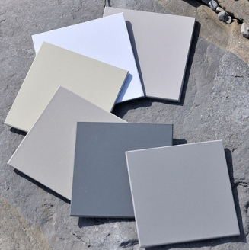
Poured resin floors
Virtually maintenance free and extremely hygienic as well as being bullet proof to everyday abuse.

Slide 19
Contemporary Style
Windows in the kitchen are functional and the only dressing is to control the light in and provide privacy usually in the form of a blind.
Contemporary style kitchens also have bold colours incorporated in their design. Colours such as reds, blues and bright colours.
The colour can be the decoration, appliances or the cabinetry.
The walls are painted, coloured tiles used as a splash back behind the sink or behind the cooker.
During boom years coloured glass splash backs were again very popular but very expensive.

Slide 20
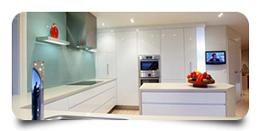
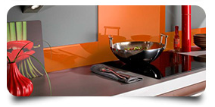
Glass splashbacks
Glass Splashbacks bring light and elegance to any home or bathroom.
Available in any colour they are stunning, hygienic and a cutting edge alternative to traditional wall tiles.
Toughened glass Splashbacks can be made to the exact size and shape you require, including cut outs for sockets and switches
http://www.vivaglass.ie/index.html

Slide 21
Contemporary Style
Accessories are coloured and can be changed regularly to create a new look.
The contemporary style kitchen is functional and versatile.
The appliance colours can be selected from white the most traditional, to black the most sophisticated or stainless steel for a clean hygienic modern feel.
Trends in colour also go out of fashion very quickly.
Some appliance mainly fridges/freezers come in a range of colours like greens, red, yellow and pink.

Slide 22
Contemporary Style
Contemporary styled kitchens cover a vast array of looks.
They fit in well in most modern homes today and are an ideal style for remodelling and renovating your kitchen.
This style of kitchen can be changed to create different looks with a minimum expense through coloured accessories.
Replacing or painting cabinet doors.
Changing worktops.

Slide 23
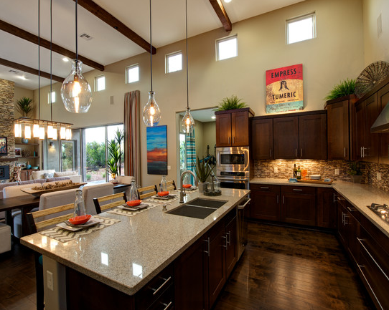
Contemporary style
Images from houzz.com

Slide 24
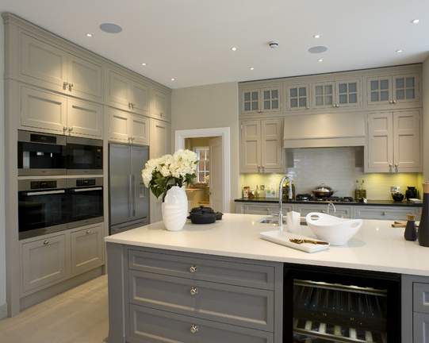
Contemporary style
Images from houzz.com

Slide 25
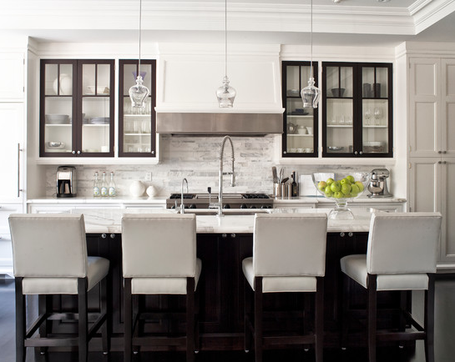
Contemporary style
Images from houzz.com

Slide 26
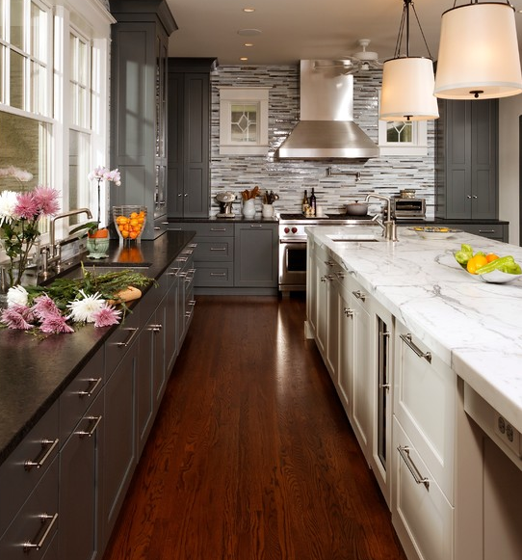
Contemporary style
houzz
Images from houzz.com

Slide 27
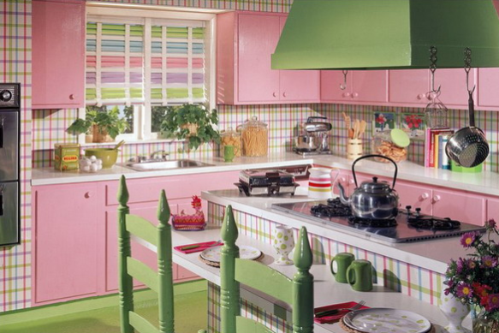
Vintage style ?
Images from Pouted.com

Slide 28
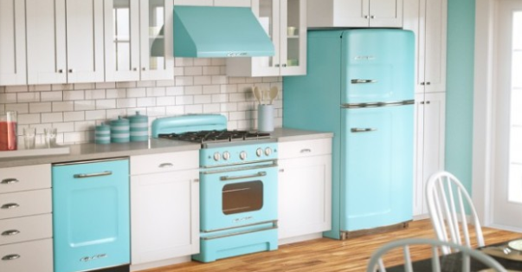
Vintage style ?
Images from Pouted.com

Slide 29
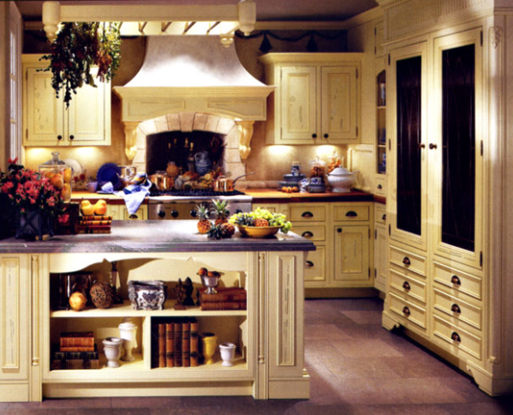
Vintage style
Images from Pouted.com

Slide 30
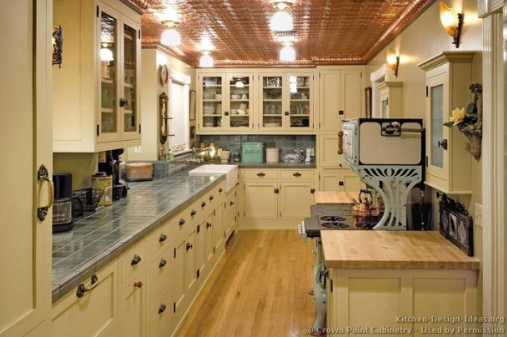
Vintage style
Images from Pouted.com

Slide 31
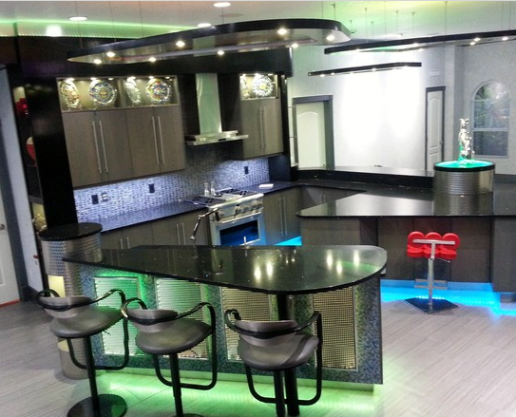
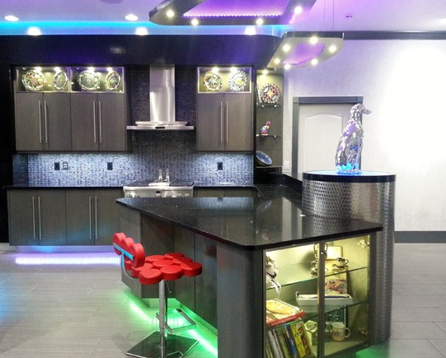
Futuristic style

Slide 32
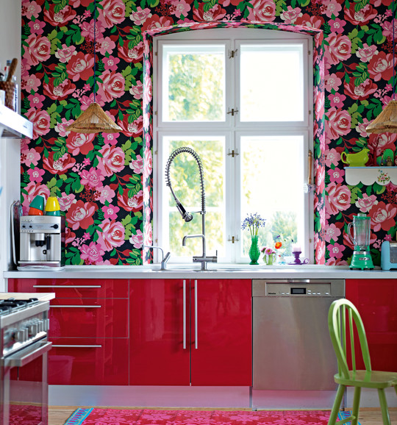
Bad Style

Slide 33
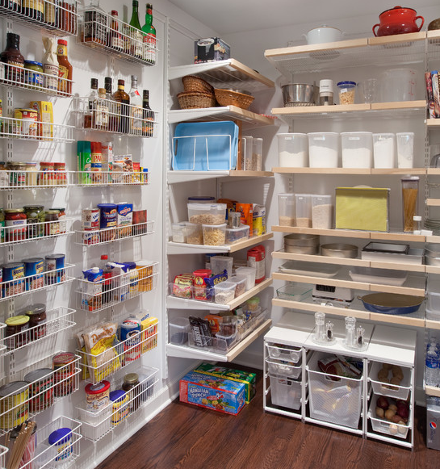
Storage
Storage room
similar to olden
day pantry

Slide 34
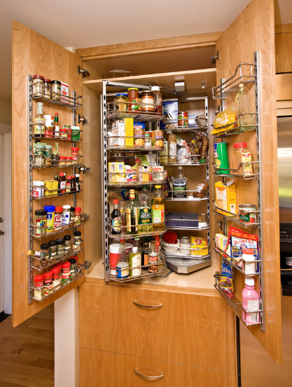
Storage
Wire works used
to create order
with storage.
Contemporary

Slide 35
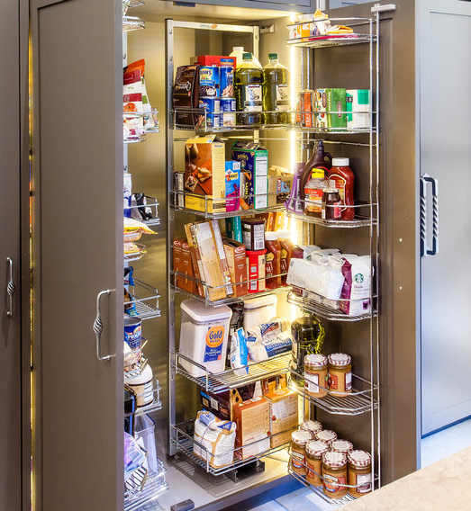
Storage
Wire works used
to create order
with storage.
Contemporary

Slide 36
References
http://www.pouted.com/breathtaking-and-stunning-italian-kitchen-designs/ Number of slides
http://www.houzz.com/photos/contemporary/kitchen/p/16 Number of slides
http://blog.relishinteriors.com/modern-vs-contemporary-whats-the-difference/ Modern versus contemporary.
http://www.flooredgenius.com/ Poured resin floors
http://www.vivaglass.ie/index.html Glass splashbacks

