Slide 1
Tiger shop
10th September 2014

Slide 2
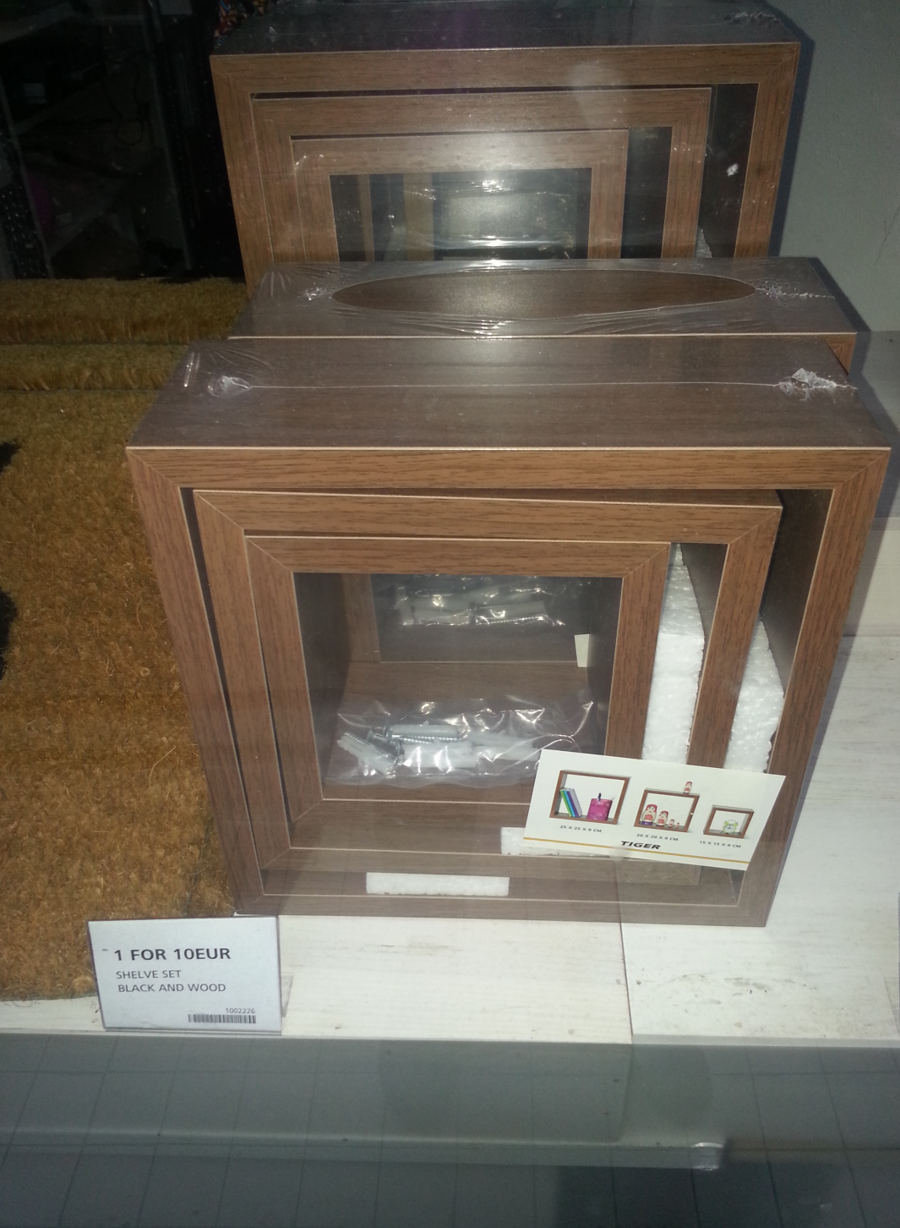
Selling Price
€10

Slide 3
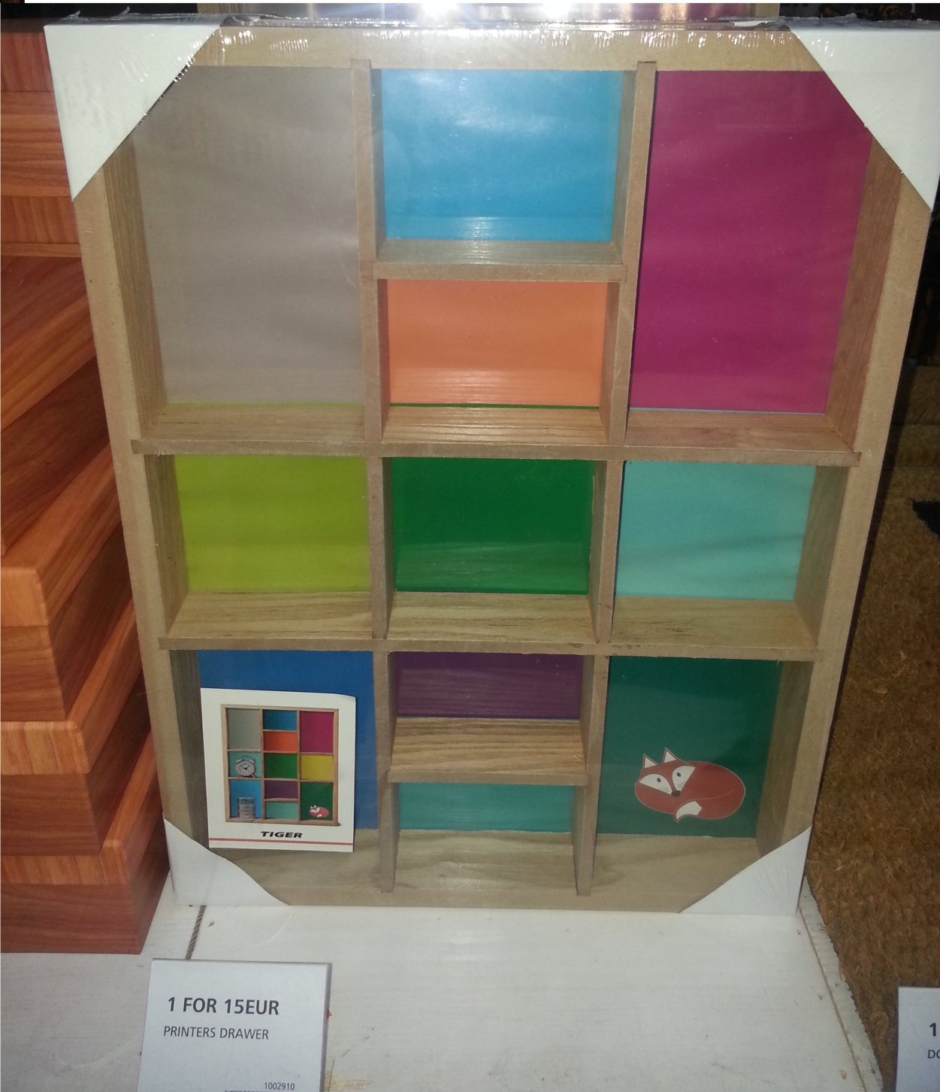
Selling Price
€15

Slide 4
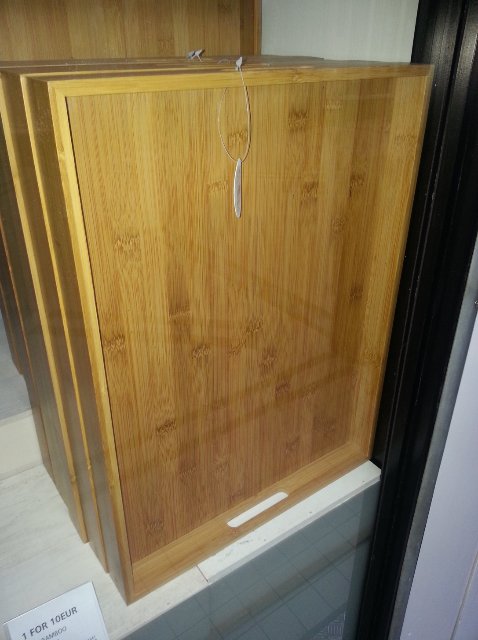
Selling Price
€10

Slide 5
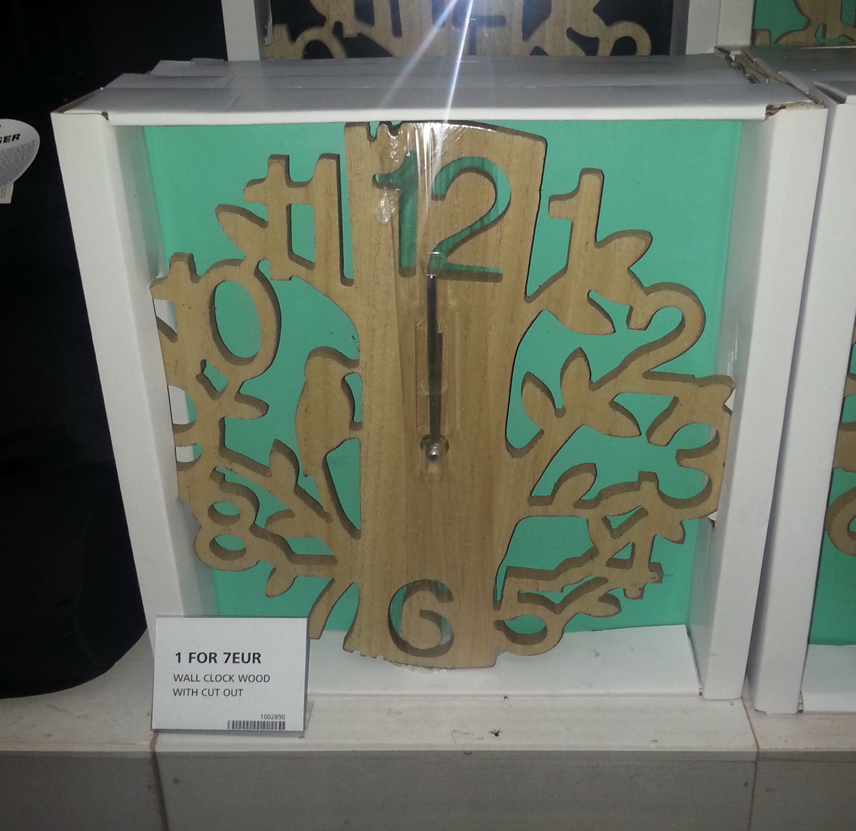
Selling Price
€7

