Slide 1
Kitchen
Solid
Worktops

Slide 2
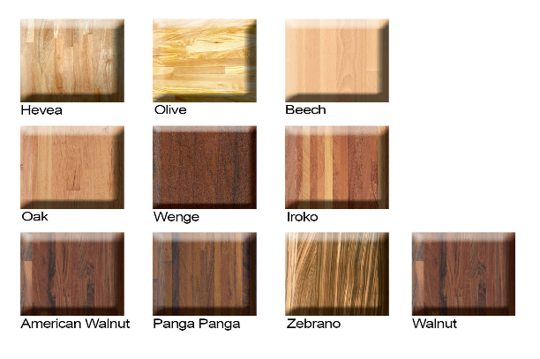

Wooden Worktops
The Panelling Centre Collection of
Solid wood Worktops
https://www.ikea.com/ie/en/cat/kitchen-worktops-24264/

Slide 3
SOLID WOOD WORKTOPS
Maple: Maple’s soft grain pattern allows it easily to be adaptable to both traditional and contemporary designs. It is a very robust and finishes well.
Cherry: A very refined, straight and close grain gives cherry a smooth and elegant look. This feature makes it well suited for mixing with other woods. It is a classy looking finish but also has durable and qualities and can handle wear and tear well.

Slide 4
SOLID WOOD WORKTOPS
Oak: Oak is rougher and more natural texture and this results in a relatively defined straight grain that is more casual than elegant. Oak can take any type of stain to create a wholesome effect because it is absorbent. The darker the stain, the more highlighted the grain pattern will become. A light stains reduce its visibility but retains its warm appeal. Be aware that the tannin in oak will react to metals and water and could result in blue/ black staining.
Pine: Pine’s straight grain is relatively long and continuous, giving your cabinets a more rugged look. Very suitable for Irish country style kitchens, yellow pine in particular is much more enduring and will always be in style no matter what fads appear.

Slide 5
SOLID WOOD WORKTOPS
Alder: can be made to look like a variety of natural finishes. Consistent in colour, alder ranges from a pale pinkish-brown to almost white, with a close tight grain. Very hard finish and also expensive. Increasing popularity may diminish price gradually.
Birch: Again, a very common material in Ireland. White paper birch and yellow birch species are available, though the latter is more popular and expensive. Perfect for painting, this cream-colored wood may stain unevenly.

Slide 6
SOLID WOOD WORKTOPS
Hickory: Very popular in America where it’s strong and robust nature are qualities to be admired. It is not available widely in Ireland. With colours ranging from white to a ruddy brown, this relatively straight and fine grain accepts medium to dark finishes and bleaches well. Expensive because of scarcity.
Mahogany: The availability of newer woods has reduced the popularity of mahogany but you will not get as rich and heavy a finish in any of the competitors out there. Mahogany stains well to give off a deep hue over time. Be aware that the tannin in this timber will react to metals and water and could result in blue/ black staining.

Slide 7
SOLID WOOD WORKTOPS
Walnut: Fairly poplar as a worktop it ranges in colour from dark brown to purplish black. Very glossy and very expensive. Walnut has approximately 40% waste margin due to resin pocket, knots and shakes.

Slide 8
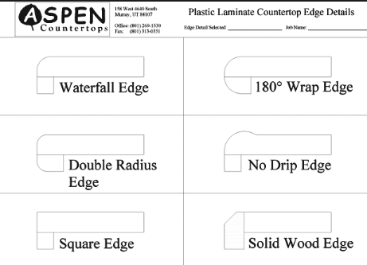
Example of Worktop edge profiles
http://aspencountertops.com/laminate-countertops/

