Slide 1
Kitchens Planning & Design
Lesson 2

Slide 2
Kitchen Planning
Kitchen design is very important, but it is sometimes confused with kitchen planning.
Both planning and design are critical, and ignoring one while concentrating on the other can lead to a disaster and regret.
A designer can use different materials, cabinets, finishes, lighting, etc. to achieve a sleek, modern look and feel or a kitchen that seems to belong to an old Irish cottage.

Slide 3
Effective use of space
Kitchen planning is primarily about the effective use of the space you create, or you are allowed to work with in an existing house.
When you plan a kitchen - think about the placement of the cooker, sink, appliances (built in), types of cabinets and the layout of the cabinets and worktops.

Slide 4
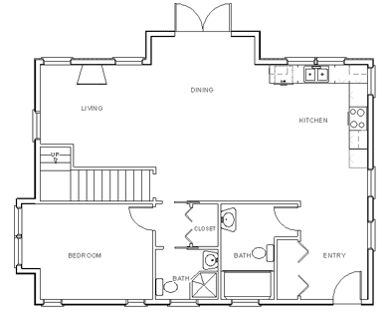
Foot Traffic
Consider what
this floor plan
will look like
after furniture
Is installed and
people are living
in
Image from:
http://www.the-house-plans-guide.com/make-your-own-blueprint.html

Slide 5
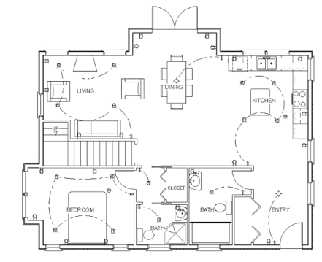
Foot Traffic
Once lived in
What may
appear to be
large and
spacious may
not always be
the case.
Image from:
http://www.the-house-plans-guide.com/make-your-own-blueprint.html

Slide 6
Designing the kitchen
Design includes every surface in the kitchen.
From wall to floor coverings, backsplash, choice of worktop, press doors to lighting.
Unfortunately, lighting is often overlooked in many kitchen designs and it the single most important element.
Natural light is the most desirable. But with more windows, you loose wall space which in turn means less press space.
As with every room in your house, planning is the key in the kitchen.

Slide 7
Considerations
The shape of the room - usually determined by walls already built.
The work triangle of the kitchen-
The relationship between sink, cooker and fridge.
Is there anyone with special needs that might for example limit height of work surfaces.
Where is the light coming into the kitchen - are there any windows?
Are there exterior walls for aroma extraction?
Is there a stove or range oven to be installed.

Slide 8
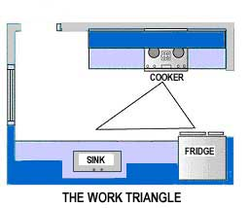
The Work Triangle
The work triangle should be considered when designing a new kitchen.
The work triangle is relative to three main workstations in the kitchen layout: the sink, the cooker and the fridge.
A well-proportioned triangle is desirable.

Slide 9
Work Triangle
This triangle should be kept clear and the distances as short as possible between stations.
This is not always possible due to islands, tables etc.
The main goal of the triangle is efficiency as it keeps all the major work stations near the cook, without placing them so close that the kitchen becomes cramped.
The work triangle is also designed to minimize traffic within the kitchen so the cook isn’t interrupted or interfered with.

Slide 10
Work Triangle Specs
The sum of the work triangle’s three sides should not exceed 26 feet (8M), each leg should measure between 4 & 9 feet ( 1.2 & 2.75M) .
The work triangle should not cut through an island or peninsula by more than 300mm.
If the kitchen has only one sink, it should be placed between or across from the cooking surface, preparation area, or refrigerator.
No major traffic patterns should cross through the triangle.

Slide 11
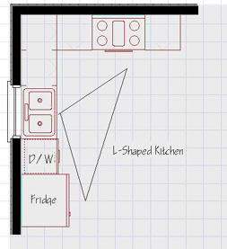
Kitchen Layouts L-Shape
The L-shaped kitchen works well for small spaces and open floor plans.
The work triangle is an efficient one. A table on the open side of this kitchen can make for a comfortable and casual feeling with room for guests and conversation. Typically farmhouse kitchen.

Slide 12
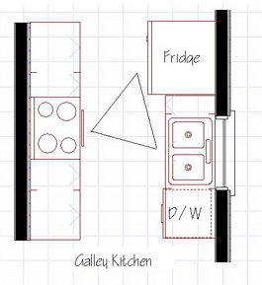
Galley
This layout is made up of two parallel counter surfaces that usually run the length of the kitchen.
Minimum distance between worktops is 900mm. Also known as safe passing distance.

Slide 13
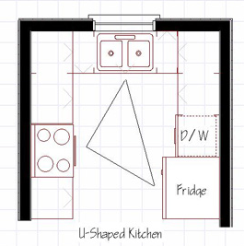
U-Shape
U Shape: This layout has cupboards and workspace on three adjoining sides.
The U-shaped design has an efficient work triangle. This layout generally works well but becomes cramped if too narrow and if too wide then walking distance is increased.
Preparation becomes too tiring extra walking distance.

Slide 14
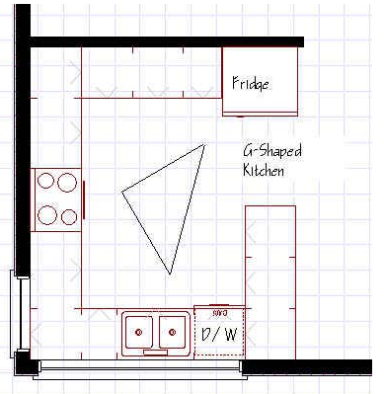
G-Shape
This floor plan provides the same efficiency of the U-shaped but with the extra advantage of having a peninsula that can be used as an eating counter or for a place for those not helping out with food prep to sit and socialize. One drawback is that the enclosed space could feel a bit claustrophobic. Large windows space can help with this feeling.

