Slide 1

Boulle Work
Beautiful patterns can be achieved by cutting veneers from Tortoiseshell, Pewter, Ivory and Brass as well as using Timber.
Notes:
3-D wood block with texture and engraved text
(Advanced)
To reproduce the shape effects on this slide, do the following:
On the Home tab, in the Slides group, click Layout, and then click Blank.
On the Home tab, in the Drawing group, click Shapes, and then under Rectangles, click Rectangle (first option from the left). On the slide, drag to draw a rectangle.
Under Drawing Tools, on the Format tab, in the Size group, do the following:
In the Shape Height box, enter 3”.
In the Shape Width box, enter 3”.
On the Home tab, in the bottom right corner of the Drawing group, click the Format Shape dialog box launcher. In the Format Shape dialog box, click Fill in the left pane, and then in the Fill pane, select Picture or texture fill. Click the button next to Texture, and then click Oak (fifth row, third option from the left).
Also in the Format Shape dialog box, click Line Color in the left pane, and then in the Line Color pane, then select No line.
Also in the Format Shape dialog box, click 3-D Rotation in the left pane, and then in the 3-D Rotation pane, do the following:
Click the button next to Presets, and then under Perspective click Perspective Left (first row, second option from the left).
In the X box, enter 40°.
In the Y box, enter 10°.
In the Perspective box, enter 20°.
Also in the Format Shape dialog box, click 3-D Format in the left pane, and then in the 3-D Format pane, do the following:
Under Bevel, click the button next to Top, and then under Bevel click Circle (first row, first option from the left). Click the button next to Bottom, and then under Bevel click Circle (first row, first option from the left).
Under Depth, in the Depth box, enter 200 pt.
Under Surface, click the button next to Material, and then under Standard, click Warm Matte (second option from the left). Click the button next to Lighting, and then under Neutral, click Soft (first row, third option from the left). In the Angle box, enter 270°.
Also in the Format Shape dialog box, click Shadow in the left pane, and then in the Shadow pane, click the button next to Presets, and then under Perspective, click Perspective Diagonal Upper Right (first row, second option from the left).
To reproduce the text effects on this slide, do the following:
On the slide, right-click the rounded rectangle, click Edit Text, then enter text.
Select the text. On the Home tab, in the Font group, select Arial Rounded MT Bold from the Font list, and then select 36 from the Font Size list.
On the Home tab, in the Paragraph group, click Center to center the text within the rectangle.
Under Drawing Tools, on the Format tab, in the bottom right corner of the WordArt Styles group, click the Format Text Effects dialog box launcher. In the Format Text Effects dialog box, click Text Fill in the left pane, and then in the Text Fill pane, do the following:
Select Solid fill.
Click the button next to Color, click More Colors, and then in the Colors dialog box, on the Custom tab, enter values for Red: 130, Green: 101, and Blue: 58.
Also in the Format Text Effects dialog box, click Shadow in the left pane, and then in the Shadow pane, do the following:
Click the button next to Presets, and then under Inner click Inside Diagonal Top Left (first row, first option from the left).
In the Transparency box, enter 25%.
In the Distance box, enter 5 pt.
To reproduce the background on this slide, do the following:
Right-click the slide background area, and then click Format Background. In the Format Background dialog box, click Fill in the left pane, select Gradient fill in the Fill pane, and then do the following:
In the Type list, select Linear.
Click the button next to Direction, and then click Linear Down (first row, second option from the left).
Under Gradient stops, , click Add gradient stops or Remove gradient stops until four stops appear in the slider.
Also under Gradient stops, customize the gradient stops that you added as follows:
Select the first stop in the slider, and then do the following:
In the Position box, enter 0%.
Click the button next to Color, click More Colors, and then in the Colors dialog box, on the Custom tab, enter values for Red: 196, Green: 178, and Blue: 152.
Select the second stop in the slider, and then do the following:
In the Position box, enter 45%.
Click the button next to Color, and then under Theme Colors click Tan, Background 2, Darker 90% (sixth row, third option from the left).
Select the third stop in the slider, and then do the following:
In the Position box, enter 72%.
Click the button next to Color, click More Colors, and then in the Colors dialog box, on the Custom tab, enter values for Red: 66, Green: 62, and Blue: 50.
Select the fourth stop in the slider, and then do the following:
In the Position box, enter 100%.
Click the button next to Color, click More Colors, and then in the Colors dialog box, on the Custom tab, enter values for Red: 149, Green: 128, and Blue: 107.

Slide 2
Boulle Work
André-Charles Bhul (1642-1732) is well known for veneering furniture with marquetry of Tortoiseshell, Pewter, Ivory and Brass as well as using Timber .
Although he did not invent the technique, Boulle was know for creating marquetry of extraordinary quality so later work using his style & techniques was called Boulle work.
Before 1666 Boulle was awarded the title of master cabinetmaker
In 1672 he became Cabinetmaker & Sculptor to Louis XIV
Many of his designs are illustrated in a book of engravings published around 1720.
https://archive.org/details/cu31924030684793

Slide 3
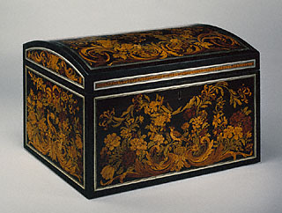
Attributed to André-Charles Boulle
French, Paris, 1675 - 1680
Oak veneered with various stained and natural woods, brass, horn, and pewter stringing
Height 406mm
Width 660mm
Depth 430mm

Slide 4
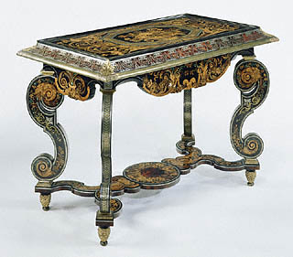
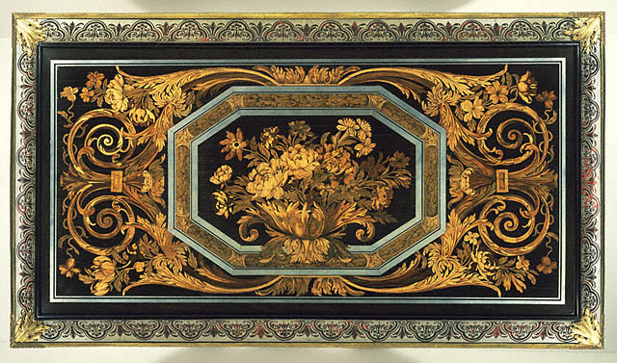
Attributed to André-Charles Boulle
French, Paris, about 1680 Table
Oak veneered with ebony, tortoiseshell, pewter, brass, ivory, horn, various stained and natural woods; gilt bronze mounts

Slide 5
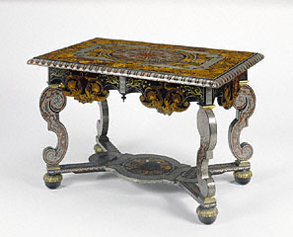
Attributed to André-Charles Boulle
Very few pieces of furniture are veneered with two types of marquetry.
Quality Marquetry in wood and in tortoiseshell, brass, horn, and pewter decorates the top of this table.
Brass banding surrounds a large central oval of tortoiseshell, with flowers like peonies, daffodils, tulips & hyacinths in wood marquetry frame the table's outer surface.

Slide 6
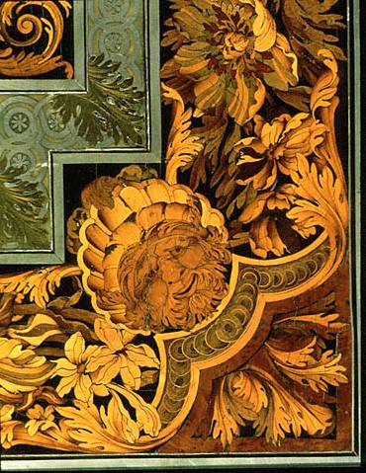
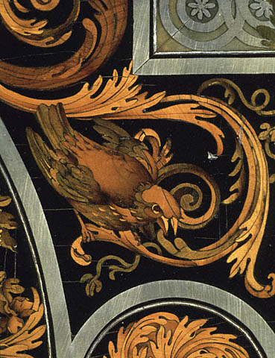
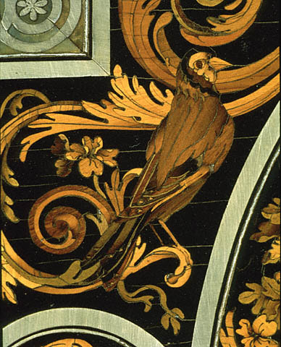
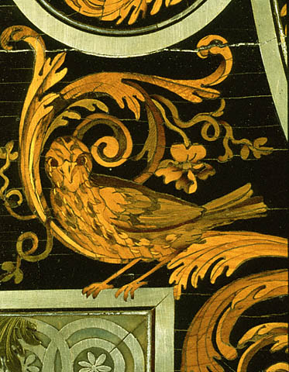
Marquetry on table

Slide 7
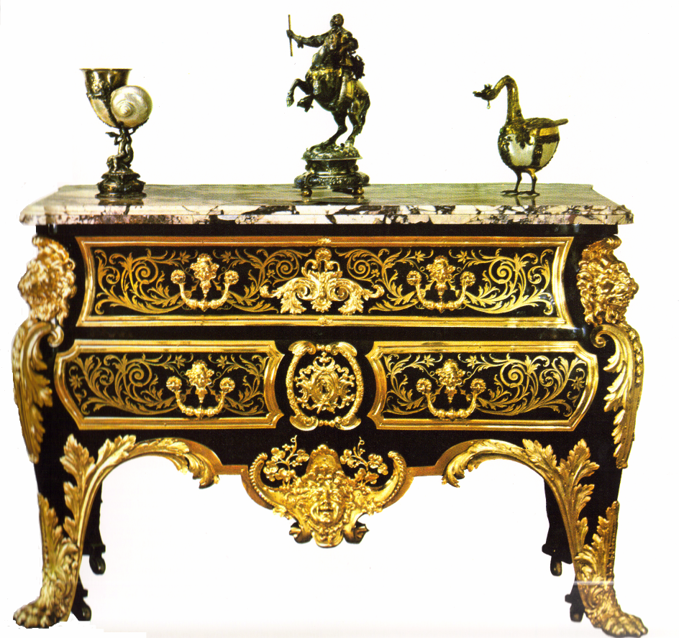
Boulle Work

Slide 8
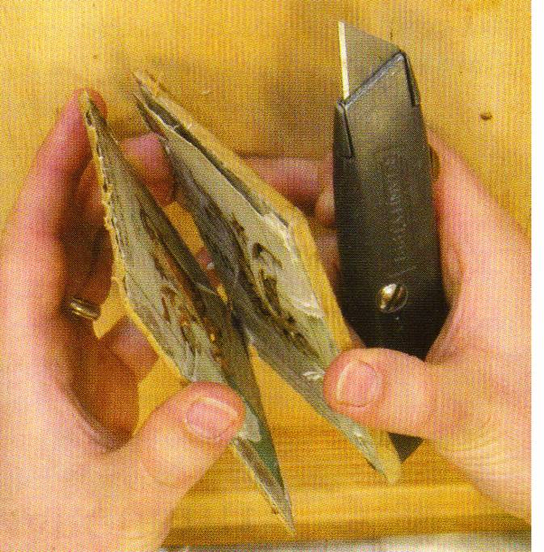
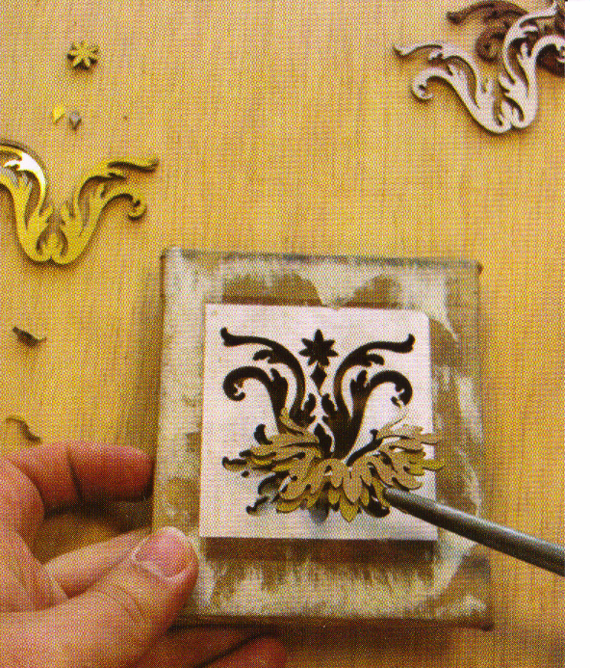
Boulle Work
Two different metals are sandwiched together between some waste wood.
The pattern is glued onto the face of the wood.
The pattern is then cut out using a Donkey saw or Fret saw.
The pack is then seperrated.
The pieces are carefully removed

Slide 9
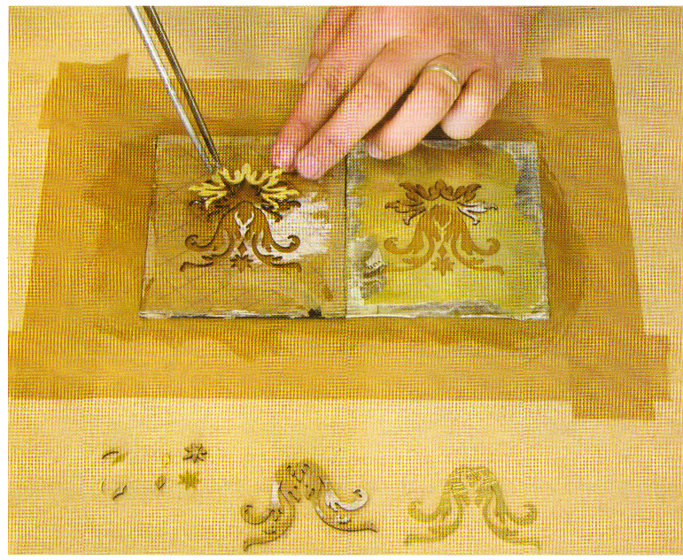
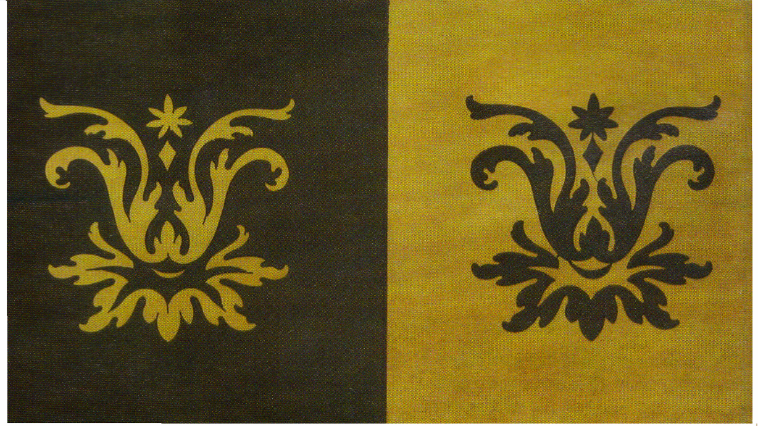
The pieces are then carefully rearranged to create new patterns

Slide 10
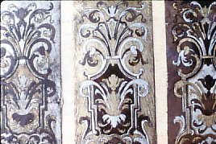
A sample of Boulle work using three layers of material, Brass, Pewter and Ebony, to produce three different results.
Since all three layers are sawn simultaneously, the result is a perfect fit every time.

Slide 11
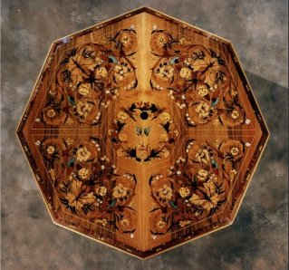
Marquetry Table from
The American School of Marquertry

