Slide 1
Kitchen Appliances
Lesson Three

Slide 2
Appliances: Cooker / Oven
Free standing cookers both electric or gas are normally 550 to 600mm wide. Most are within 900mm in height some models will need packers under the feet to bring to a higher level if required.
They fit between presses. Worktop edge will need to be finished at either side of this appliance.
Built in ovens are increasingly popular as they can be installed at centre level and built into the cabinets. Thus making them more user friendly.

Slide 3
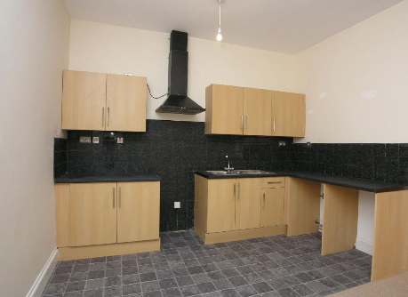
Kitchen without freestanding appliances

Slide 4
Appliances : Hob
A Hob can also be gas or electric with some lager 800mm+ hobs being both.
Hobs can be placed anywhere in a kitchen providing that they are 600mm from the sink.
Safe practice is to have at least 600mm of worktop space either side of your cooker/hob.
When the sink and cooker are at right angles it is recommended they should be separated by a minimum of 900mm of worktop space.

Slide 5
Appliances: Extraction
The Extraction unit above hob or cooker is usually the same width as the appliance 600mm.
Ensure correct spacing between extraction unit and hob/ cooker.
- Minimum distance of 650mm from underside of hood to electric hob.
- Minimum distance of 760mm from underside of hood to gas hob.

Slide 6
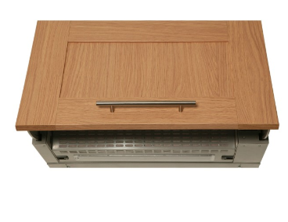
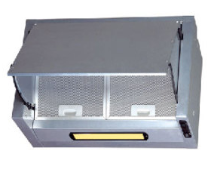
Types of extraction units
Built in extraction unit fits between two wall presses and is fixed to these presses.
A door is screwed to the front panel giving a streamline finish in line with the wall presses.

Slide 7
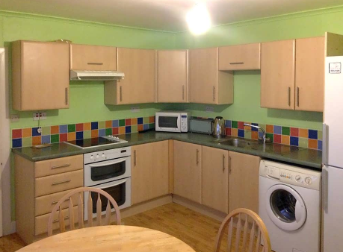
Types of extraction units
This unit is fitted to the underneath part of the press with the extraction hose going through the press.

Slide 8
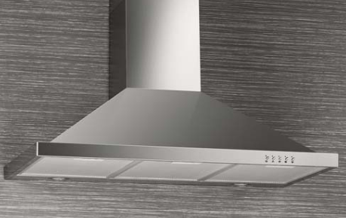
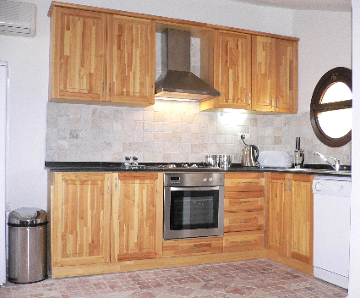
extraction hoods
Metal extraction unit and hood. Built to be seen usually polished /shiny finish.

Slide 9
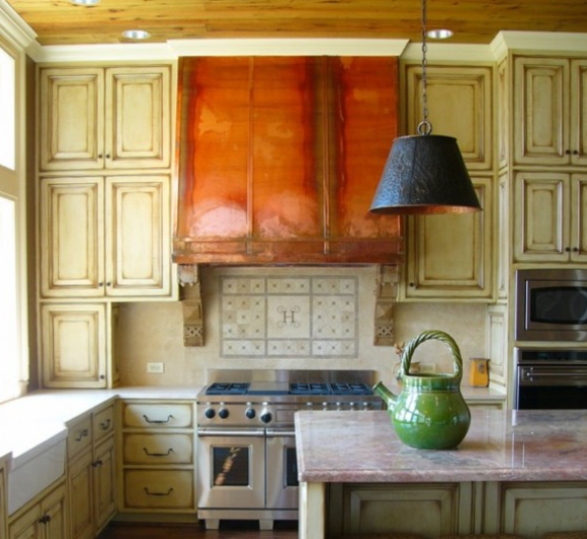
The Copper Stove Hood Kitchen

Slide 10
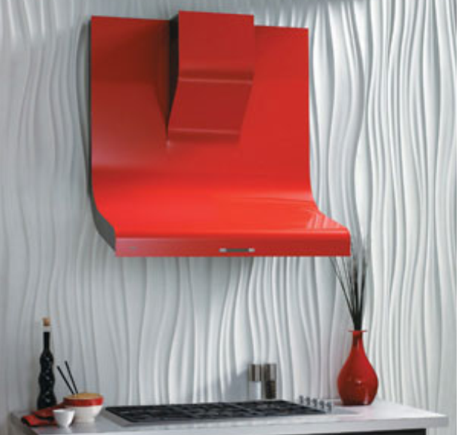
Stylish Kitchen Stove hood

Slide 11
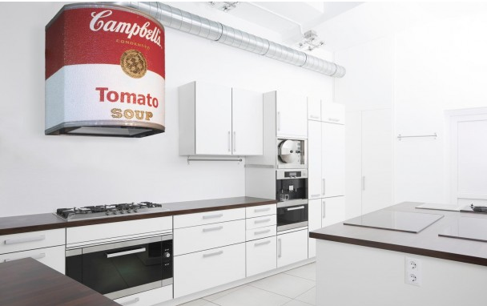
Customised Hood

Slide 12
Freestanding appliances
Best practice nowadays is to have a separate utility room where the washing machine and clothes drier are installed.
If these appliances are to be installed in the kitchen then it is best to keep them near the sink for water and waste services.
Washing machine 600mm standard
Dish washer 600mm standard
Sinks come in a vast range of styles and sizes some are fitted with waste disposal units (apartment blocks)

Slide 13
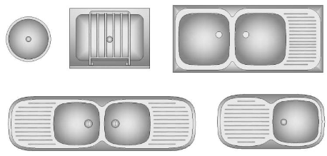
Sinks
Sink base unit must allow for bowl.
Very important to remember if customer requested left hand bowl or right hand bowl.
Some sinks have a push out cap to allow fitting of taps on either side, however most do not.

Slide 14
Fridge Freezers
Fridge/Freezer these units are available as integrated (as are some dish washers) and come as standard to fit inside 600mm carcases.
Free standing units are no longer standard and range in size from 600mm up to 1200mm double doors fridge /freezer.
The heights vary considerably too.
Never position a fridge freezer near a source of heat such as cooker or oven and certainly as far away as possible from a fuel burning cooker.
The extra heat will mean that the fridge or freezer will have to use more electricity to keep cool.

Slide 15
Microwaves / Micro-ovens
Microwaves can also be built in or free standing.
Microwave ovens are a combination of both microwaves and grill and oven.
Only built in microwaves can be installed inside presses as they have been designed for this type of installation.
Never put a free standing microwave into a press as prolonged use can lead to a risk of overheating and fire.

Slide 16
Child safety
Most accidents in the home occur in the kitchen and most accidents involve children.
Install pan guards around island or peninsular hobs.
Fit guard rails to cookers to stop children turning knobs on.
Fit child locks to presses that store dangerous products such as cleaning products.
Ensure that leads from worktop appliances are not hanging over the edges.
This includes phones, games and tablet chargers as well.

Slide 17
References
http://www.thekitchendahab.com/ Images of extraction hoods
http://www.diy.com/diy/jsp/bq/kitchenplanner/planning_guide/page4.html B&Q planning guide
http://www.diy.com/diy/jsp/bq/kitchenplanner/installation_guide/index.html B&Q Installation Guide

