Slide 1
Kitchen
Worktops other
Materials

Slide 2
Corian SOLID WORKTOPS
The solid surface material Corian® from DuPont is a premium material with extraordinary faculties.
Although, at first, Corian® was used primarily only for kitchen worktops, architects and designers have strongly influenced its development.
Due to its properties, such as 3D thermoforming, the substantial range of colours in which it is available and its functionality, durability and aesthetics.
Range of colours
https://www.rosskopf-partner.com/materials/solid-surface-material/corian/corian-colours

Slide 3
Corian SOLID WORKTOPS
Corian® also adheres to the high standards required for hygiene, it can also be used with no limitations to manufacture elements in bathrooms, kitchens, hospitals and in restaurants.
Solid surface material was developed in the 1960s by DuPont and marketed as Corian®. Therefore, the term solid surface material is still associated with the same brand, Corian®.
Today, the solid surface material market has grown significantly and offers numerous other brands such as Avonite® from Aristech Surfaces LLC, HI-MACS®, Varicor® and GetaCore®.

Slide 4
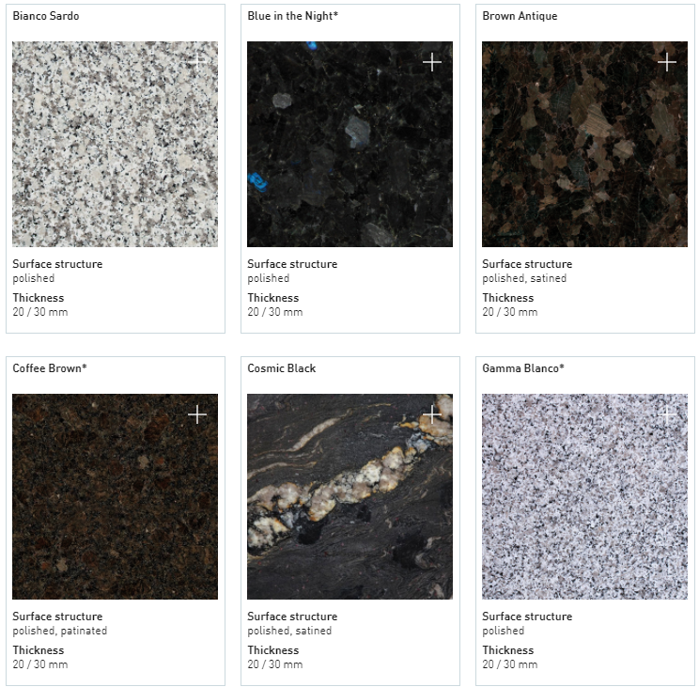
Solid surface material
Natural Stone

Slide 5
Medite Tricoya MDF
MEDITE TRICOYA EXTREME Durable MDF is a ground-breaking construction material.
Advantages
Durability
Dimensional Stability
Can be used in similar applications as concrete, plastics or metals.
Added benefits of light weight, sustainable raw materials and a guarantee of up to 50 years above ground and 25 years in ground.
Endless opportunities for creativity.
Medite SmartPly
Sustainability

