Slide 1

Inlay & Bandings
Inlay is the insertion of thin pieces of wood, stringing, ivory, copper brass etc., into a solid base.
Bandings are available as strips of patterns made up from side grain sections of coloured hardwoods.
Notes:
3-D wood block with texture and engraved text
(Advanced)
To reproduce the shape effects on this slide, do the following:
On the Home tab, in the Slides group, click Layout, and then click Blank.
On the Home tab, in the Drawing group, click Shapes, and then under Rectangles, click Rectangle (first option from the left). On the slide, drag to draw a rectangle.
Under Drawing Tools, on the Format tab, in the Size group, do the following:
In the Shape Height box, enter 3”.
In the Shape Width box, enter 3”.
On the Home tab, in the bottom right corner of the Drawing group, click the Format Shape dialog box launcher. In the Format Shape dialog box, click Fill in the left pane, and then in the Fill pane, select Picture or texture fill. Click the button next to Texture, and then click Oak (fifth row, third option from the left).
Also in the Format Shape dialog box, click Line Color in the left pane, and then in the Line Color pane, then select No line.
Also in the Format Shape dialog box, click 3-D Rotation in the left pane, and then in the 3-D Rotation pane, do the following:
Click the button next to Presets, and then under Perspective click Perspective Left (first row, second option from the left).
In the X box, enter 40°.
In the Y box, enter 10°.
In the Perspective box, enter 20°.
Also in the Format Shape dialog box, click 3-D Format in the left pane, and then in the 3-D Format pane, do the following:
Under Bevel, click the button next to Top, and then under Bevel click Circle (first row, first option from the left). Click the button next to Bottom, and then under Bevel click Circle (first row, first option from the left).
Under Depth, in the Depth box, enter 200 pt.
Under Surface, click the button next to Material, and then under Standard, click Warm Matte (second option from the left). Click the button next to Lighting, and then under Neutral, click Soft (first row, third option from the left). In the Angle box, enter 270°.
Also in the Format Shape dialog box, click Shadow in the left pane, and then in the Shadow pane, click the button next to Presets, and then under Perspective, click Perspective Diagonal Upper Right (first row, second option from the left).
To reproduce the text effects on this slide, do the following:
On the slide, right-click the rounded rectangle, click Edit Text, then enter text.
Select the text. On the Home tab, in the Font group, select Arial Rounded MT Bold from the Font list, and then select 36 from the Font Size list.
On the Home tab, in the Paragraph group, click Center to center the text within the rectangle.
Under Drawing Tools, on the Format tab, in the bottom right corner of the WordArt Styles group, click the Format Text Effects dialog box launcher. In the Format Text Effects dialog box, click Text Fill in the left pane, and then in the Text Fill pane, do the following:
Select Solid fill.
Click the button next to Color, click More Colors, and then in the Colors dialog box, on the Custom tab, enter values for Red: 130, Green: 101, and Blue: 58.
Also in the Format Text Effects dialog box, click Shadow in the left pane, and then in the Shadow pane, do the following:
Click the button next to Presets, and then under Inner click Inside Diagonal Top Left (first row, first option from the left).
In the Transparency box, enter 25%.
In the Distance box, enter 5 pt.
To reproduce the background on this slide, do the following:
Right-click the slide background area, and then click Format Background. In the Format Background dialog box, click Fill in the left pane, select Gradient fill in the Fill pane, and then do the following:
In the Type list, select Linear.
Click the button next to Direction, and then click Linear Down (first row, second option from the left).
Under Gradient stops, , click Add gradient stops or Remove gradient stops until four stops appear in the slider.
Also under Gradient stops, customize the gradient stops that you added as follows:
Select the first stop in the slider, and then do the following:
In the Position box, enter 0%.
Click the button next to Color, click More Colors, and then in the Colors dialog box, on the Custom tab, enter values for Red: 196, Green: 178, and Blue: 152.
Select the second stop in the slider, and then do the following:
In the Position box, enter 45%.
Click the button next to Color, and then under Theme Colors click Tan, Background 2, Darker 90% (sixth row, third option from the left).
Select the third stop in the slider, and then do the following:
In the Position box, enter 72%.
Click the button next to Color, click More Colors, and then in the Colors dialog box, on the Custom tab, enter values for Red: 66, Green: 62, and Blue: 50.
Select the fourth stop in the slider, and then do the following:
In the Position box, enter 100%.
Click the button next to Color, click More Colors, and then in the Colors dialog box, on the Custom tab, enter values for Red: 149, Green: 128, and Blue: 107.

Slide 2
Bandings
Walnut, Ebony, Beech, Ramin, Tulipwood, Rosewood & Boxwood are a few species of timber used.
The strips are approx. the same thickness as knife cut veneers and are produced in various widths.
They can be taped together with other veneers for pressing or inlaid afterwards by cutting a groove into the wood.
How to make Banding

Slide 3




Common Bandings
Bandings made up from Tulipwood, Ebony
& Boxwood Available 6, 9 & 12mm
Satinwood & Ebony sizes 6, 9 & 12mm
Walnut Herringbone 12, 16 & 19mm
Inlay / Strings
Boxwood or Ebony
strings sizes 2, 3 & 4mm

Slide 4




Bandings
2 & 3mm bandings
4 & 6mm bandings
6 to 19mm bandings

Slide 5
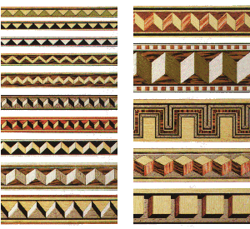
Bandings More Examples

Slide 6
Intarsia
Intarsia uses solid pieces inset into one another to create pictures.
Notes:
3-D wood block with texture and engraved text
(Advanced)
To reproduce the shape effects on this slide, do the following:
On the Home tab, in the Slides group, click Layout, and then click Blank.
On the Home tab, in the Drawing group, click Shapes, and then under Rectangles, click Rectangle (first option from the left). On the slide, drag to draw a rectangle.
Under Drawing Tools, on the Format tab, in the Size group, do the following:
In the Shape Height box, enter 3”.
In the Shape Width box, enter 3”.
On the Home tab, in the bottom right corner of the Drawing group, click the Format Shape dialog box launcher. In the Format Shape dialog box, click Fill in the left pane, and then in the Fill pane, select Picture or texture fill. Click the button next to Texture, and then click Oak (fifth row, third option from the left).
Also in the Format Shape dialog box, click Line Color in the left pane, and then in the Line Color pane, then select No line.
Also in the Format Shape dialog box, click 3-D Rotation in the left pane, and then in the 3-D Rotation pane, do the following:
Click the button next to Presets, and then under Perspective click Perspective Left (first row, second option from the left).
In the X box, enter 40°.
In the Y box, enter 10°.
In the Perspective box, enter 20°.
Also in the Format Shape dialog box, click 3-D Format in the left pane, and then in the 3-D Format pane, do the following:
Under Bevel, click the button next to Top, and then under Bevel click Circle (first row, first option from the left). Click the button next to Bottom, and then under Bevel click Circle (first row, first option from the left).
Under Depth, in the Depth box, enter 200 pt.
Under Surface, click the button next to Material, and then under Standard, click Warm Matte (second option from the left). Click the button next to Lighting, and then under Neutral, click Soft (first row, third option from the left). In the Angle box, enter 270°.
Also in the Format Shape dialog box, click Shadow in the left pane, and then in the Shadow pane, click the button next to Presets, and then under Perspective, click Perspective Diagonal Upper Right (first row, second option from the left).
To reproduce the text effects on this slide, do the following:
On the slide, right-click the rounded rectangle, click Edit Text, then enter text.
Select the text. On the Home tab, in the Font group, select Arial Rounded MT Bold from the Font list, and then select 36 from the Font Size list.
On the Home tab, in the Paragraph group, click Center to center the text within the rectangle.
Under Drawing Tools, on the Format tab, in the bottom right corner of the WordArt Styles group, click the Format Text Effects dialog box launcher. In the Format Text Effects dialog box, click Text Fill in the left pane, and then in the Text Fill pane, do the following:
Select Solid fill.
Click the button next to Color, click More Colors, and then in the Colors dialog box, on the Custom tab, enter values for Red: 130, Green: 101, and Blue: 58.
Also in the Format Text Effects dialog box, click Shadow in the left pane, and then in the Shadow pane, do the following:
Click the button next to Presets, and then under Inner click Inside Diagonal Top Left (first row, first option from the left).
In the Transparency box, enter 25%.
In the Distance box, enter 5 pt.
To reproduce the background on this slide, do the following:
Right-click the slide background area, and then click Format Background. In the Format Background dialog box, click Fill in the left pane, select Gradient fill in the Fill pane, and then do the following:
In the Type list, select Linear.
Click the button next to Direction, and then click Linear Down (first row, second option from the left).
Under Gradient stops, , click Add gradient stops or Remove gradient stops until four stops appear in the slider.
Also under Gradient stops, customize the gradient stops that you added as follows:
Select the first stop in the slider, and then do the following:
In the Position box, enter 0%.
Click the button next to Color, click More Colors, and then in the Colors dialog box, on the Custom tab, enter values for Red: 196, Green: 178, and Blue: 152.
Select the second stop in the slider, and then do the following:
In the Position box, enter 45%.
Click the button next to Color, and then under Theme Colors click Tan, Background 2, Darker 90% (sixth row, third option from the left).
Select the third stop in the slider, and then do the following:
In the Position box, enter 72%.
Click the button next to Color, click More Colors, and then in the Colors dialog box, on the Custom tab, enter values for Red: 66, Green: 62, and Blue: 50.
Select the fourth stop in the slider, and then do the following:
In the Position box, enter 100%.
Click the button next to Color, click More Colors, and then in the Colors dialog box, on the Custom tab, enter values for Red: 149, Green: 128, and Blue: 107.

Slide 7

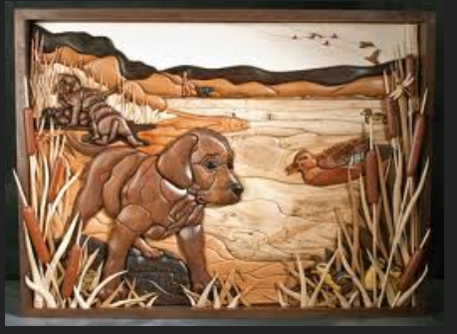
Intarsia

Slide 8
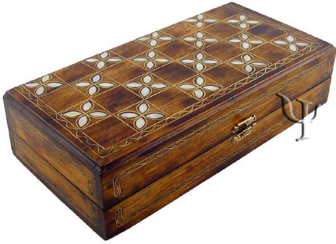
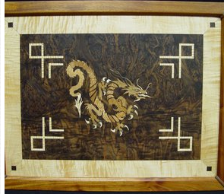
Intarsia using Ivory or Mother of Pearl

