Slide 1
Kitchen Floor
Plan

Slide 2
Sketch The floor Plan
Take sketches of the room showing as much information as possible.
Take lots of measurements at both ground level and floor level.
If replacing an old kitchen look inside existing presses for pipe work, or obstructions.
Note windows, doors and the direction that they open.
Mark exact position of all sockets and light switches.
Measure electrical points from two reference points, note water services and waste pipes.

Slide 3
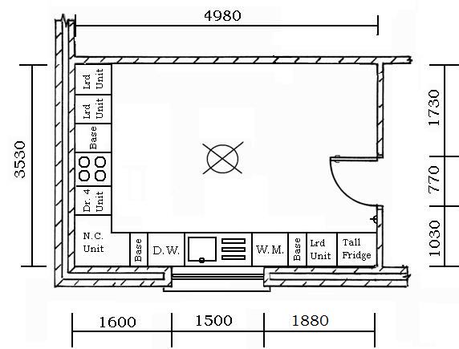
Kitchen floor plan 1
Kitchen floor plan showing base units and appliances.

Slide 4
List units required
1 500mm Larder unit
1 300mm Base
1 1100mm Sink
1 300mm base
1 900 x 900mm Norwegian corner unit
1 500 Drawer x 4
1 500mm Base
1 500mm Larder unit
1 500mm Larder unit

Slide 5
Re-List groups of units
3 500mm Larder unit
2 300mm Base
1 500 Drawer x 4
1 900 x 900mm Norwegian corner unit
1 500mm Base

Slide 6
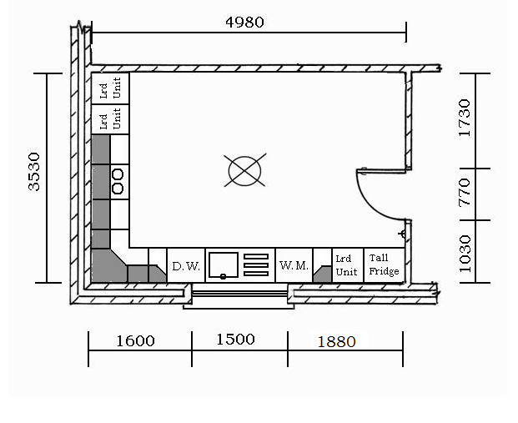
Kitchen floor plan 2
Kitchen floor plan showing wall units.

Slide 7
List wall units required
1 300mm Return unit
1 300mm Return unit
1 300mm Wall unit
1 600 x 600mm Angled corner unit
1 300mm Wall unit
1 500mm Wall unit
1 600mm Extraction unit
1 500mm Display wall unit

Slide 8
Re-List groups of wall units
2 300mm Return unit
2 300mm Wall unit
1 600 x 600mm Angled corner unit
1 500mm Wall unit
1 600mm Extraction unit
1 500mm Display wall unit

Slide 9
Final List of units
3 500mm Larder unit
2 300mm Base
1 1100mm Sink
1 900 x 900mm Norwegian corner unit
1 500mm Drawer x 4
1 500mm Base
2 300mm Return unit
2 300mm Wall unit
1 600 x 600mm Angled corner unit
1 500mm Wall unit
1 600mm Extraction unit
1 500mm Display wall unit

Slide 10
Compile List of doors
3 500mm Larder unit (3 X 3) 9 495 x 715
2 300mm Base 2 295 x 715
1 1100mm Sink 2 545 x 715
1 900 x 900mm Nor. cnr unit 2 295 x 715
1 500 Drawer x 4 4 495 x 175
1 500mm Base 1 495 x 715
2 300mm Return unit None
2 300mm Wall unit 2 295 x 715
1 600 x 600mm Angled cnr unit 1 395 x 715
1 500mm Wall unit 1 495 x 715
1 600mm Extraction unit 1 595 x 345
1 500mm Display wall unit 1 495 x 715 Glazed

Slide 11
extra doors
Are any of the appliances integrated or built in.
Will extra oven or microwave be housed in one of the larder units.
Would it be better to convert the 500mm Base to a basket drawer unit.
Would larder unit look better with full door and top door. ( More economical) Rather than three equal doors.
What wirework is required?

Slide 12
Extras
What other items do we need to account for?
Cornice
Pelmet
Toe boards/ Kicker Boards
Ends / Gables
Lights
Wirework & inserts
Display units have glass doors therefore inside of press needs to be timber effect. To match exterior of doors.

Slide 13
Kitchen floor plan 1

Slide 14
Kitchen floor plan 2

