Slide 1
Kitchen Floor
Plan
Task week 11

Slide 2
Sketch The floor Plan
Look at the kitchen in your home.
I want you to make a sketch of the room.
Take sketches of the room showing as much information as possible.
Take lots of measurements at both ground level and floor level.
Note windows, doors and the direction that they open.
Mark exact position of all sockets and light switches.
Measure electrical points from two reference points, note water services and waste pipes.

Slide 3
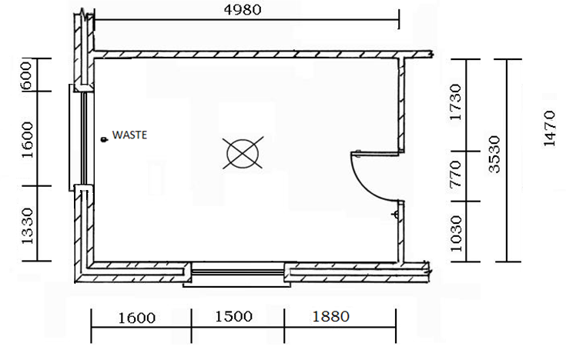
Kitchen floor plan 1
Example of floor plan showing windows, door waste and lights.

Slide 4
Sketch The Kitchen Plan
Next I want you to sketch the existing units and appliances
Look inside existing presses for pipe work, or obstructions.
Note the direction that doors open.
Mark exact position of all sockets and light switches.

Slide 5
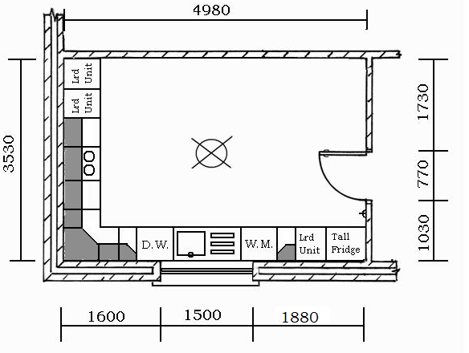
Kitchen floor plan 2
Example of a different room and kitchen floor plan showing base and wall units.

