Slide 1
Principles of Furniture & Joinery Design
Jack, Conor and Gareth.

Slide 2
Introduction
We were tasked to come up with a design for a display cabinet.
Group Project.
Cabinet would display different types of traditional tools donated by Pat Quinn.
Everyone in our group designed their own cabinet.
See the groups individual designs. There were curved elements in one, one was more modern cabinet and the other one was more of a traditional style cabinet.

Slide 3
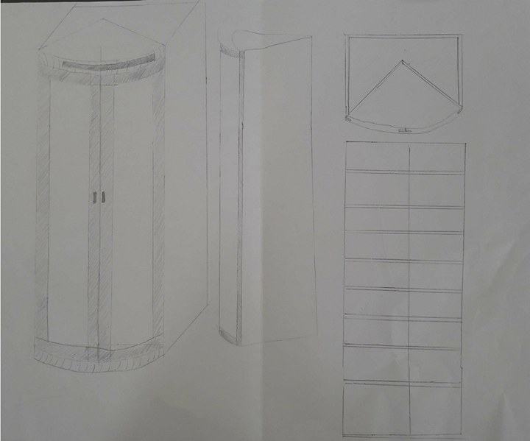
Design 1
Modern and stylish design.
Curved glass to catch the eye of passers by.
A lot of display space.
Storage hidden form the public.
May be unsteady.
Curved glass is very expensive compared to flat glass.
Too modern of a style for where it would be situated

Slide 4
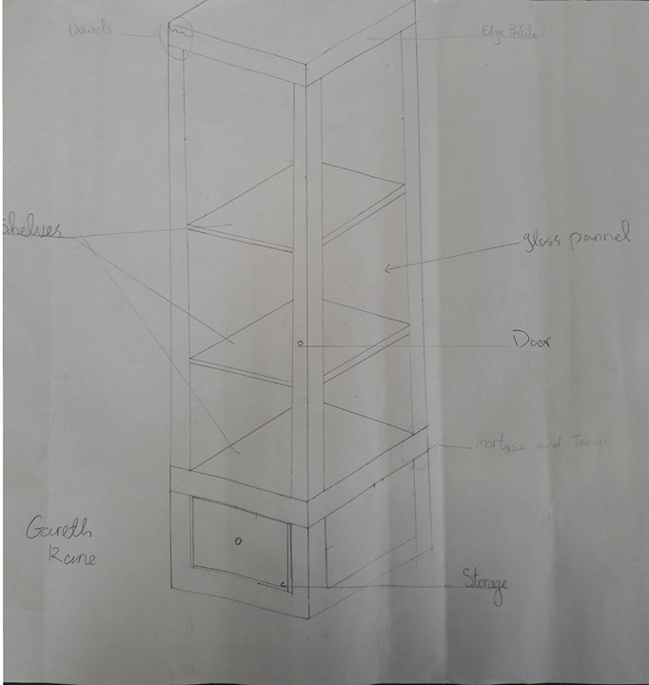
Design 2
It’s a modern style cabinet.
One door, with three glass planes to allow people to view any tools that are inside.
Storage compartment at the bottom to place any tools that couldn’t fit on the shelves.
The style of the cabinet was to modern, Display was too small.
We took the idea’s storage drawer and the idea of the three shelves to put in our final design.

Slide 5
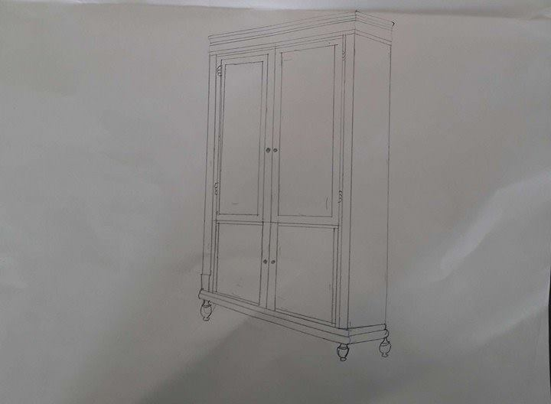
Design 3
Old style traditional cabinet.
Two glass panel doors.
Two veneered press doors at the bottom for storage.
Edge profiles top and bottom, Waterfall and ogee profile for visual effect.
Deign would be to complex to build if given a time frame.
Group liked the idea’s of the mitred doors and the edge profiles, so we put these in the final design.

Slide 6
Timber selection and why
For the type of timber we used is mahogany.
Once a finish is applied to it, it seals the wood to protect it from moisture.
Mahogany is also less liable from warping, shrinking, swelling and twisting when applied with a finish.
When the finish is applied to the mahogany it should make the cabinet stand out wherever the cabinet is placed.

Slide 7
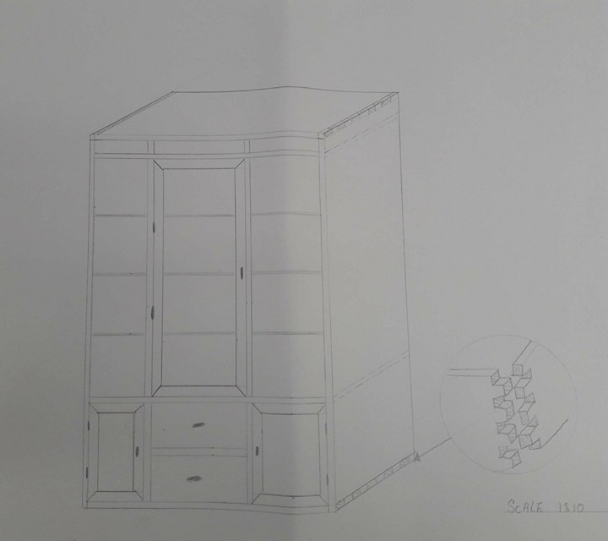
Final Design
Group decision this would be the cabinet we run with.
Felt as thought this cabinet would suit the room were the cabinet is being situated.
Drawers will have lap dovetails at the front of the drawer which will be visible to the public eye
It includes a large viewing area as well as a small compartment for storage.
The storage consists of two drawers that are relatively big
Either side of this we also have presses in which have shelves for smaller tools.

Slide 8
Principles of Furniture & Joinery Design
Thank you For listening,
Any Questions ??

