Slide 1
Display Cabinet Design
Client: Mark Deegan, Head of Apprenticeship and Engagement
& Orna Hanly, Head of School

Slide 2
Brief
Display cabinet
Pat Quinn
Location

Slide 3
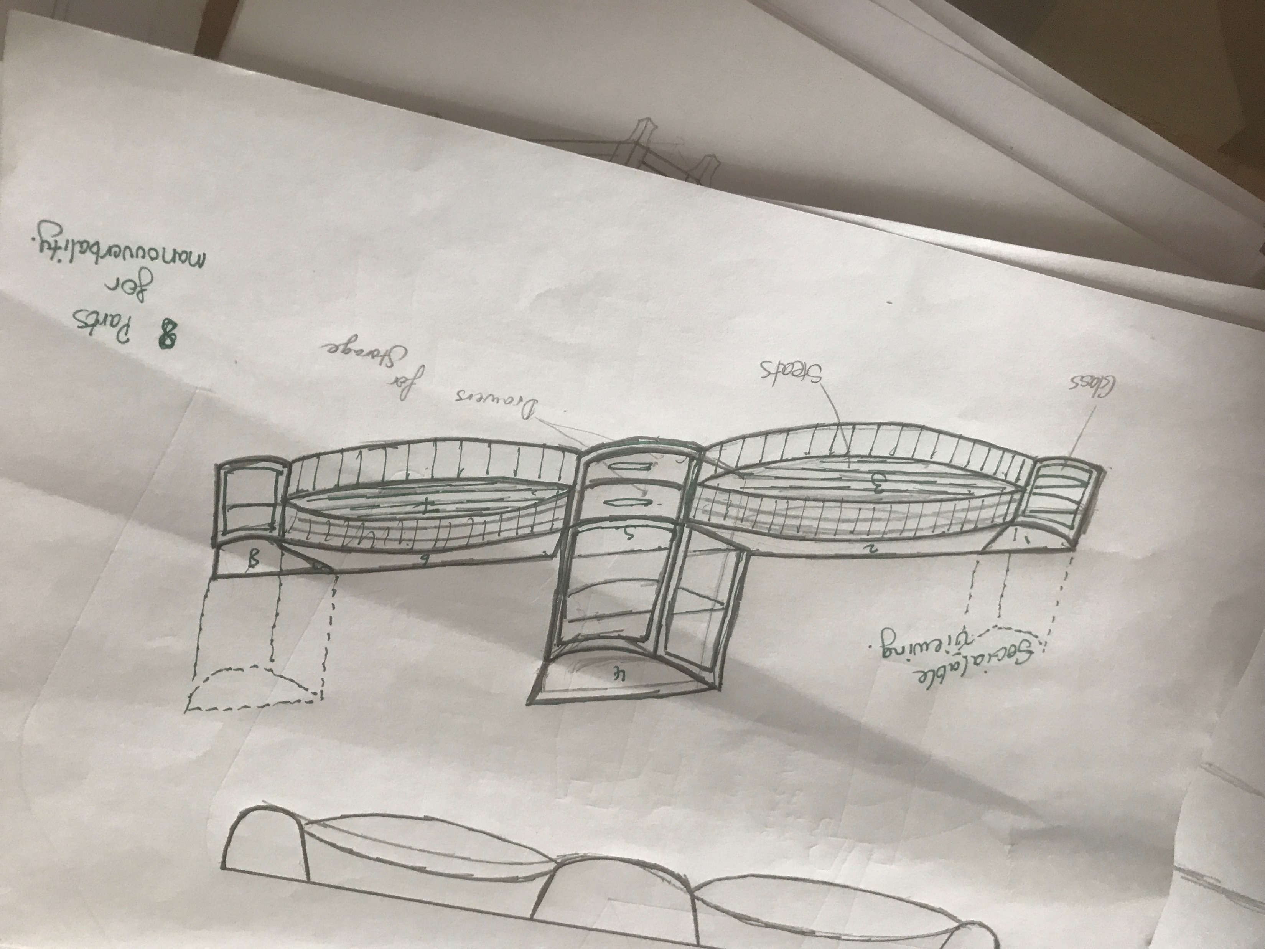

James’ sketch

Slide 4
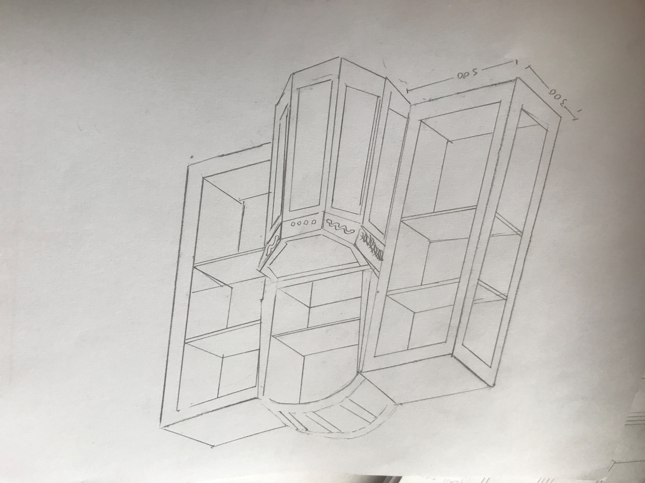
Padraig's sketch

Slide 5
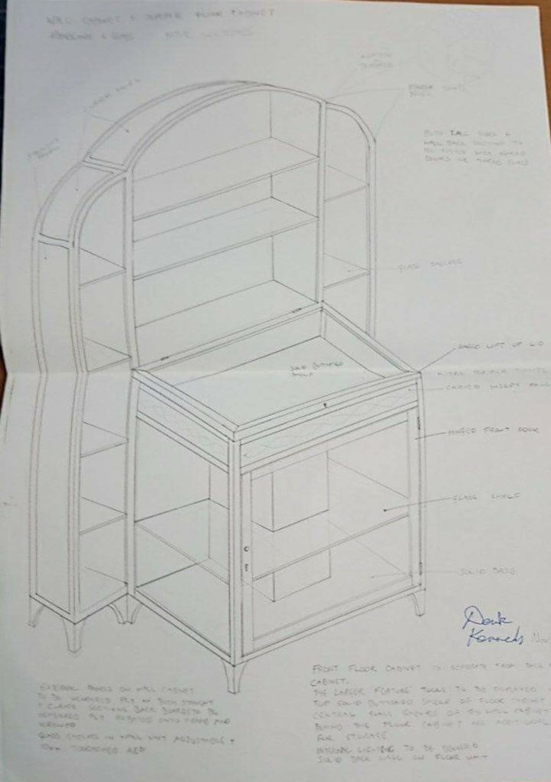
Derek’s sketch

Slide 6
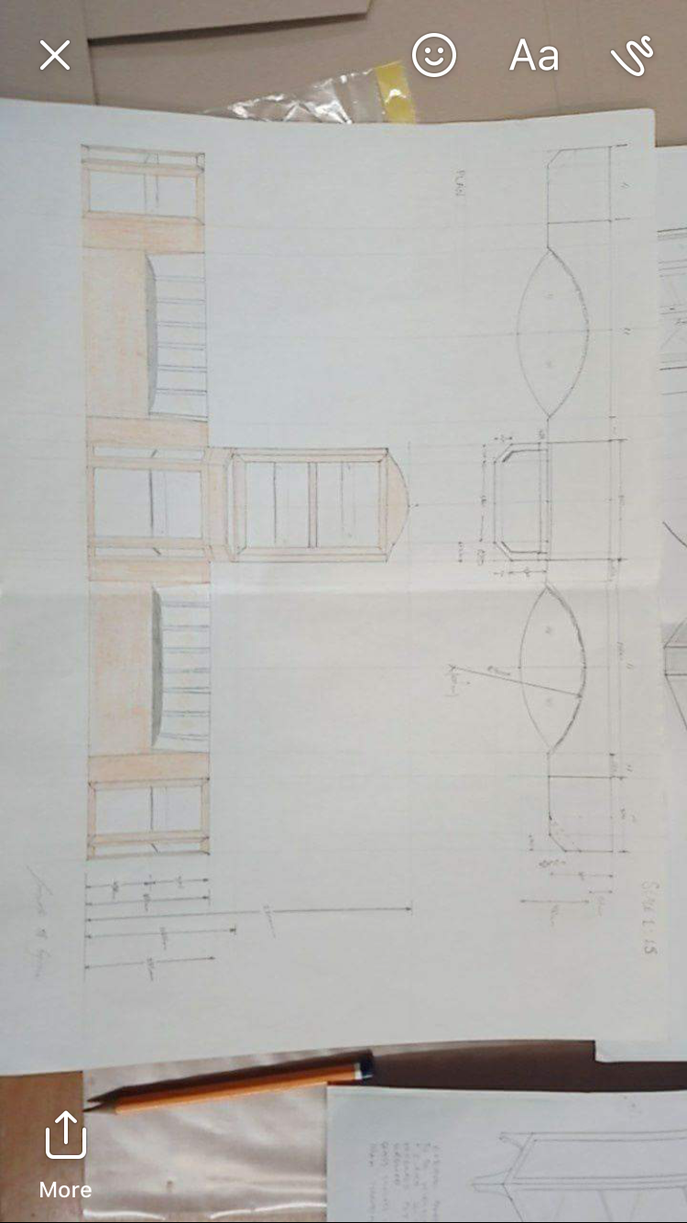
Plan and Elevation

Slide 7
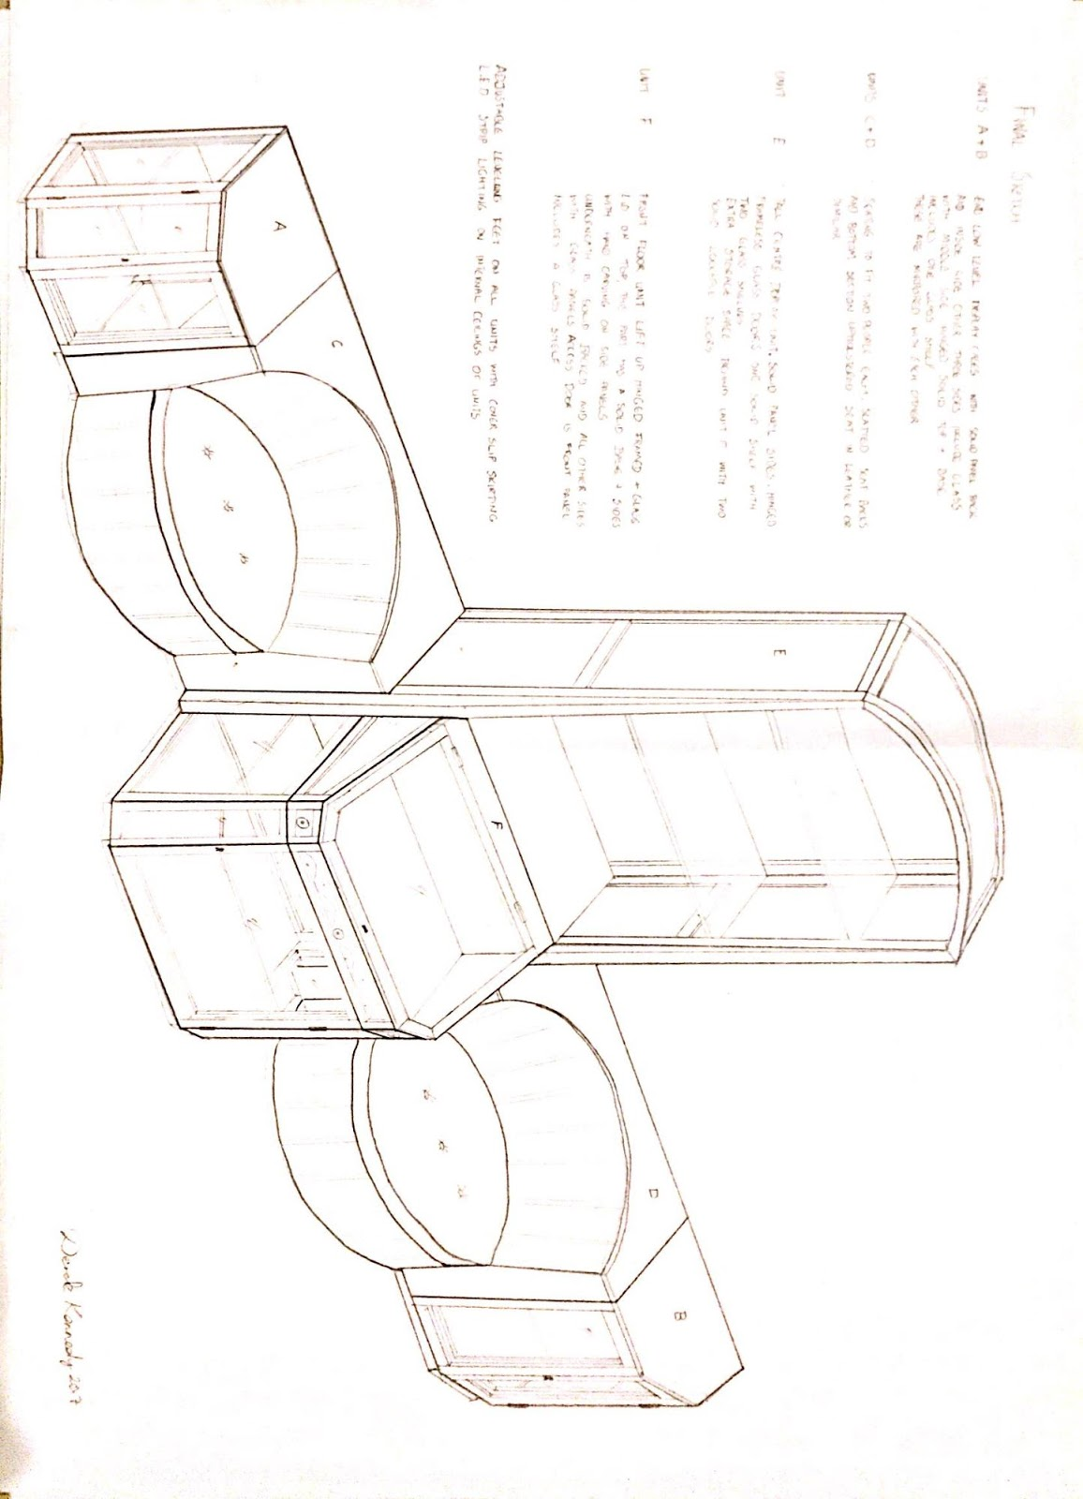
6 separate units
Inspiration
Two seating
Interchangeable
Mahogany

Slide 8
Closing
We believe we fulfilled the brief
Happy with our design
Great learning outcomes in the manufacturing

