Slide 1
Harry Walker, Elysia Taylor
& Stefan Jennings.
A Display Cabinet to
display various traditional wooden hand tools
donated by Pat Quinn
to the
Dublin School of Architecture.

Slide 2
Overview of Presentation
Stefan - Introduction & Conclusion
Elysia - Research and Initial ideas
Harry – Final design and design Features

Slide 3
Project Aim
“appreciate the various stages of the design process. Demonstrate an understanding of the theoretical elements and their application as required in the construction of furniture.”

Slide 4
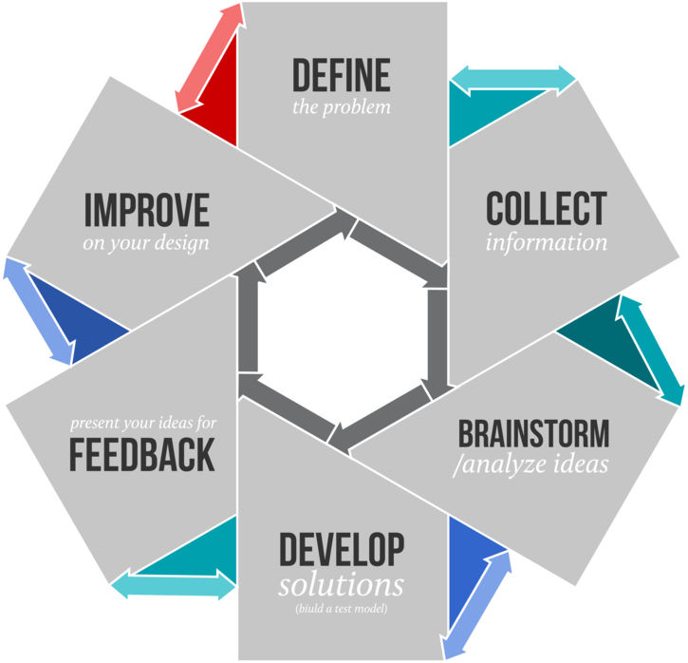
The Design Process

Slide 5
Elysia Taylor with:
Research and Initial ideas

Slide 6
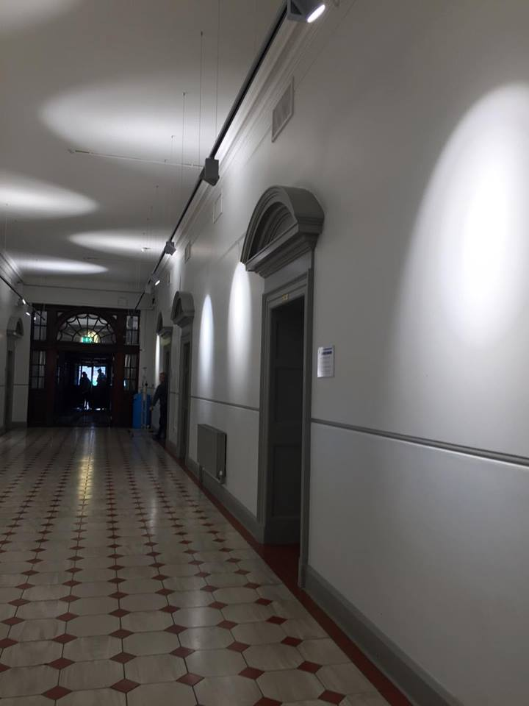
Meeting with Mark Deegan
We began with a informal meeting to discuss the display cabinets desired features and here are some of the key points that arose:
A variety of tools will be displayed including small & large tools.
Arches in the location.
The depth is important.
Workmanship.
Made within the next year.
Solid timber preferred.
The lighting .
The budget is flexible.

Slide 7
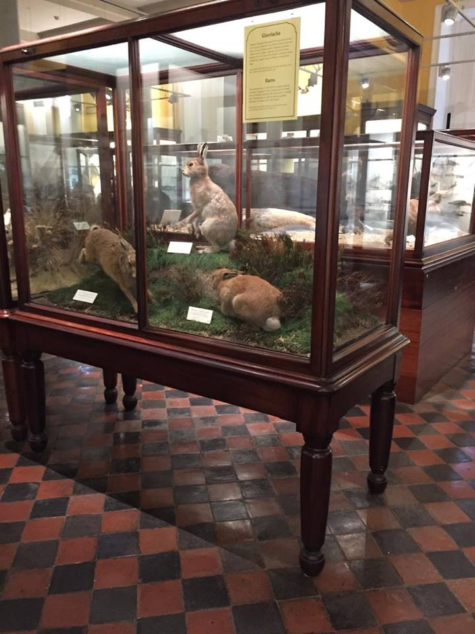
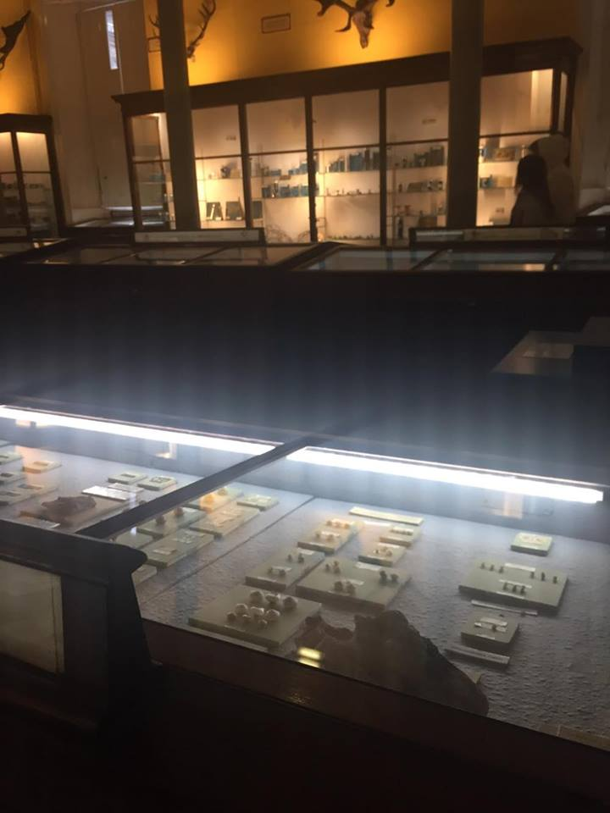
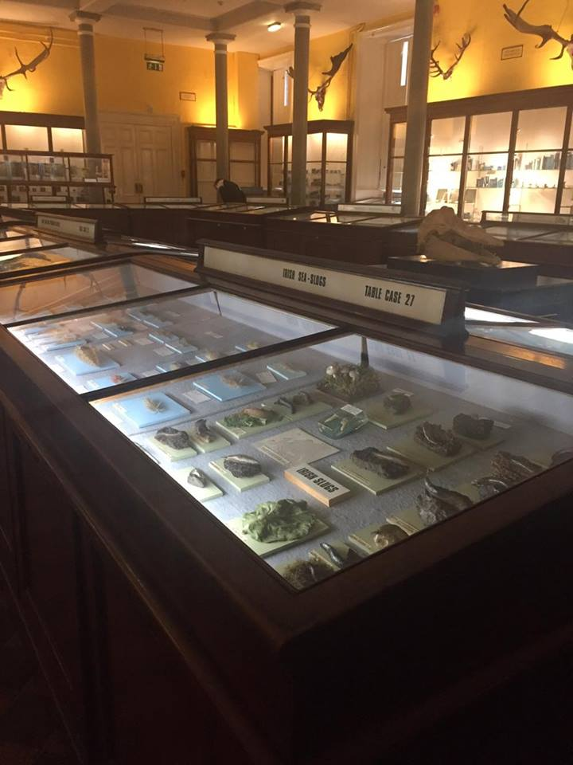
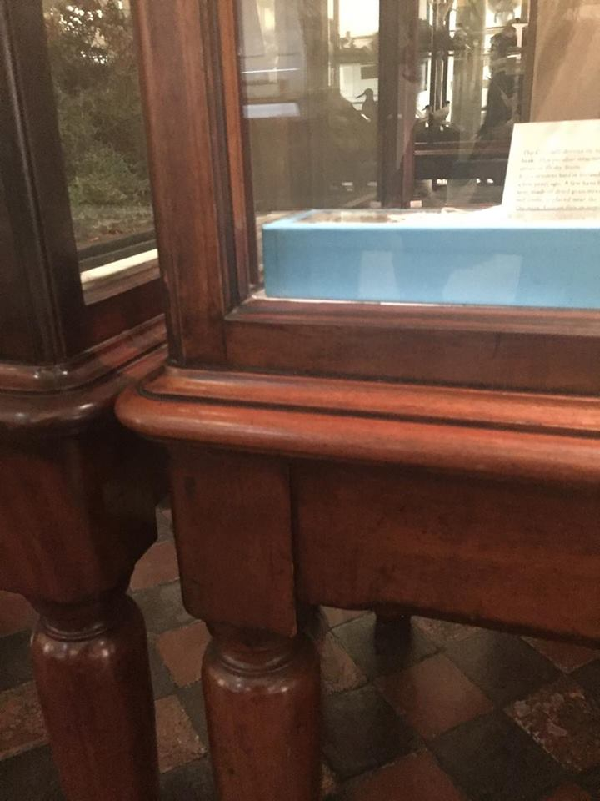
Research
A selection of cabinets on display at the
National History museum.

Slide 8
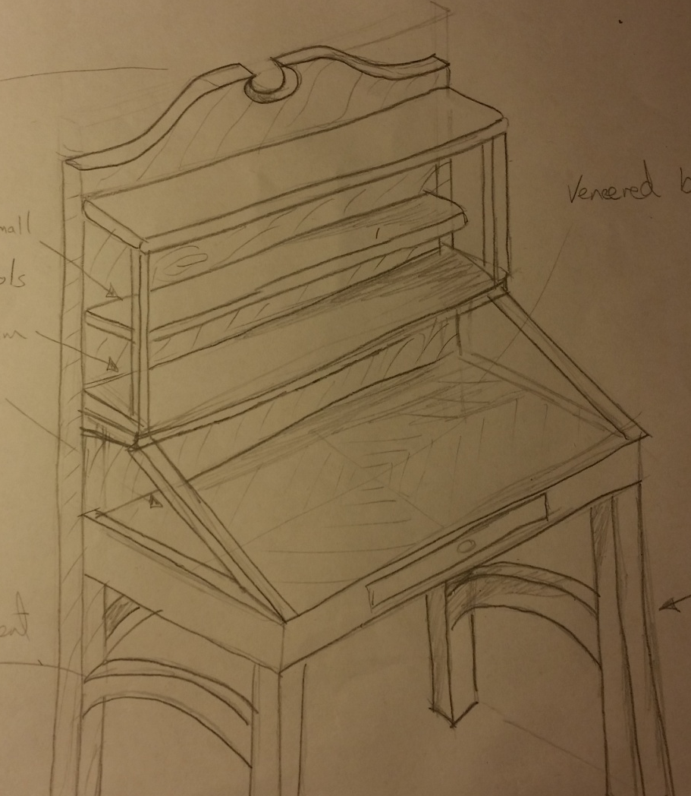
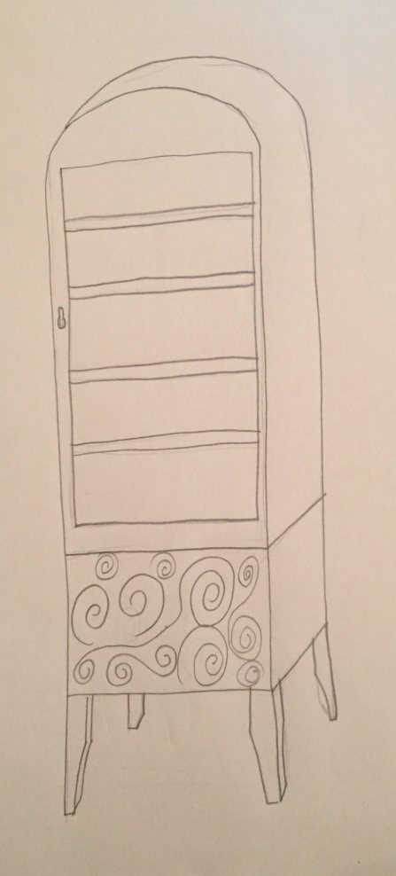
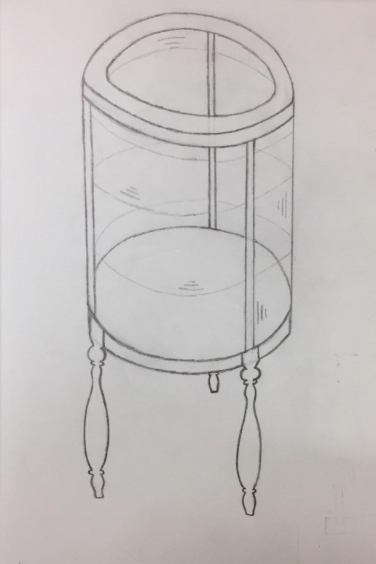
Initial ideas

Slide 9
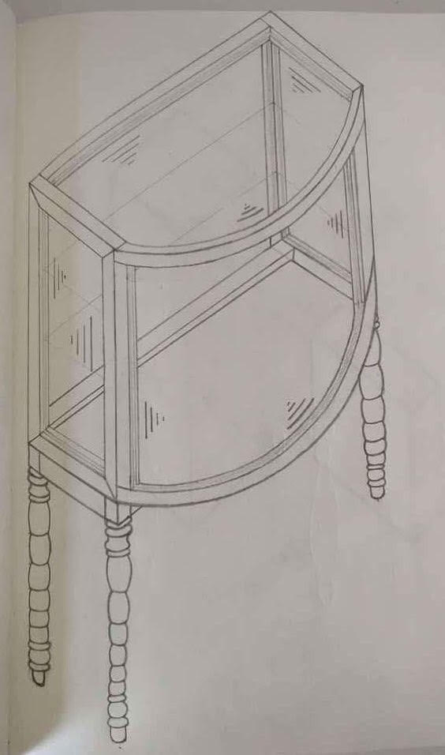
Final design
      We decided on a curved front shape
      cabinet with the following features:
Both the sides will be straight with a flat back so that it can sit flush against the wall.
The cabinet will be made out of an ash frame, as well as the wood turned legs.
The cabinet can be access from the sides, which will have a door with a lock.
A set of LED lights will be inserted to the back.

Slide 10
Harry with:
Final design and design Features

Slide 11
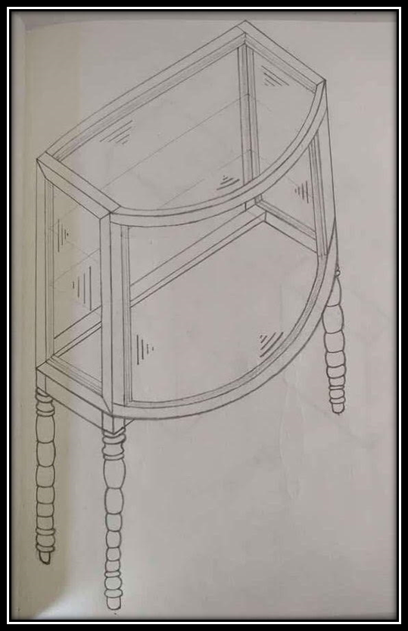

Slide 12
Thank you for your time
We’ll be happy to answer any questions you have

