Slide 1
20th Century
Furniture Designers and Architects
Eero Aarnio 1960’s
Finland

Slide 2
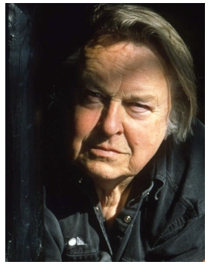
Eero Aarnio 1932 -
Eero Aarnio was born in Helsinki, Finland in 1932. He graduated in 1957 from the Institute of Industrial Arts, Helsinki.
Aarnio embraced the new material production processes that were available from the late 1950's onwards.
In the 1960s, Eero Aarnio began experimenting with plastics, vivid colours and organic forms, breaking away from traditional design conventions.

Slide 3
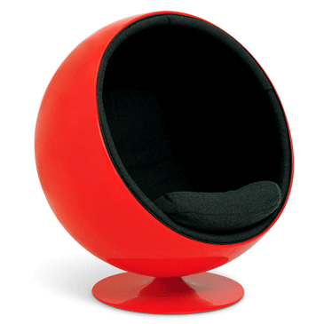
The Ball Chair
He believed that designers should use the most up to date technology possible.
His design concepts were well ahead of his time and he didn't follow any predetermined style. He created a path for others to follow.
The ball Chair 1963 has featured in many . Movies.
Ball Chair 1963

Slide 4
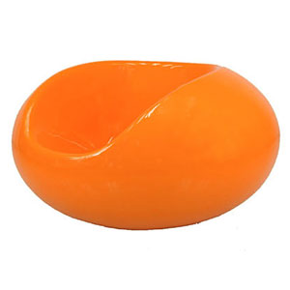
The Pastil Chair
He believed that designers should use the most up to date technology possible.
His design concepts were well ahead of his time and he didn't follow any predetermined style. He created a path for others to follow.
The Pastil chair provided him with an American Industrial Design Award in 1968.
Made from moulded fibreglass this chair appears to float above the floor. It has a glasslike finish.
Pastil Chair

Slide 5
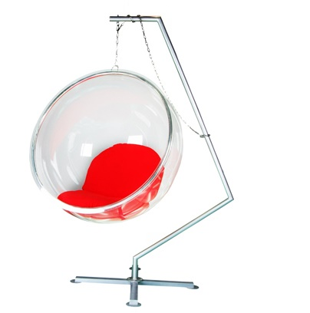
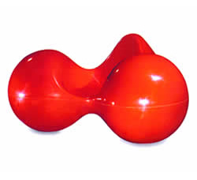
Eero Aarnio Chairs
Bubble Chair 1968
Tomato Chair
Aarnio’s works are on display in the world’s
most prestigious museums, including
Victoria and Albert Museum in London,
MoMA in New York and
Vitra Design Museum in Weil am Rhein.

