Slide 1
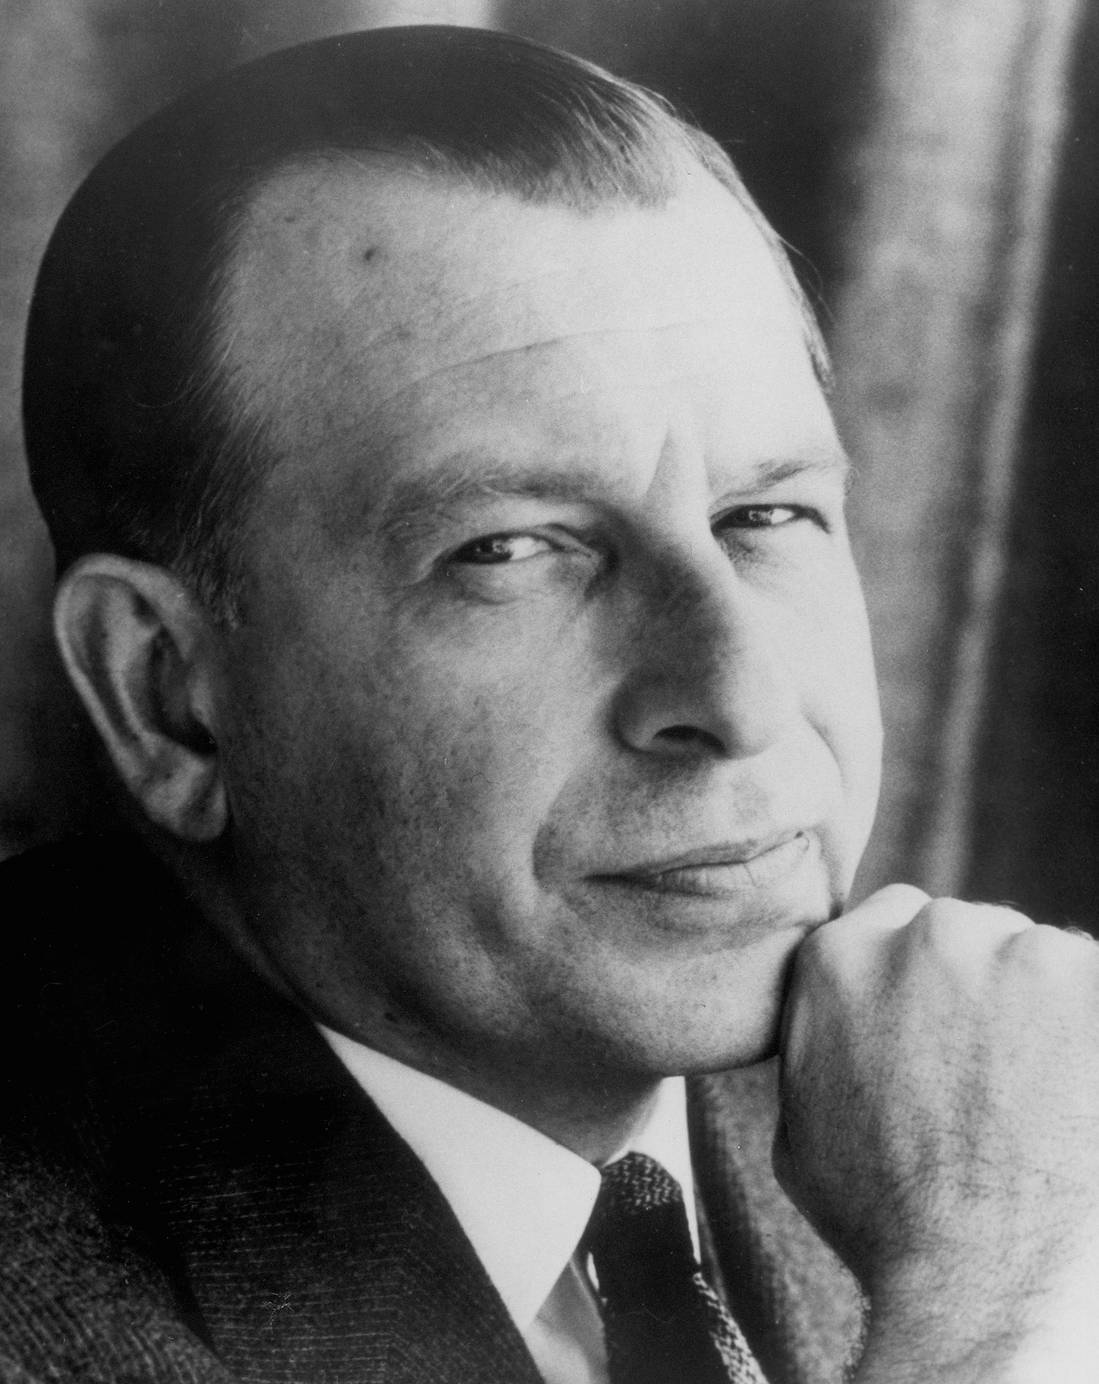
Eero Saarinen
Born 1910 Finland

Slide 2
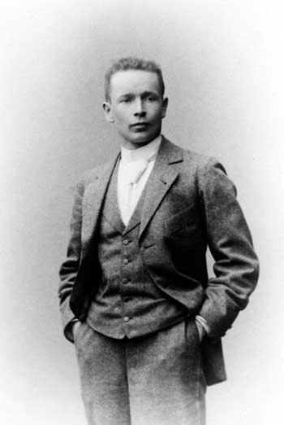
Eliel Saarinen

Slide 3
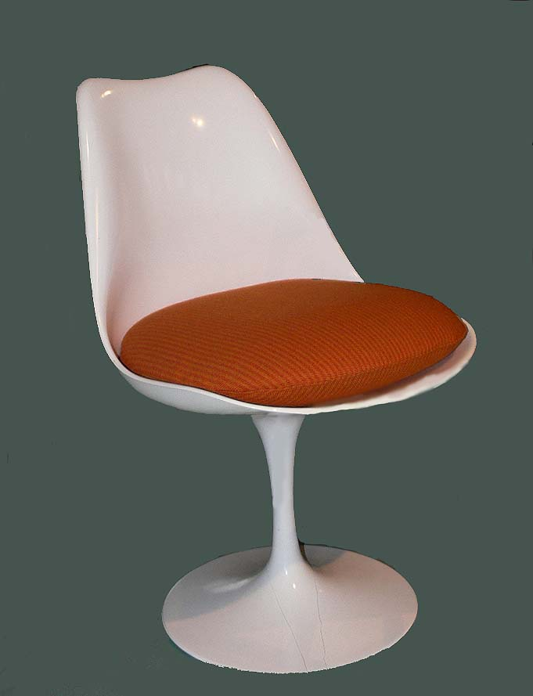

Slide 4
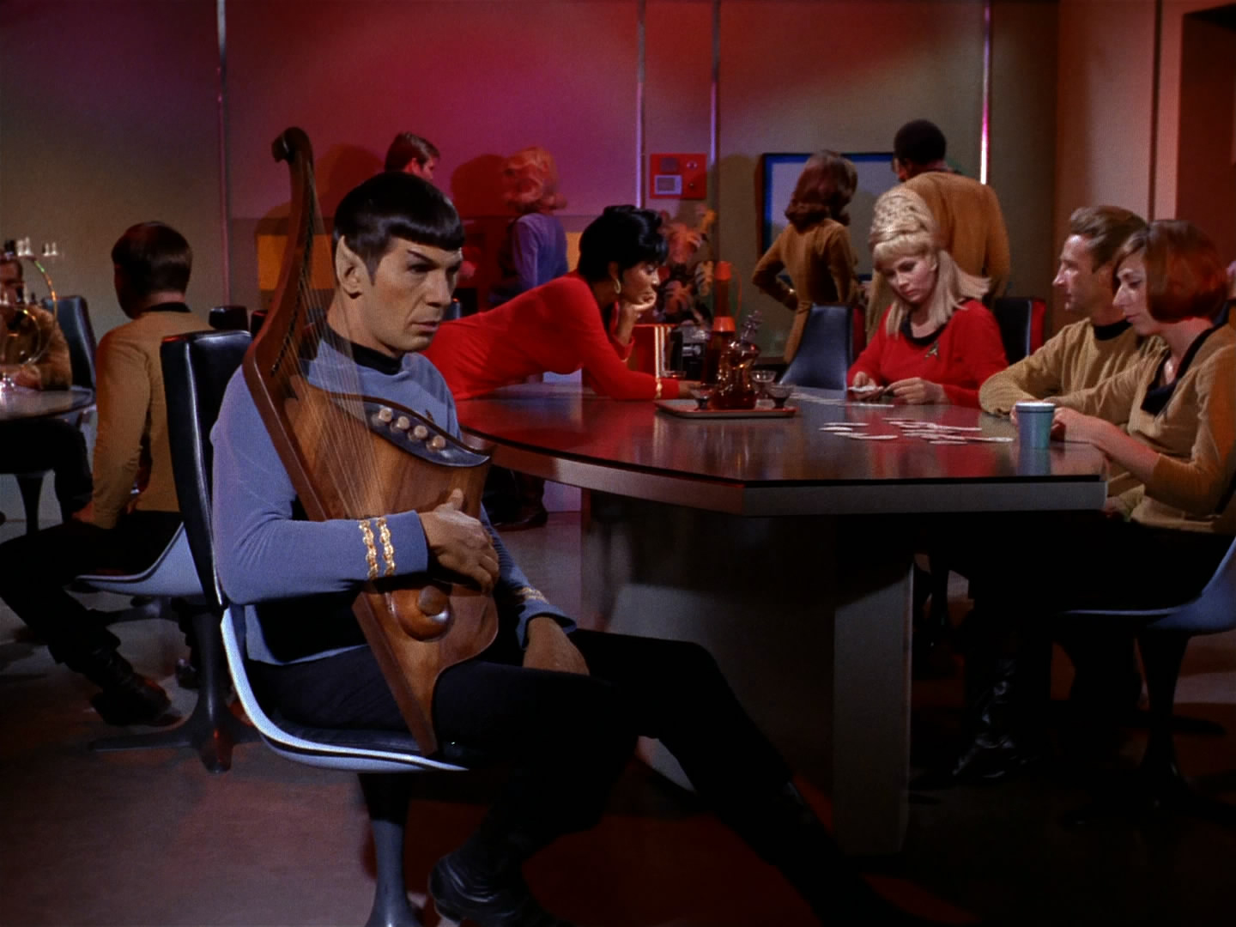
Star Trek

Slide 5
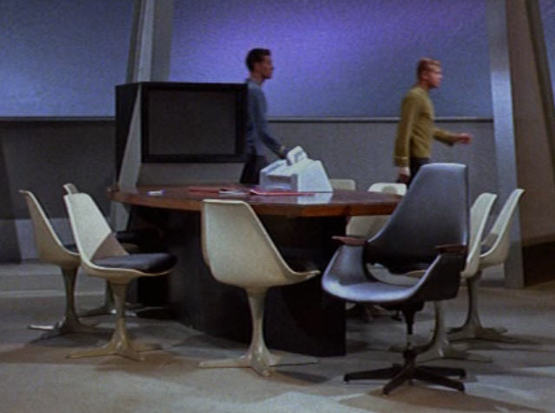

Slide 6
Early Saarinen
(1930-1931) Studied sculpture at the Academie de la Grande Chaumiere, Paris.
(1934) Earned a bachelor of fine art degree from the School of Architecture at Yale University.
Travelled the world working on various projects.
Began working for his fathers business.

Slide 7
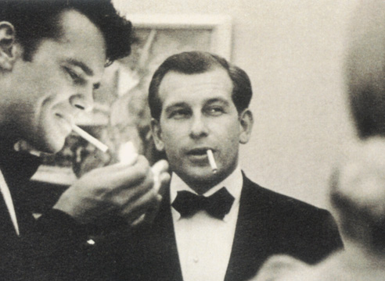
Cranbrook Design Shop
Charles Eames

Slide 8
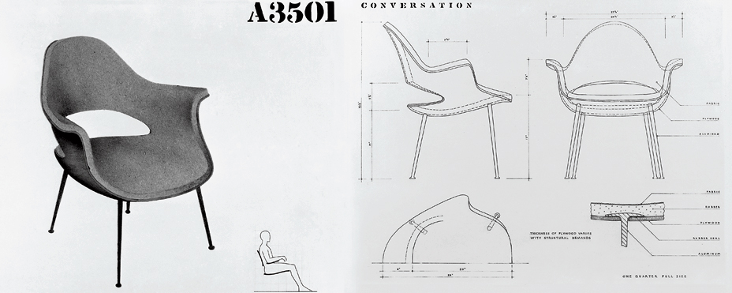
Organic Chair (1940)

Slide 9
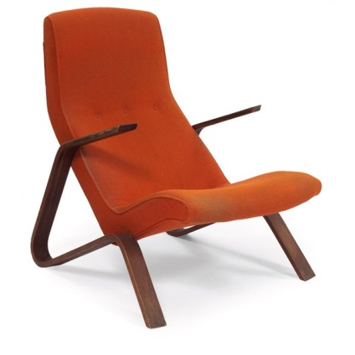
Grasshopper Chair (1946-1965)

Slide 10
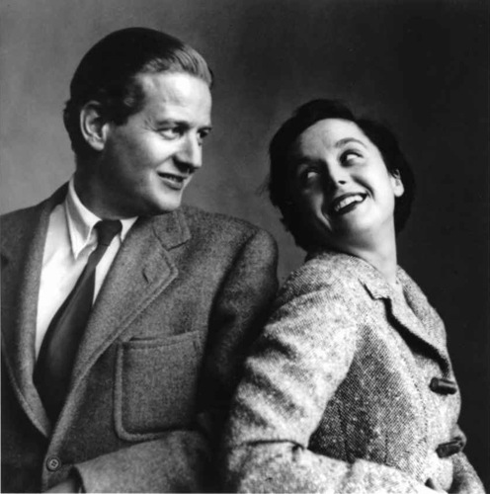
Hans Knoll & Florence Schust

Slide 11
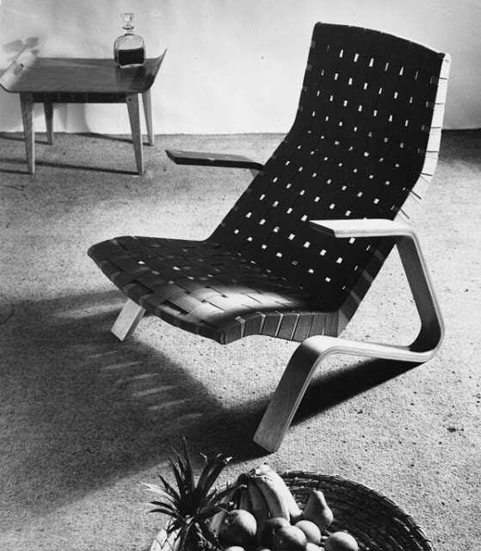

Slide 12
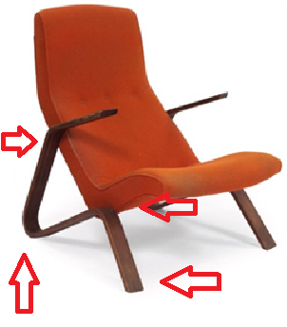
Innovative Design

Slide 13

Womb Chair (1948-Present)

Slide 15
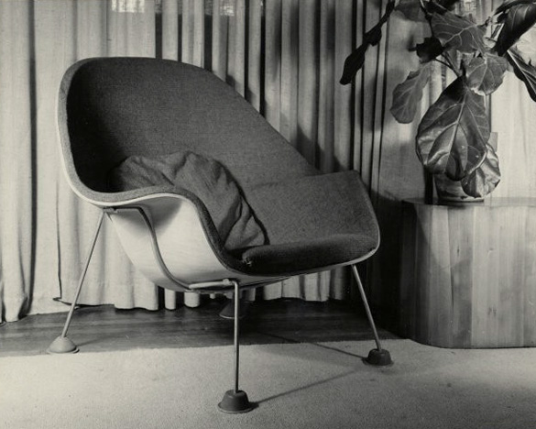
Prototype with formed plywood shell

Slide 16
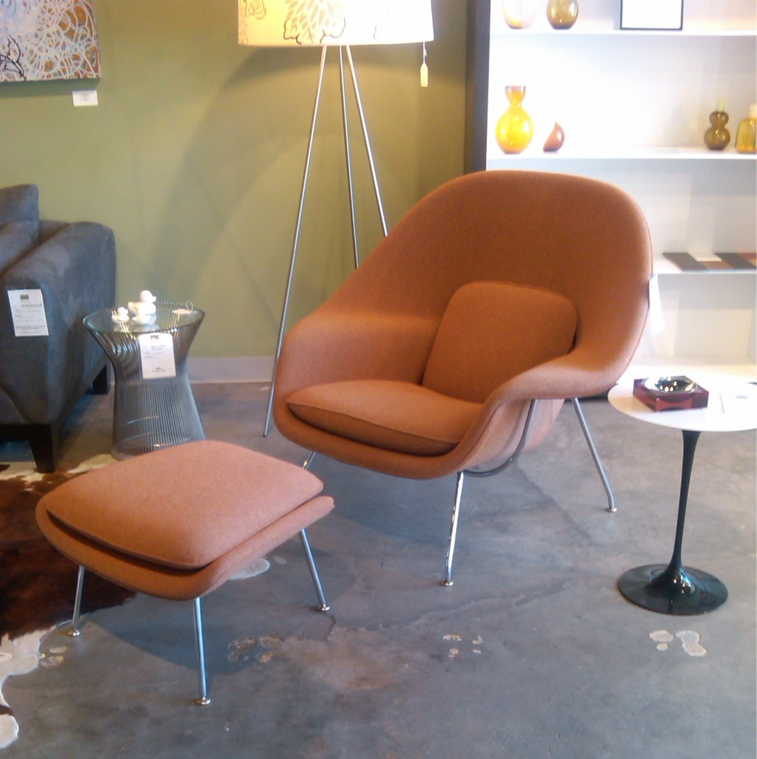
Modern upholstered fibreglass shell

Slide 17
Tulip Chair (1955-Present)

Slide 18
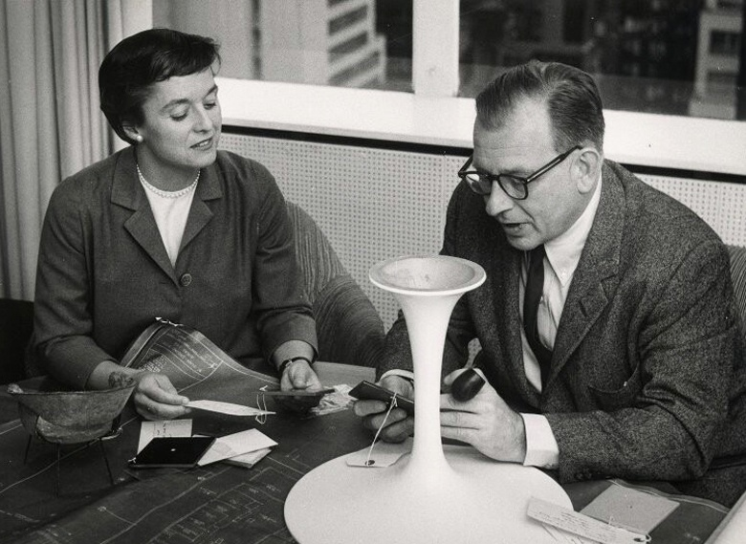
Florence Schust

Slide 19
needed to be comfortable for all body types.
contemporary materials were to be used.
needed to fit into many environments in order for it to be mass produced.
it had to address the problem of chair legs.
(Lutz, 2012, p. 159)

Slide 20
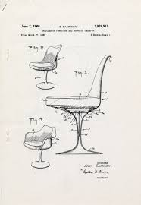

Slide 21
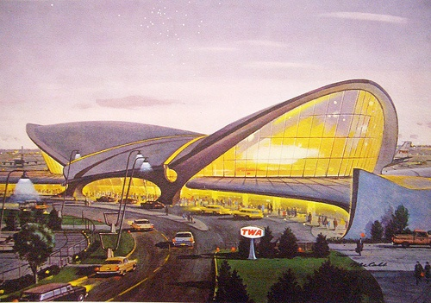
TWA terminal in New York

Slide 22
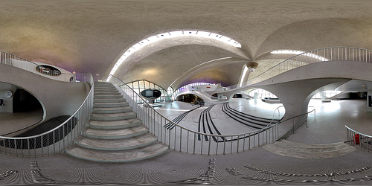

Slide 23
Cast aluminium leg
Moulded fibreglass shell finished in a fibreglass resin.
Upholstered foam cushion
Return mechanism
(Eero Saarinen Design Archive, 2014)

Slide 24
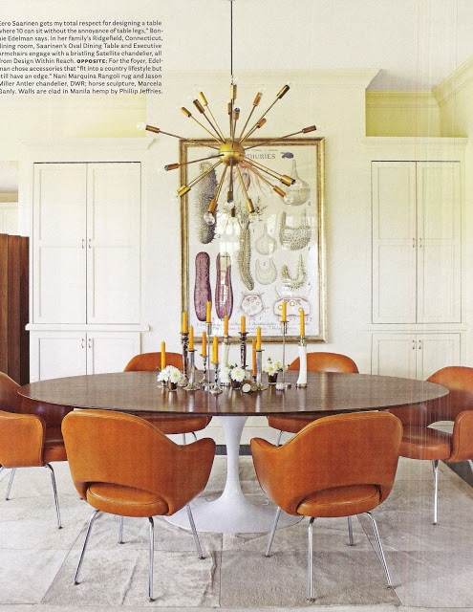
Pedestal Collection

Slide 25
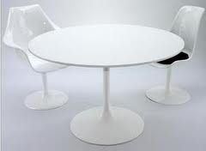

Slide 26
The End

