Slide 1
Fixtures
&
Fittings
Traditional Fixtures & Fittings

Slide 2
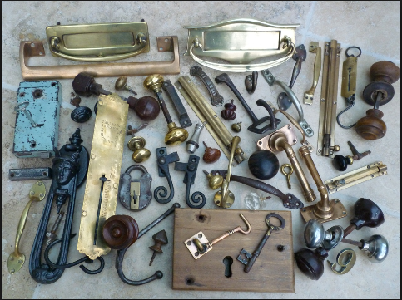
Fixtures & Fittings

Slide 3
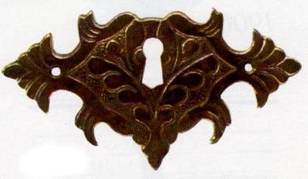
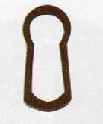
Escutcheons
An escutcheon An escutcheon is a small decorative metal plate used to surround a keyhole cut in timber. Most escutcheons are pinned to the surface, but there are also small unobtrusive recessed versions.

Slide 4
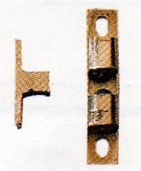
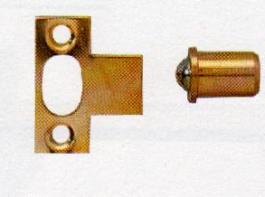
Ball Catch
This catch comprises a spring loaded steel ball trapped in a cylindrical brass case that is inserted in the edge of a cupboard door. When the door is closed the ball springs into a recess in a metal striker plate screwed to the carcase.

Slide 5
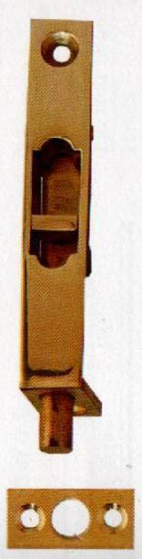
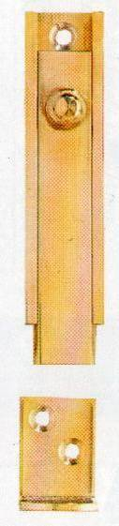
Door Bolt
On a twin door cupboard, one door is often fitted with a pair of neat surface mounted or flush bolts and the other with a lock or catch.

Slide 6
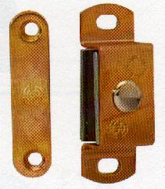
Magnetic Catch
Small-encased magnets are screwed to the inside of a carcase side panel or located in a hole drilled in its edge. The magnet attracts a flat metal striker plate fixed to the cupboard door.

