Slide 1
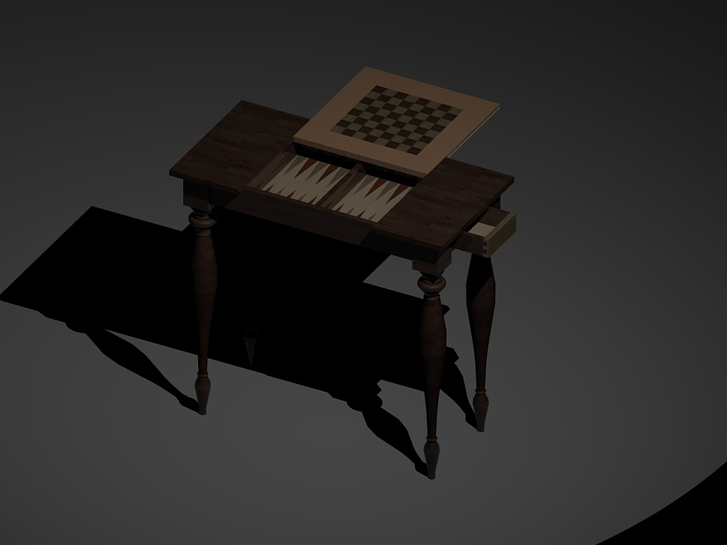

GAMES TABLE
Nathanael O’Hara

Slide 2
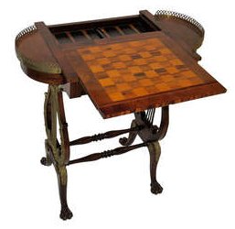
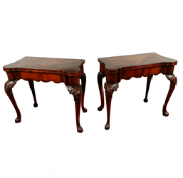
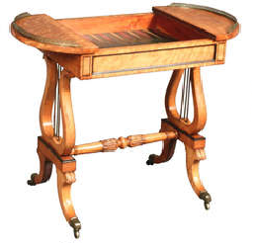
IDEAS
Researched Games Tables
I decided to merge the designs into something I liked and also could work with.
(www.1stdibs.com)

Slide 3
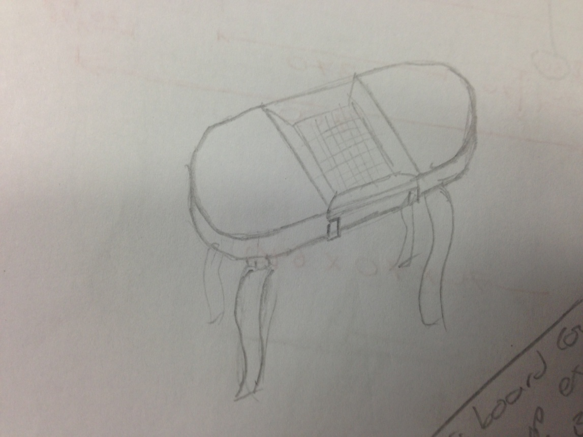
1st concept Ideas
I combined the designs I researched
I did not like the round top so I changed it to a rectangle shape

Slide 4
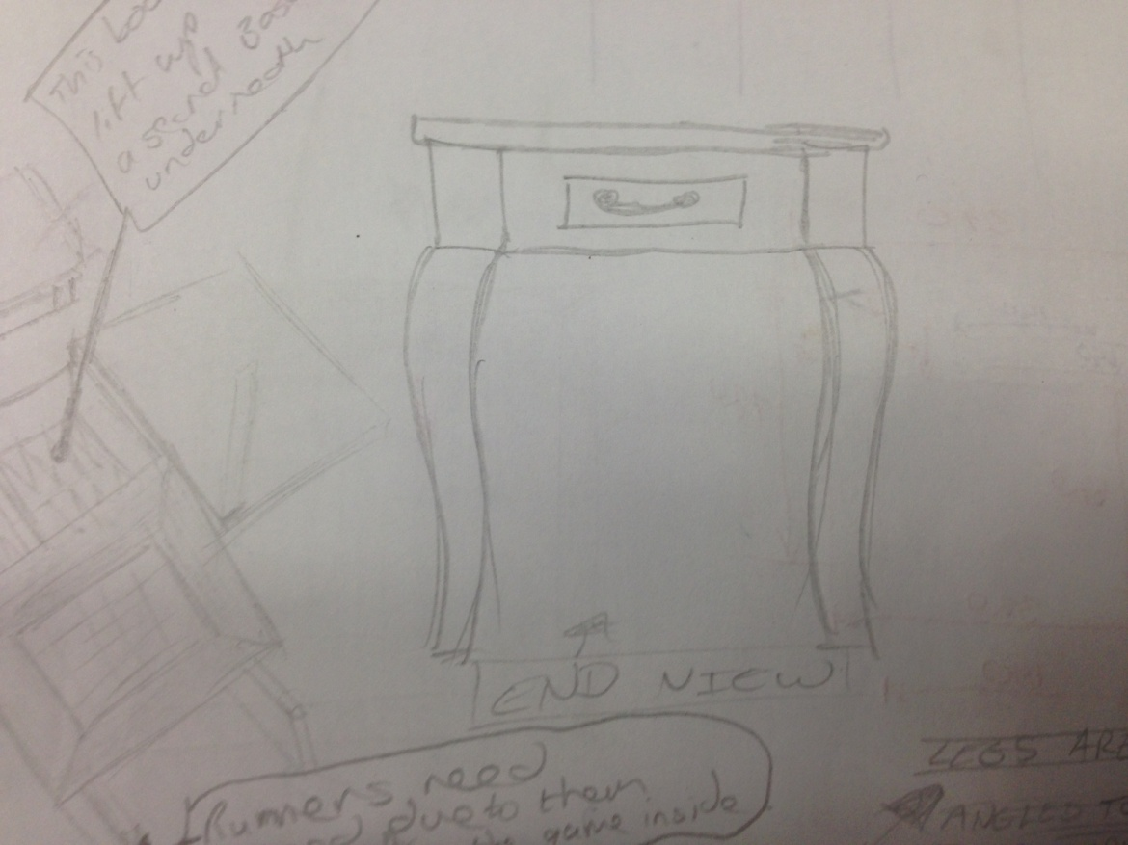
Idea Advancing
After analysing my current design I realised that the leg design was too complicated
So for the sake of time I changed the legs to a design that was still nice but could be done in time allocated

Slide 5
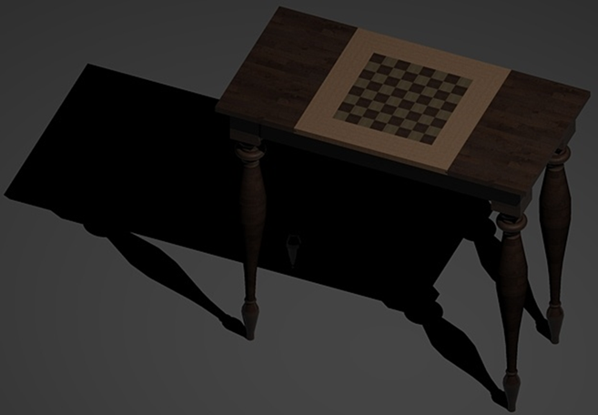
Final Design
I decided to turn the legs
I also think that I will keep the two small drawers on the sides of the table.

Slide 6

Manufacture
I plan on utilising as many of the hand held power tools and machines available to me and combine them with my hand skills to manufacture this piece.

Slide 7
Finishing
For the finish I propose applying two coats of nitrocellouse base coat and one coat of PC satin finish lacquer.

Slide 8
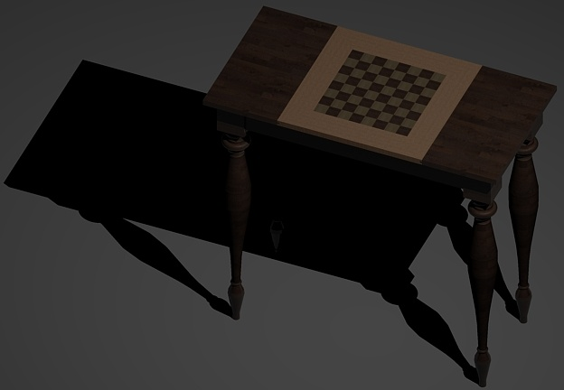
The End
Thank you for listening
Any Questions

