Slide 1
Games Table
By Ciaran Walshe
Timber Product Technology – 2nd year

Slide 2
Introduction
As part of our “ Principles of furniture & joinery” and “Bespoke Machining” modules ,we were required to design and make a games table.
The only design requirement was that the table incorporated the chessboard box.
All other element were our own individual designs.
This was a chance to design and manufacture my own furniture piece.

Slide 3
Stages of Games table production:
From start to finish there were really three main stage of producing the games table .
Design
Planning production
Manufacturing

Slide 4
Design stage

Slide 5
Concept of design
During my design process I took it into consideration that the table would be a centre piece to a room.
Designed for a social environment, not competitive.
Function as a table while not being used for games.
An opportunity to try different methods of joining timber and mixing materials

Slide 6
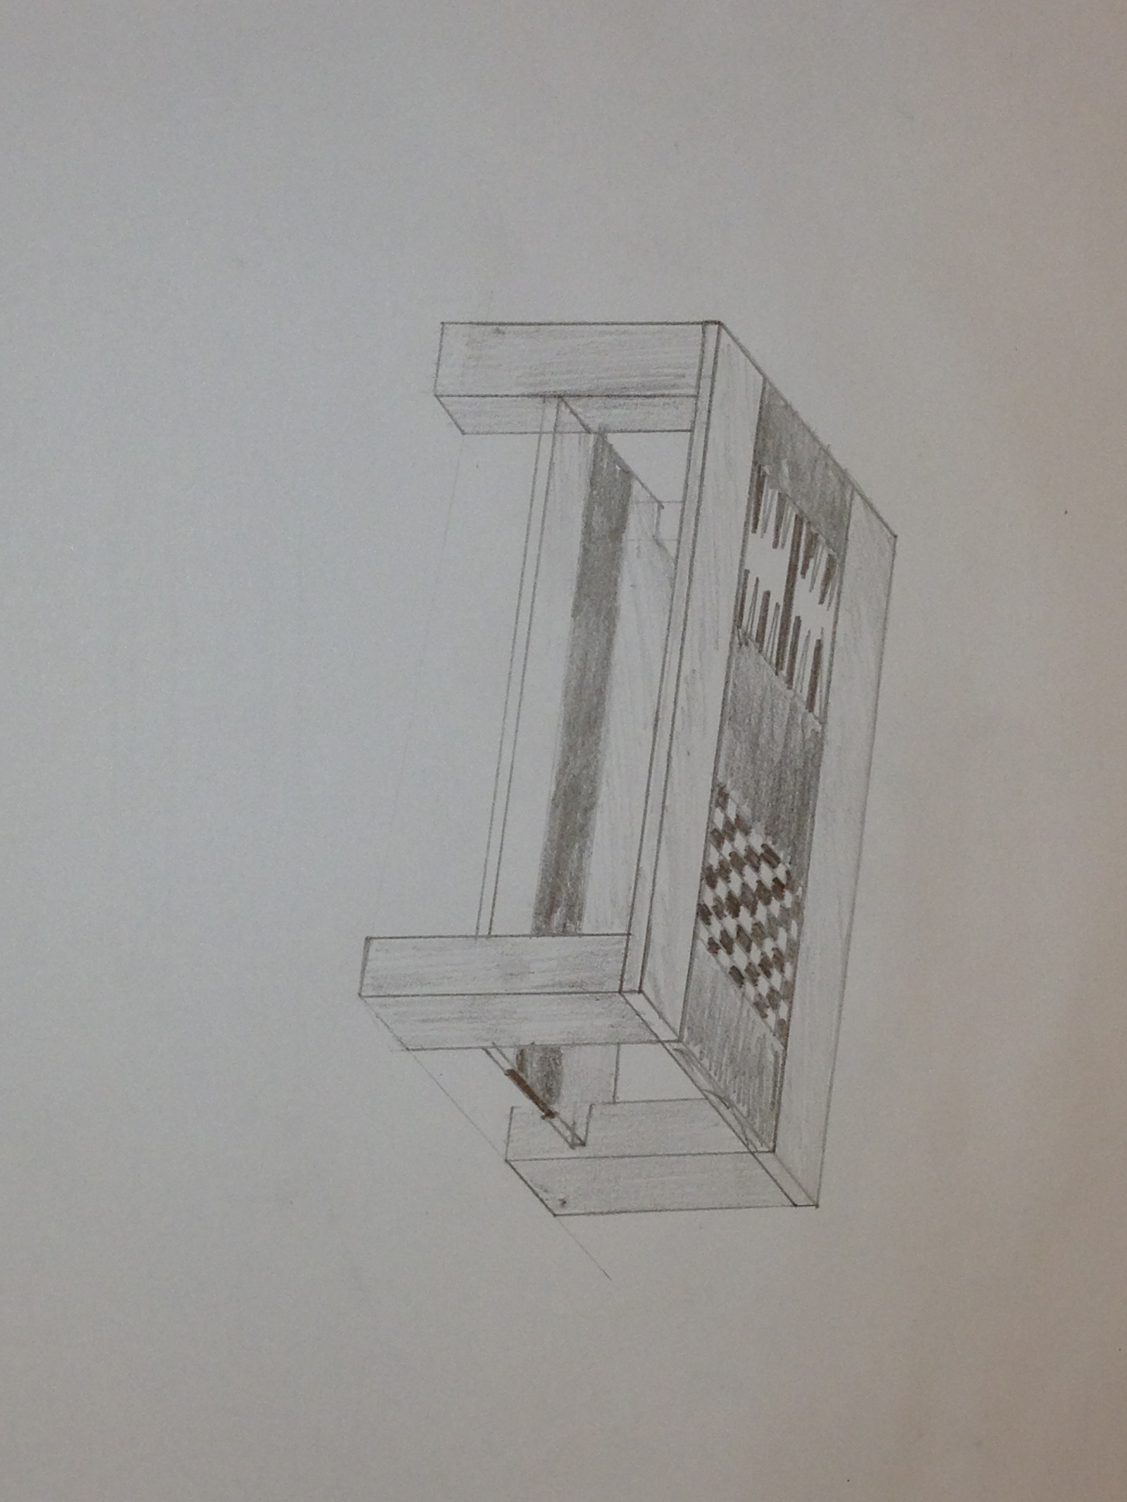
Design Idea 1

Slide 7
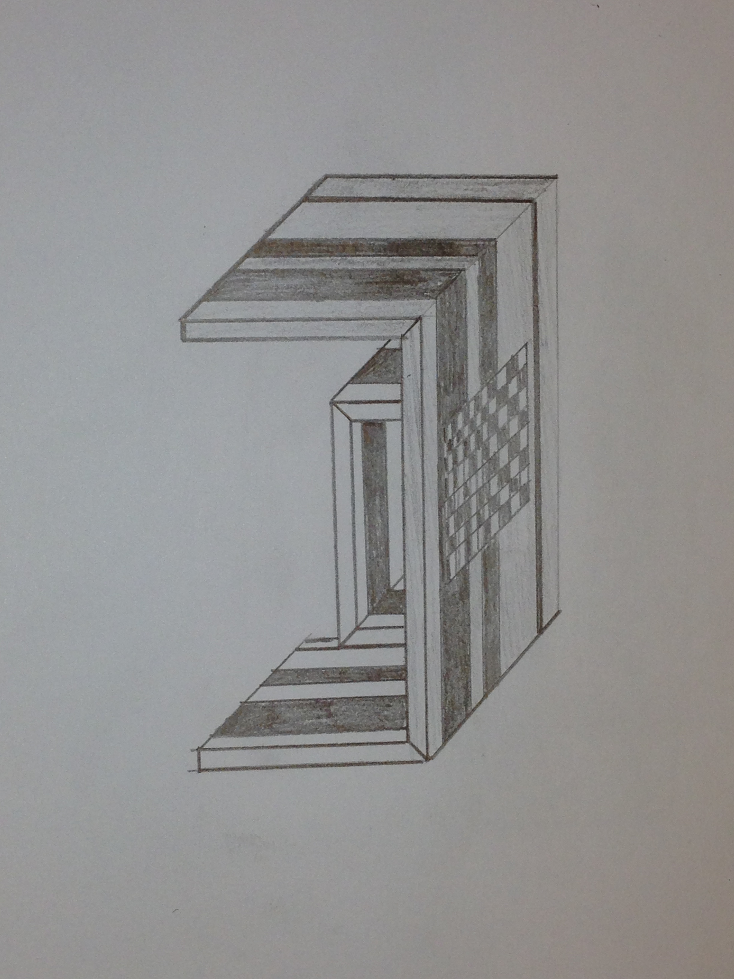
Design Idea 2

Slide 8
Final design

Slide 9
Planning production stage

Slide 10
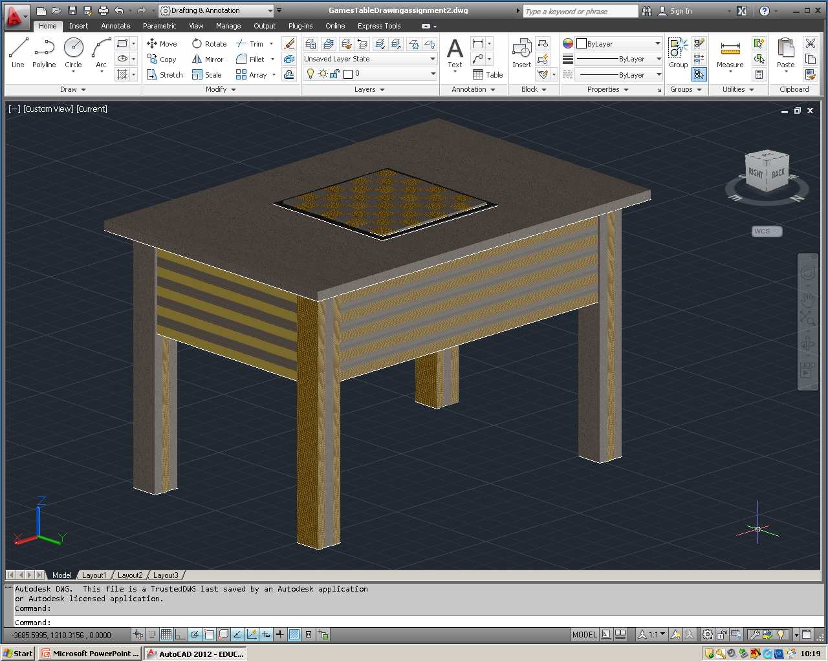
AutoCAD drawing of table
Created to scale

Slide 11
Cutting list
Legs
Rails

Slide 12
Manufacturing stage

Slide 13
Production of the legs

Slide 14
Production of the Rails

Slide 15
Production of the table top

Slide 16
Creating solid chessboard

Slide 17
Reflection

Slide 18
Thanks , any questions?
Ciaran Walshe
C12459032@mydit.ie

