Slide 1
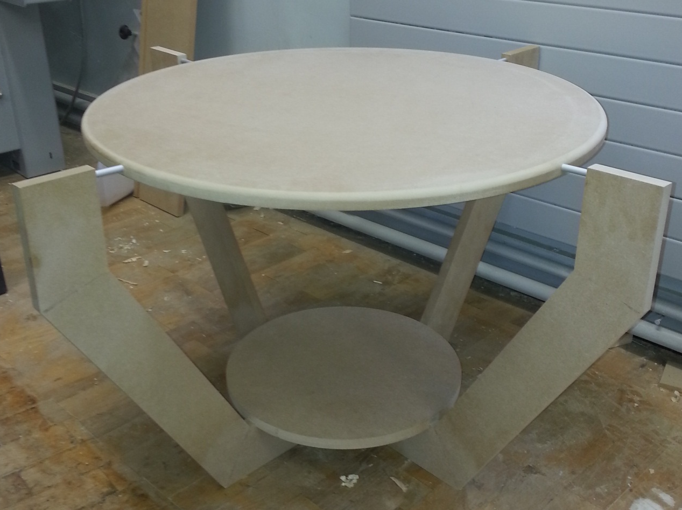
The Butterfly Table
Gary Weir 2014

Slide 2
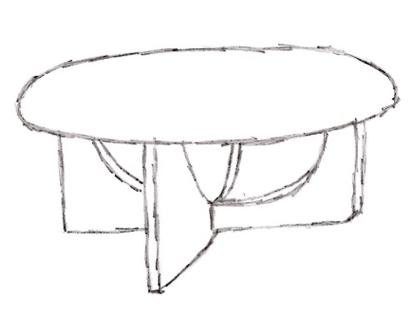

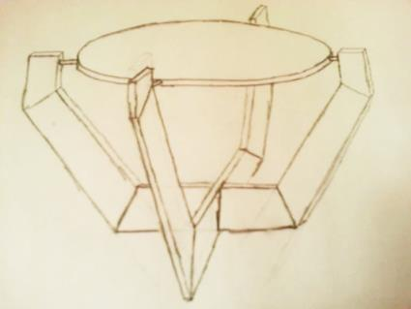
Thought Process
Nice and simple design.
I thought it looked a bit too square.
Has a more unique look.
Legs are a potential trip hazard.
This idea looked unusual and unique.
Relatively straightforward construction.
Little waste from half of the MDF sheet.

Slide 3
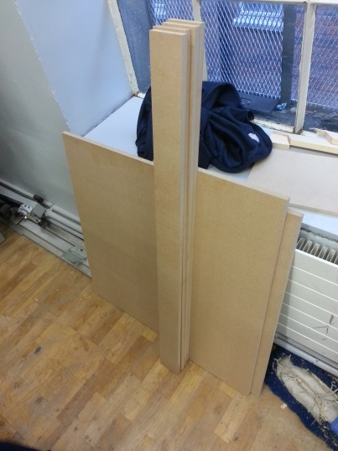
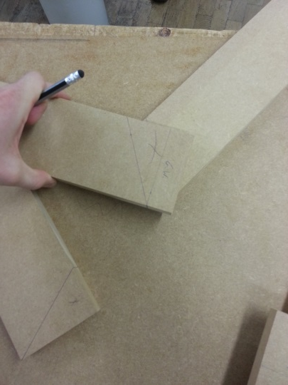
Construction Process
I cut necessary pieces from the half sheet.
I marked and cut the length and the angles of my legs.

Slide 4
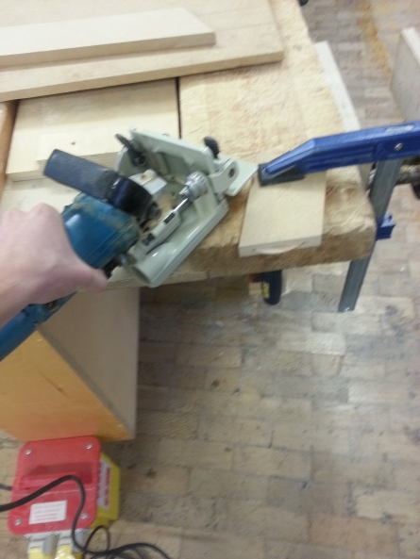
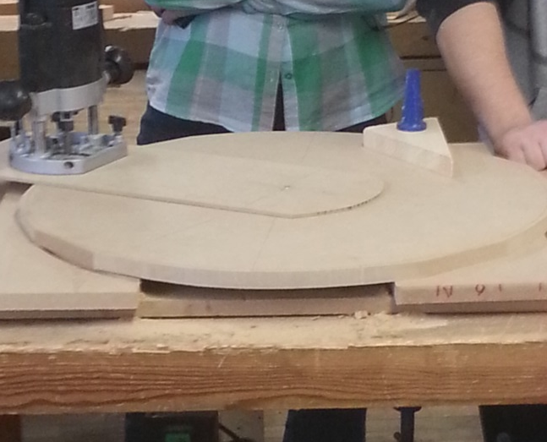
Biscuits were used to connect the legs together.
Circle cutting jig used to cut my table top and shelf.

Slide 5
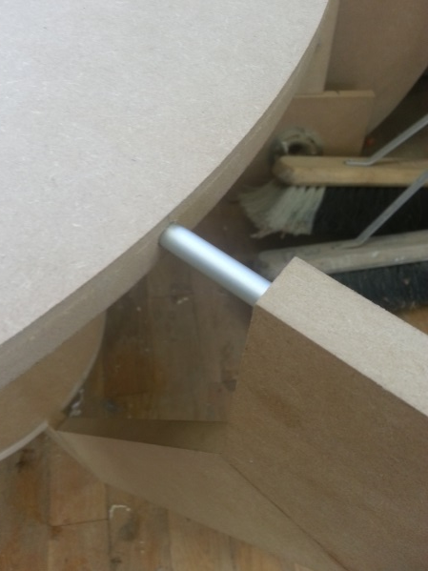
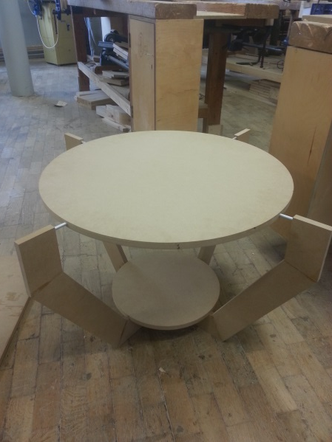
Aluminium bars connect the top to the legs.
Intended finished product was very weak.

Slide 6
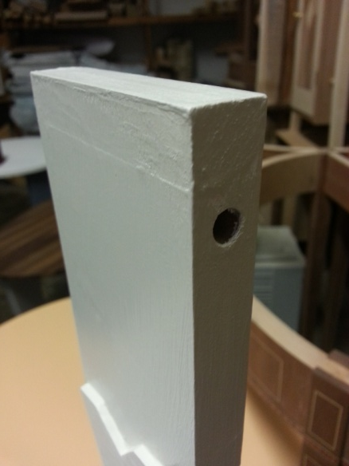
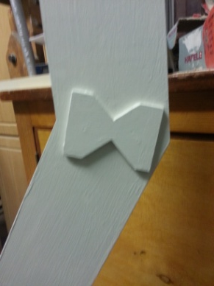
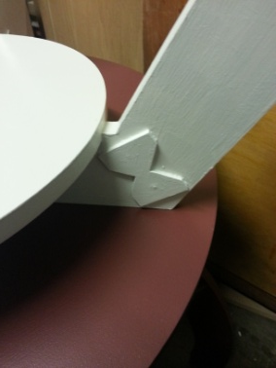
Added material above the holes to prevent breakage.
Added “butterfly” shaped supports to the joints on the legs.

Slide 7
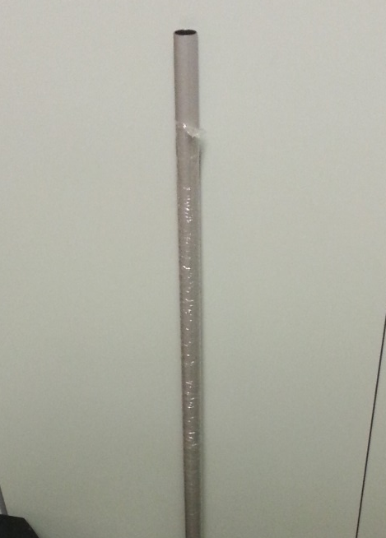
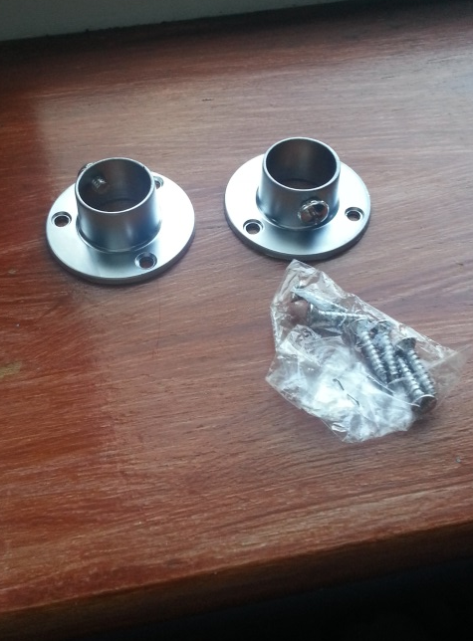
Steel bar to allow the table to hold more weight.
Brackets used to hold the bar in place.

Slide 8
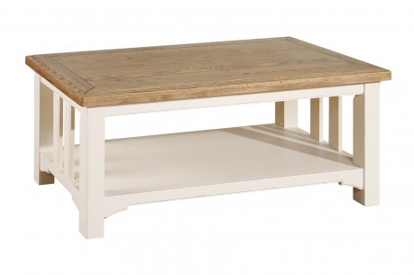
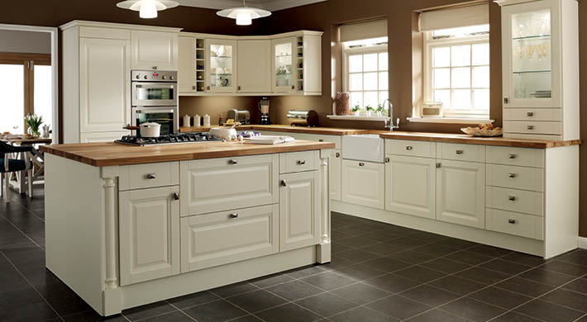
Intended Look
http://www.furniture-barn.co.uk/Furniture_Items/Tables/Coffee_Table
I'm hoping to have a cream and oak look to my table when it is finished.
http://www.homedoo.com/superbly-designed-built-in-kitchens/

Slide 9
Any Questions?

