Slide 1

Urkund
Plagiarism Checker
How to use it.

Slide 2
Submission
Submission is as normal upload the file to the correct Assignment Section.
The file will be scanned by Urkund and you will be sent a copy by email.
In the following slides I will show you what that will look like.
When you have gone through your document and included the missing references you can re submit.
Important: Do Not change the file name. If you do then the 2nd attempt will be scanned against the 1st attempt and your result will be 100%
I uploaded a doc. that I had on Duncan Phyfe that I later created into a Powerpoint and the results are on the following pages.

Slide 3
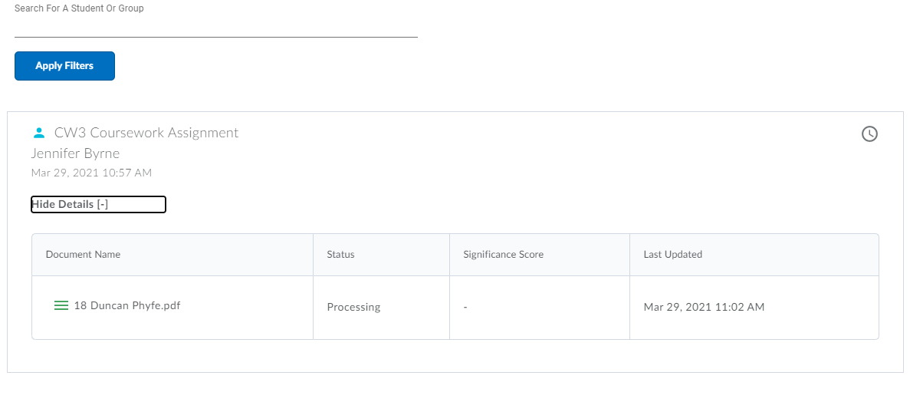
This is what I see as a Lecture
It shows processing, when complete it will show complete.
I uploaded at 10.57 and got the email 20.57 with the report.
The report was created at 12.48.

Slide 4
Email from Urkhund
Document sent by: jennifer.byrne@TUDublin.ie Document received: 3/29/2021 11:58:00 AM Report generated 3/29/2021 12:48:20 PM by Ouriginal's system for automatic control.
Document : 18 Duncan Phyfe.pdf[D100054406]
About 62% of this document consists of text similar to text found in120sources. The largest marking is 120 words long and is 93% similar to its primary source.
PLEASE NOTE that the above figures do not automatically mean that there is plagiarism in the document. There may be good reasons as to why parts of a text also appear in other sources. For a reasonable suspicion of academic dishonesty to present itself, the analysis, possibly found sources and the original document need to be examined closely.
Click here to open the analysis:
https://secure.urkund.com/view/95463531-463314-451643 Click this link in your email.

Slide 5
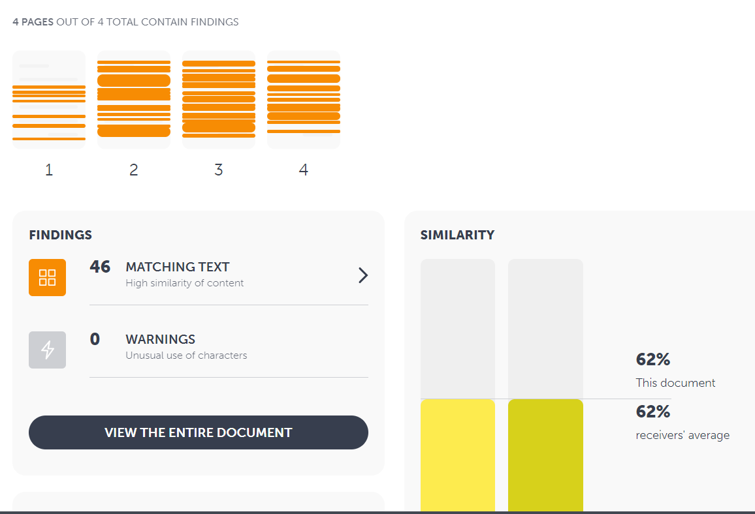
The Analysis Report

Slide 6
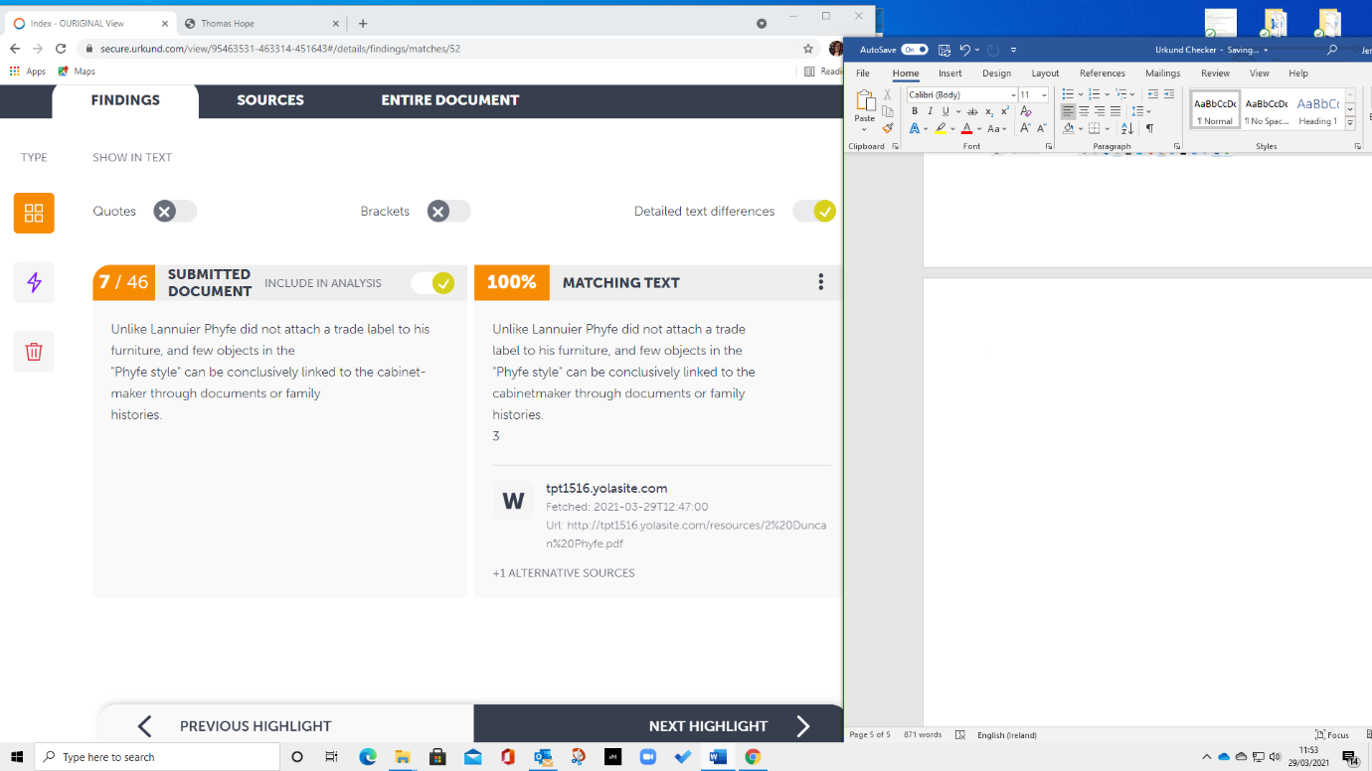
The Analysis Report
It will tell you where the source is and the source is hyperlinked. This is coming back to one of my websites where I have a lot of this material in a PowerPoint.

Slide 7
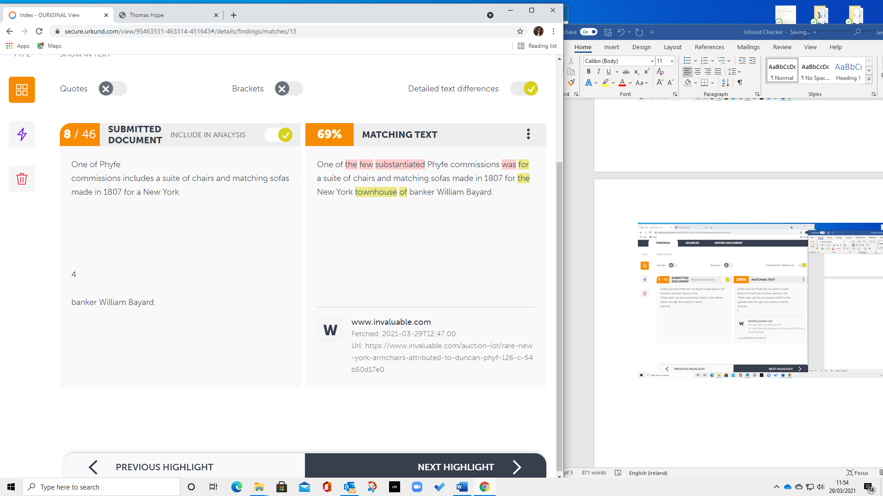
The Analysis Report
This is where I have reworded text from a website so I would need to reference this (Invaluable.com).

Slide 8
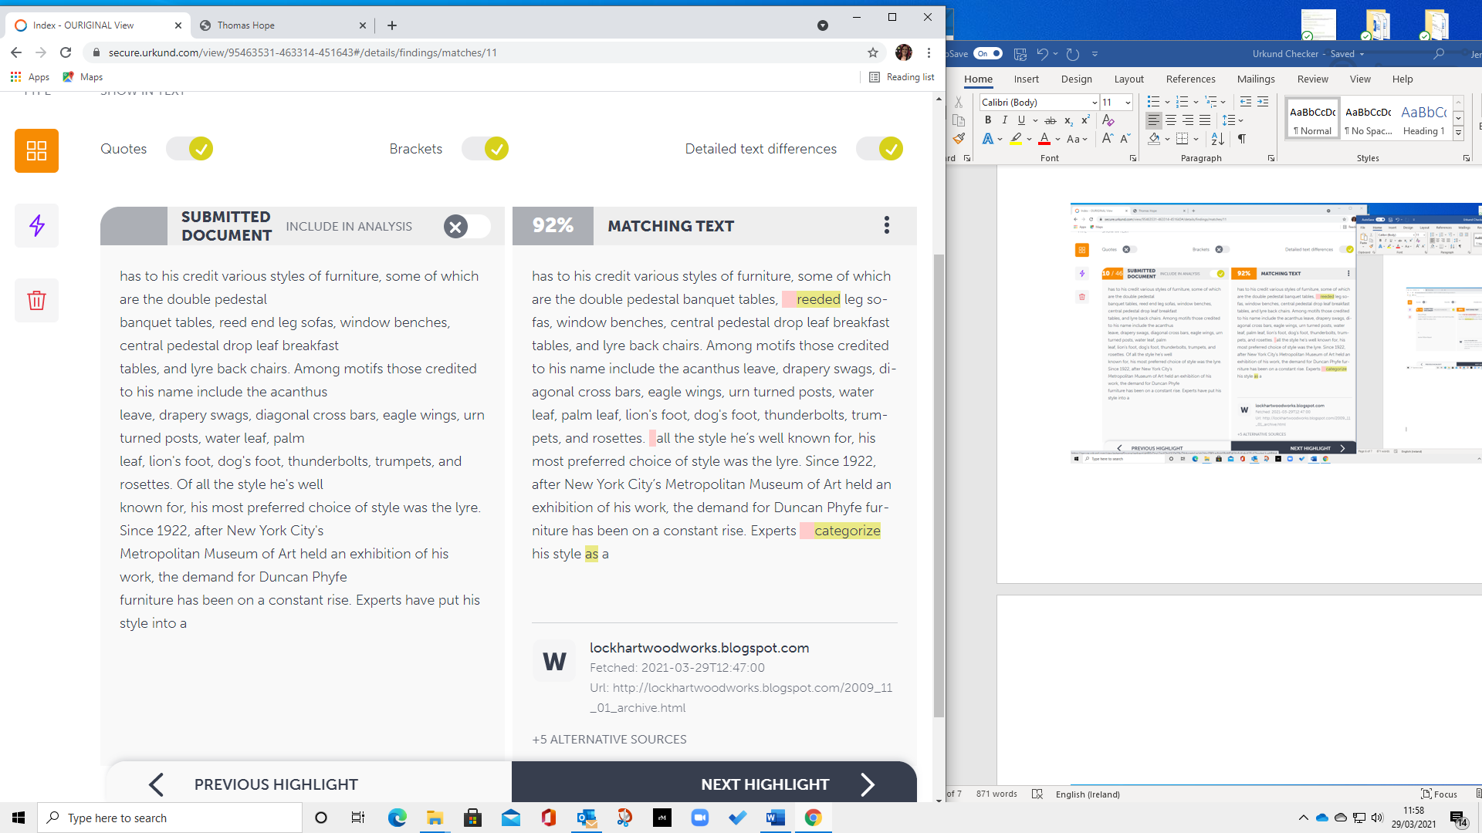
The Analysis Report
Now I have to go through the document and check the tick boxes above to show green if I have referenced this material correctly. Then tick the include in analysis box for this section to be disregarded. This will reduce the over all percentage.

Slide 9
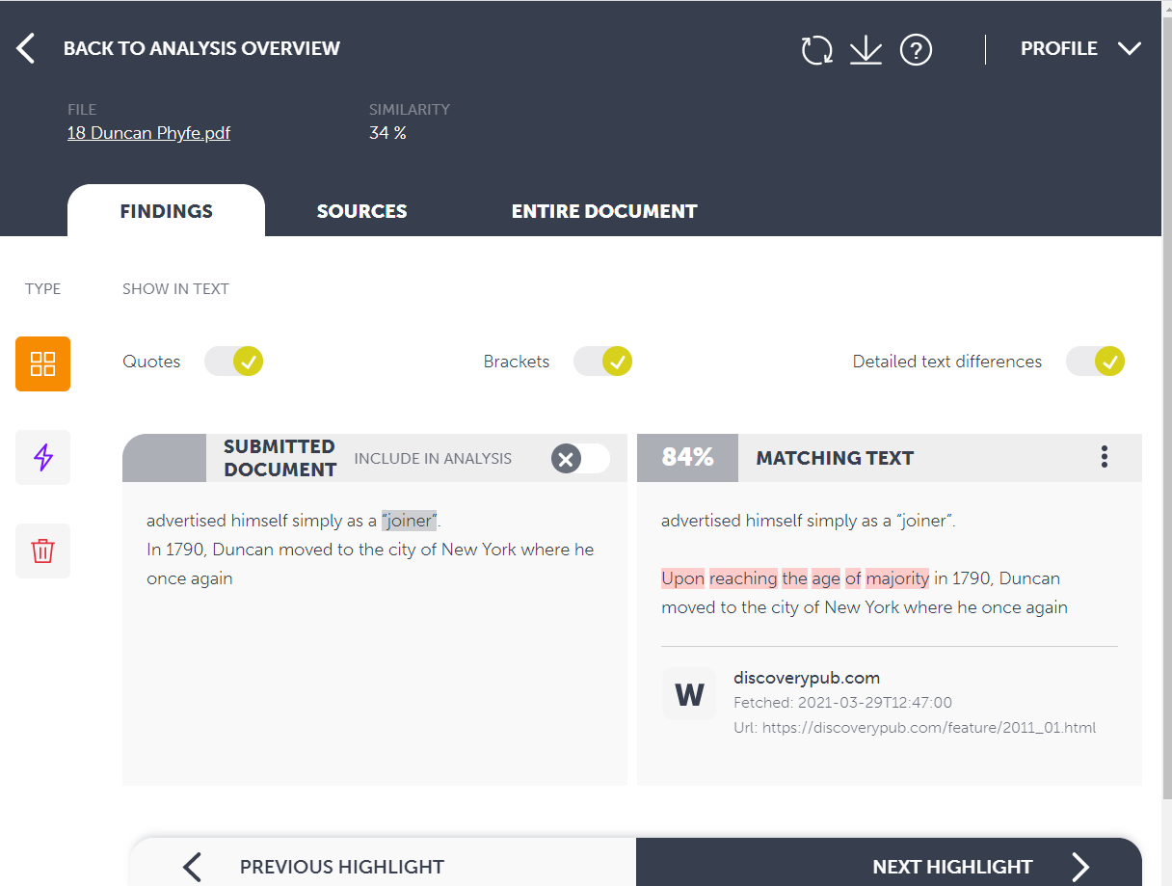
The Analysis Report
The over all percentage has lowered from 64% to 34% by carrying out this action.
When you submit a 2nd time in my report it will show these areas as referenced and I can then check that they are referenced correctly.

Slide 10
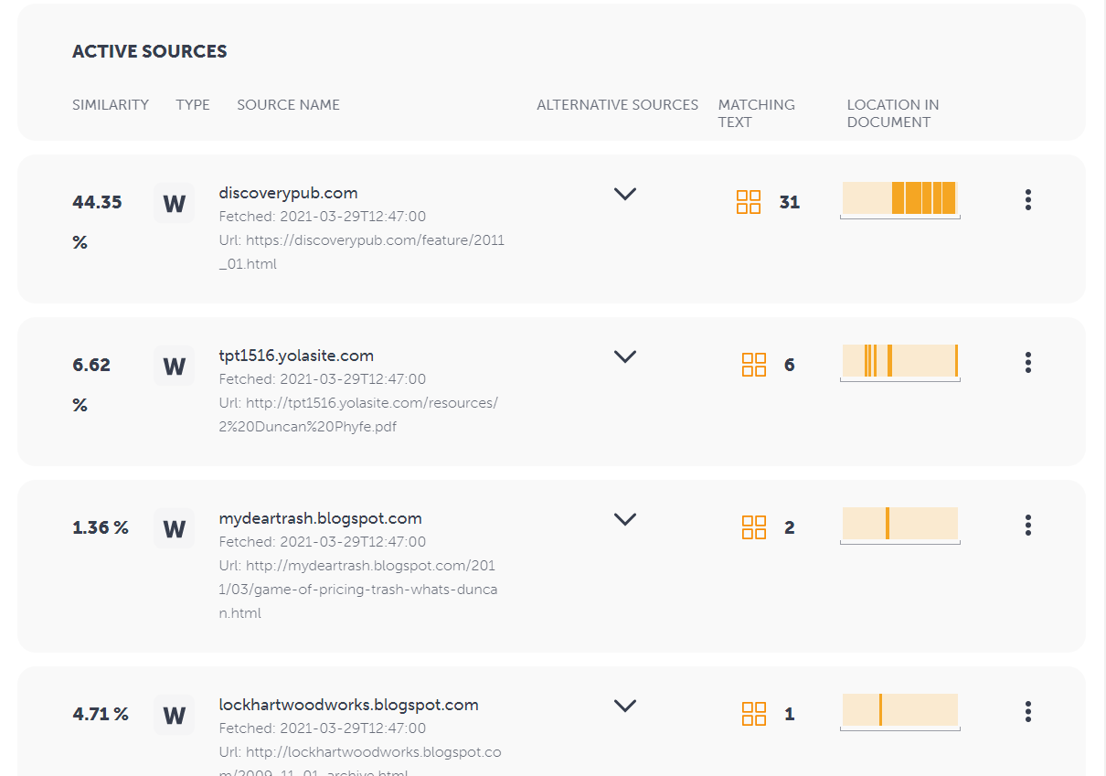
The Analysis Report
The report now shows how much of the work comes from where.

Slide 11
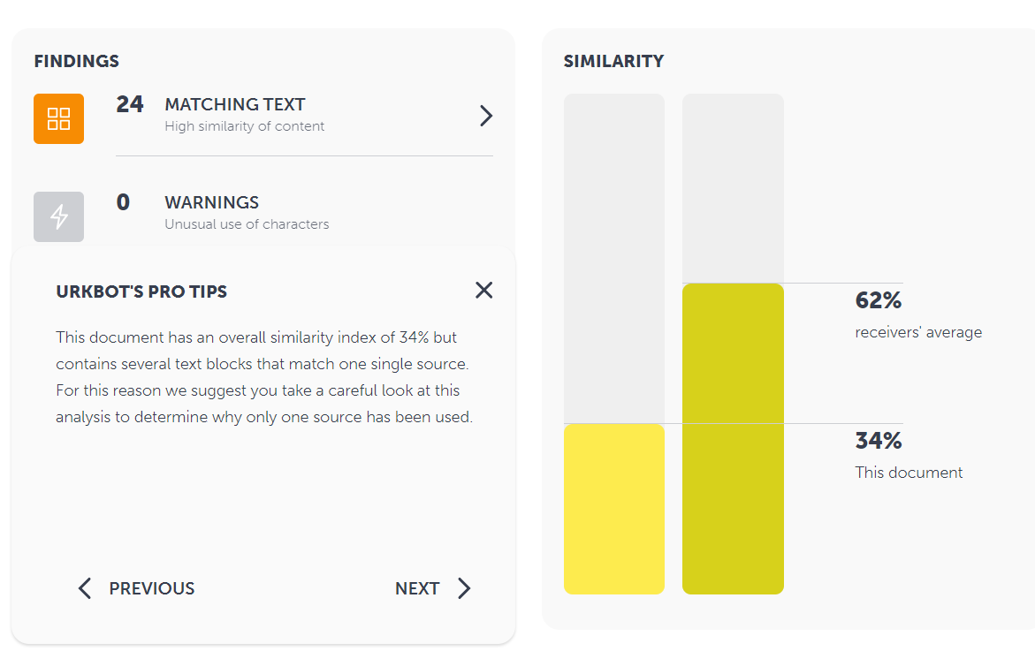
The Analysis Report
The report now shows how much of the work comes from where.
The software also detects any anomalies for when people try to cheat the system such as inserting white full stops into a sentence to break up the sentence.

Slide 12
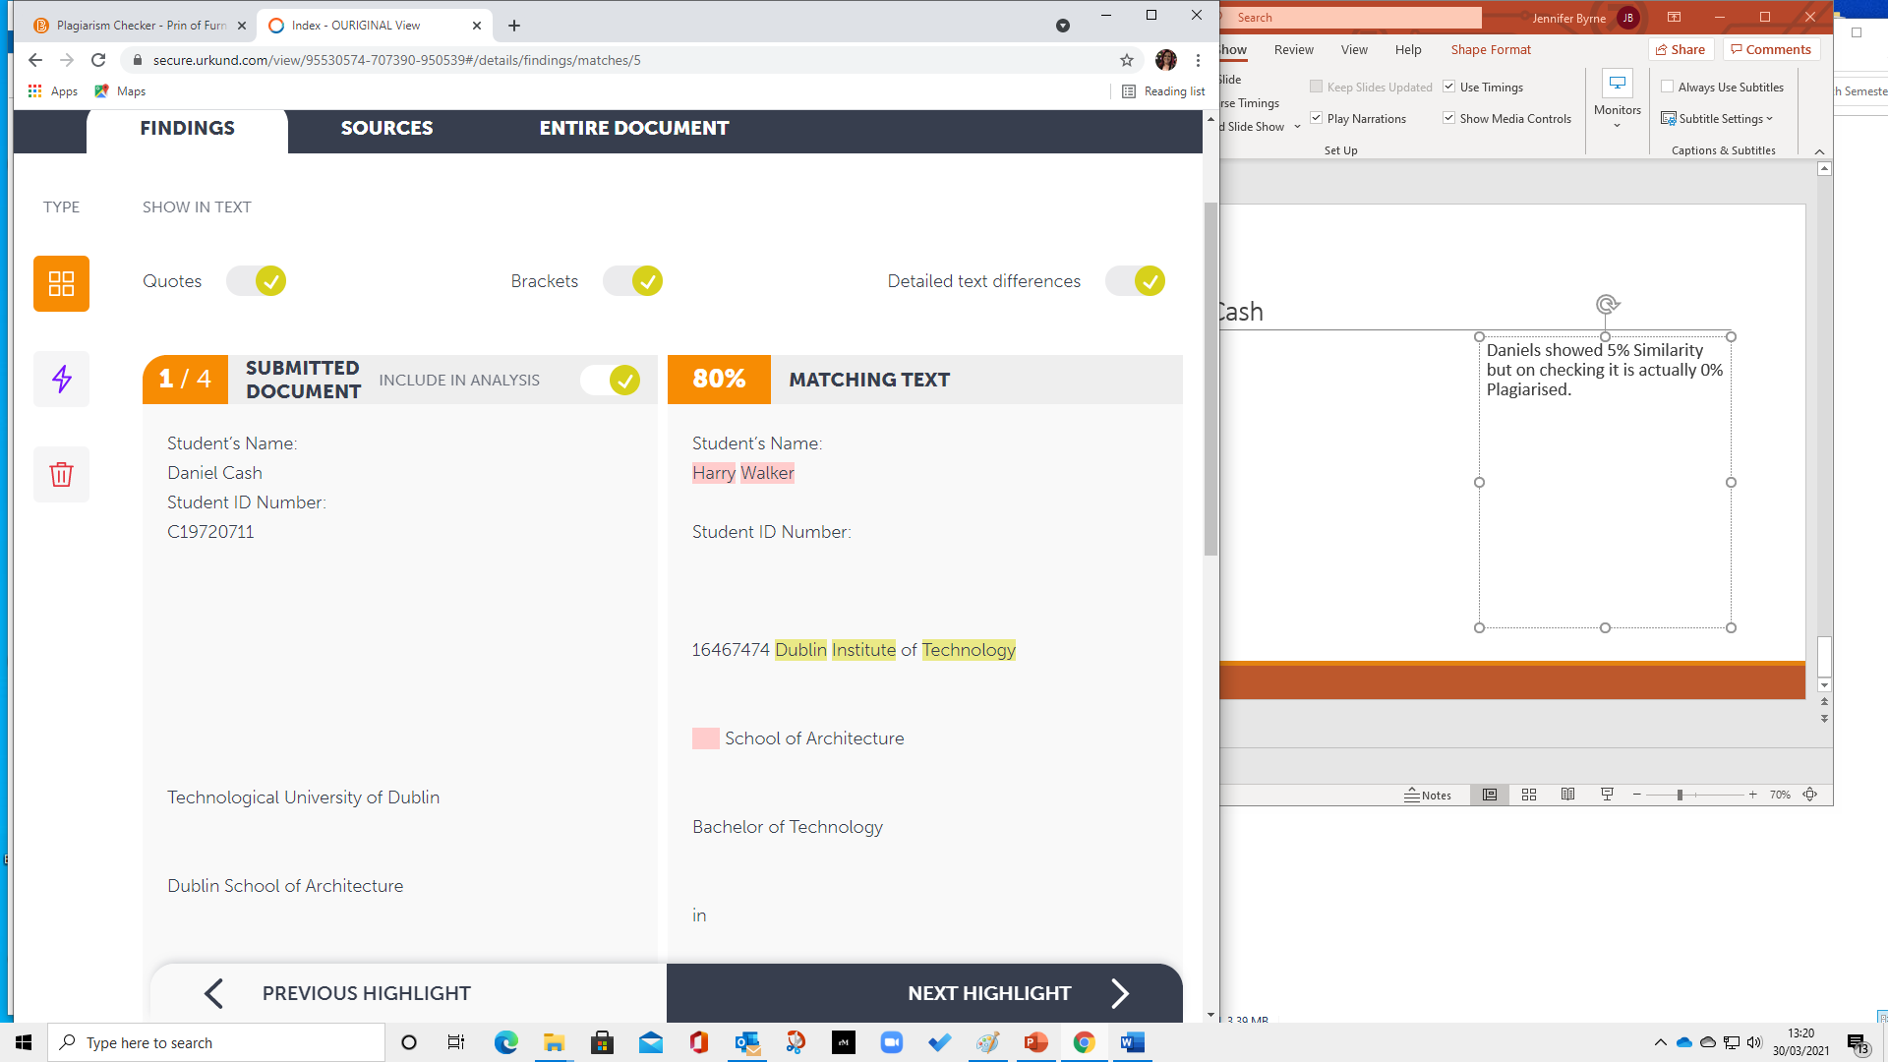
Report on Daniel Cash
Daniels showed 5% Similarity but on checking it is actually 0% Plagiarised.
The declaration sheet always comes up as similar so ignore.

Slide 13
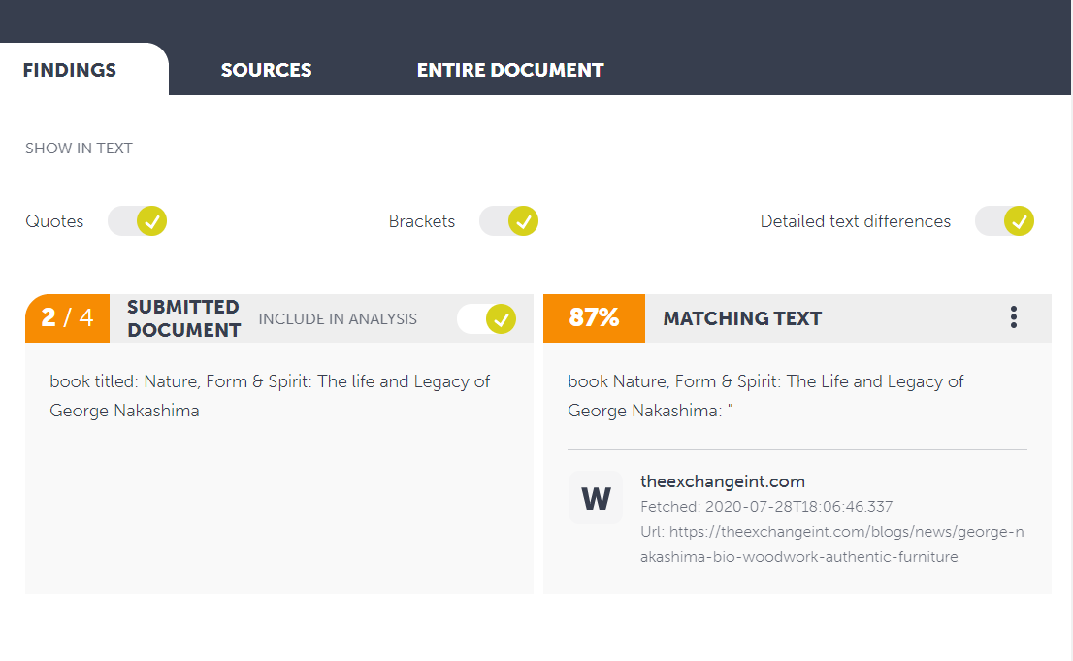
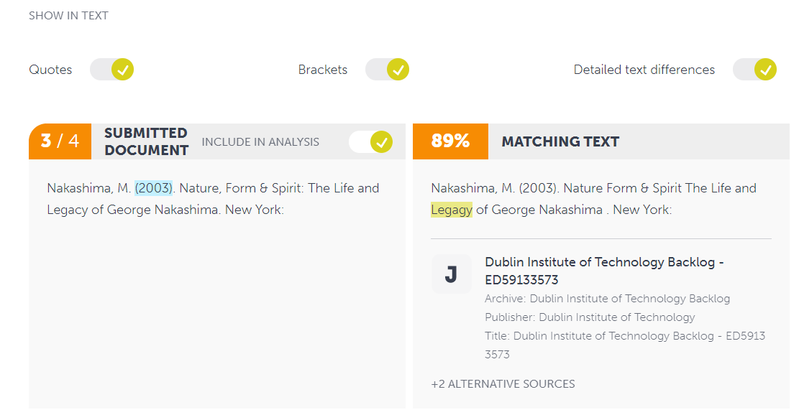
Report on Daniel Cash
The titles of books will come up as similar if they are advertised on websites.
The title of books, art exhibitions etc. will of course come up if another past student has referenced them also.

Slide 14
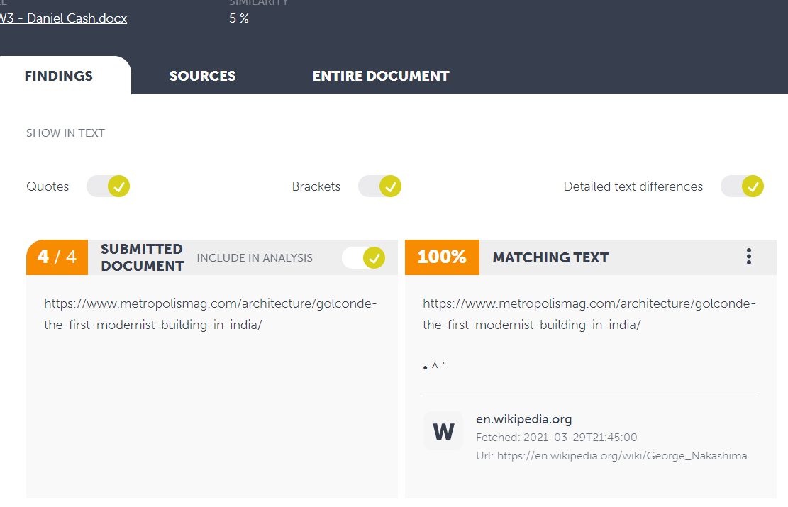
Report on Daniel Cash
Also links to website may come up as similar.
Well Done Daniel.

