Slide 1
Up-cycling Tables

Slide 2
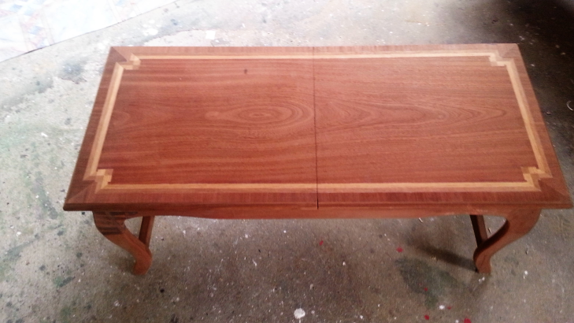
Mahogany Games Table
This table has sabre legs, H frame and veneered split top.
The top opens to reveal storage space.
J.Byrne 2016

Slide 3
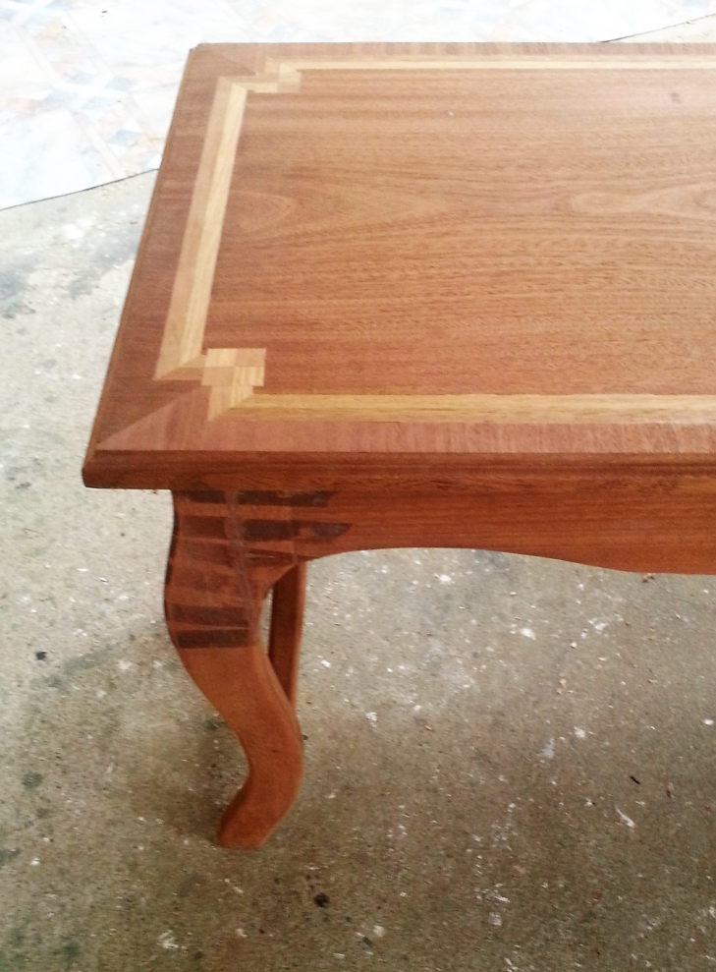
Surface preparation
Although chalk paint does not require primers imperfections such as residue from masking tape & oils still need to be removed.
Dents, holes and cracks will also need to be filled and sanded when dry.
J.Byrne 2016

Slide 4
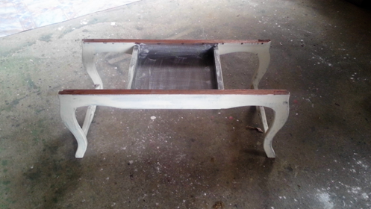
Distressed surface
A darker colour needs to be applied first and allowed to dry (see storage area for first colour).
Then a lighter colour is applied and allowed to dry.
J.Byrne 2016

Slide 5
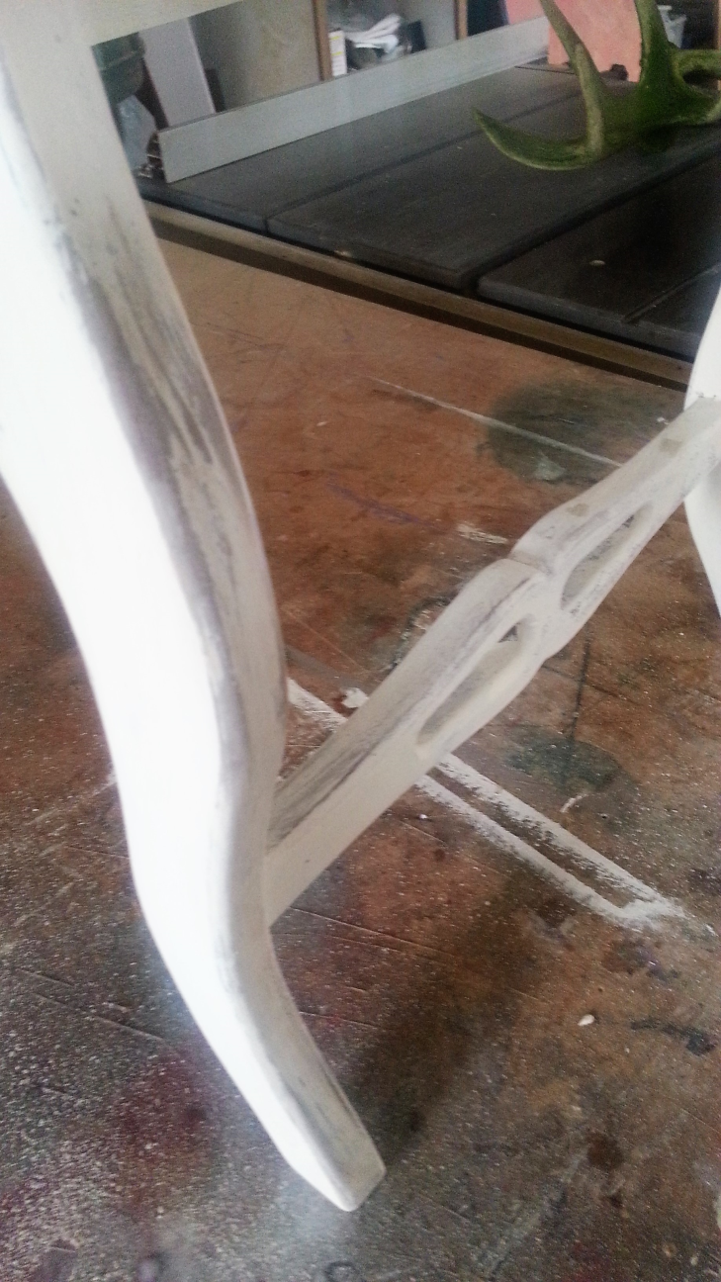
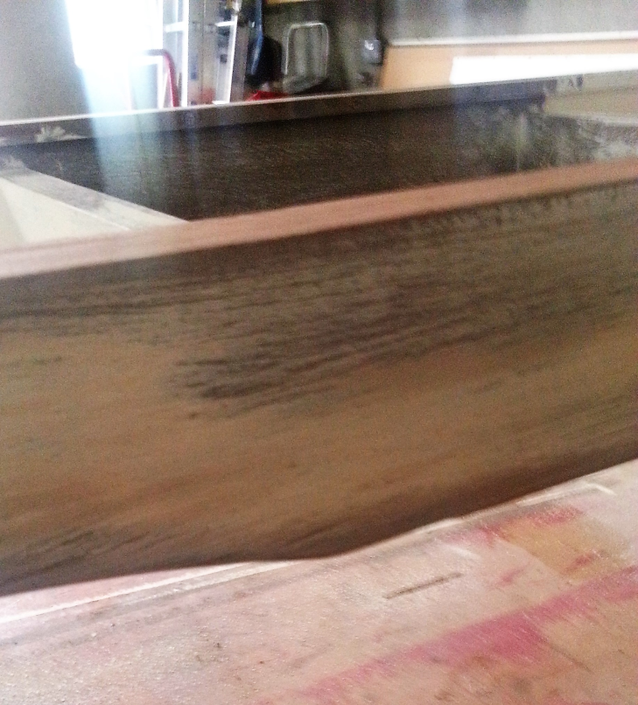
Distressed surface
Some sanding is then required to allow the darker surface to come through in places.
Usual areas for wear are edges tops of chair rungs.
J.Byrne 2016

Slide 6
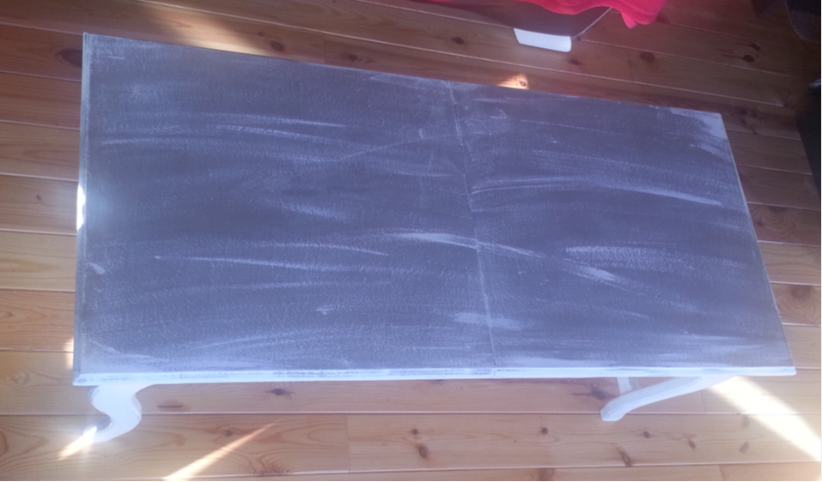
Finished Table
Vaseline can also be applied to the raw wood in some areas before applying the paint then when dry rub off Vaseline before applying wax.
J.Byrne 2016

Slide 7
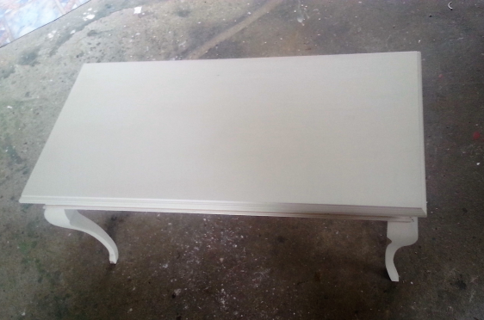
Mahogany Queen Anne Style Table
This table has Cabriole legs, astragal moulding & moulded veneered MDF top. It is missing lugs that should be placed at the knees of the cabrioles.
It has been painted with two coats of white chalk paint.
J.Byrne 2016

Slide 8
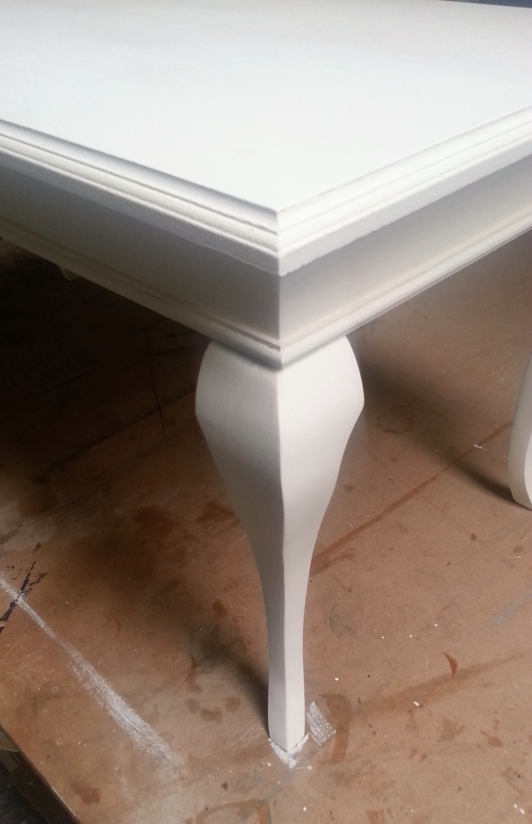
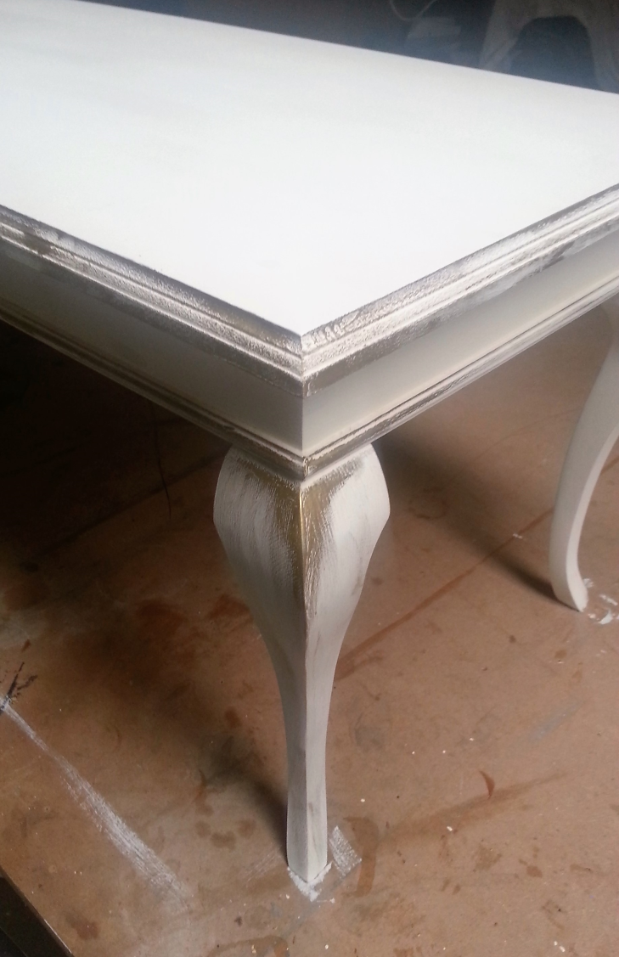
Mahogany Queen Anne Style Table
A gold coloured gilding wax was applied to the tables edges.
J.Byrne 2016

Slide 9
Finished Table
Various different coloured gilding waxes are available such as tin, copper, antique brass, brass, antique gold, gold.
J.Byrne 2016

