Slide 1
Mark Waston
Half Sheet Table

Slide 2
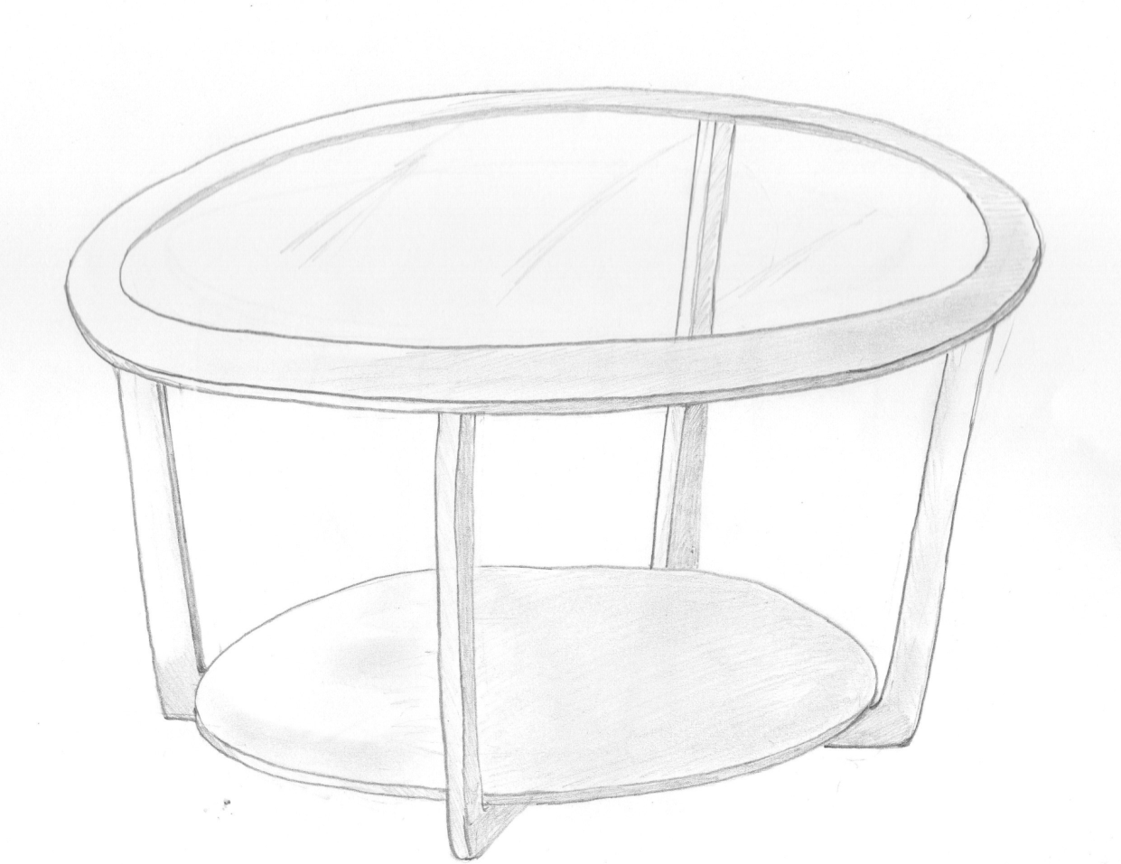
Design Idea 1

Slide 3
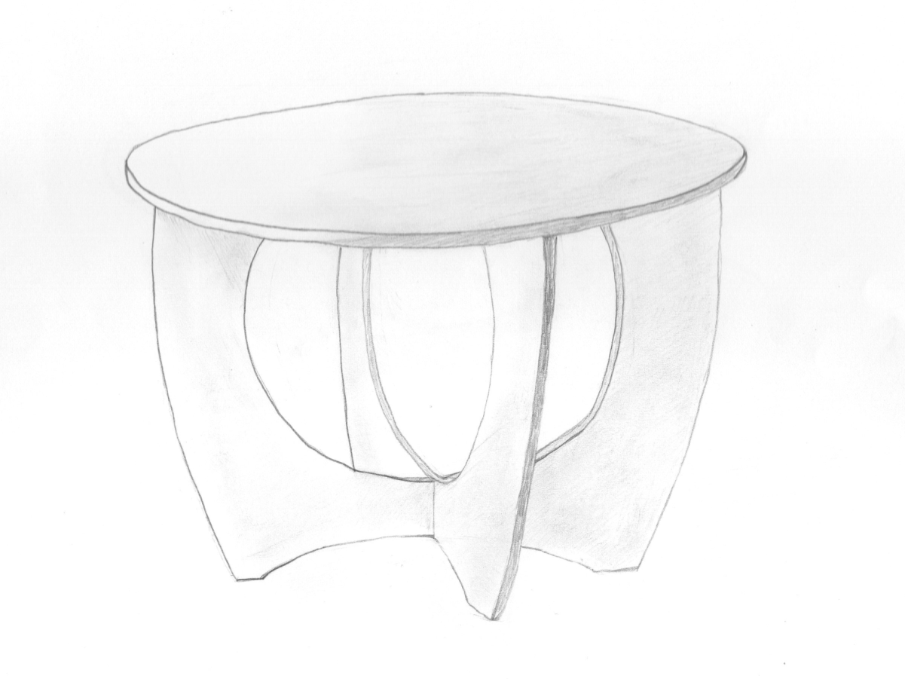
Design Idea 2

Slide 4
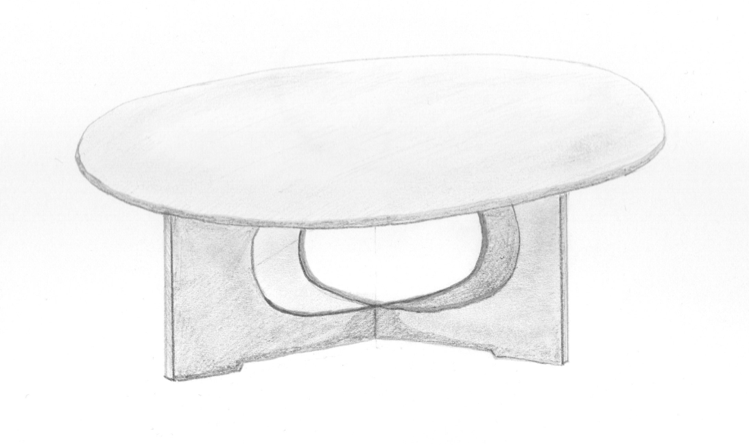
Design Idea 3

Slide 5
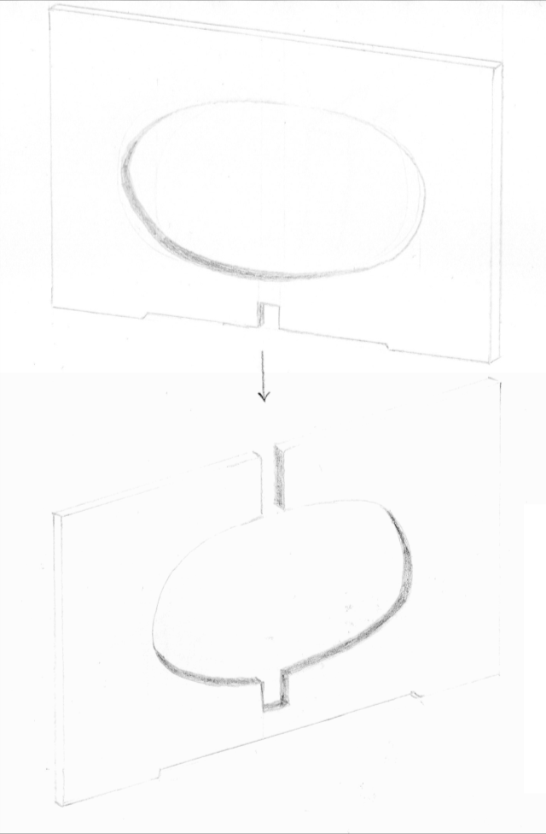
Detail of leg
construction

Slide 6
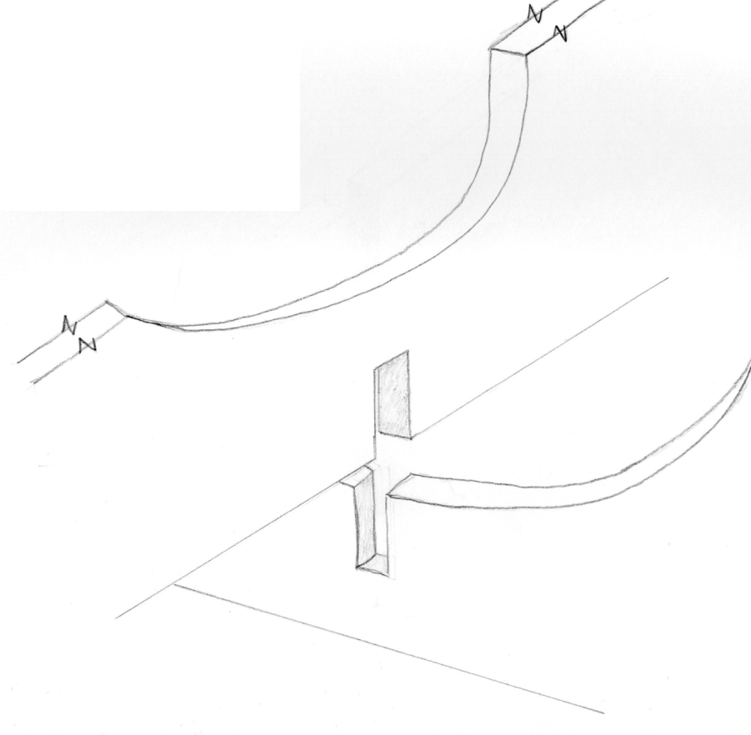
Cross halving joint

Slide 7
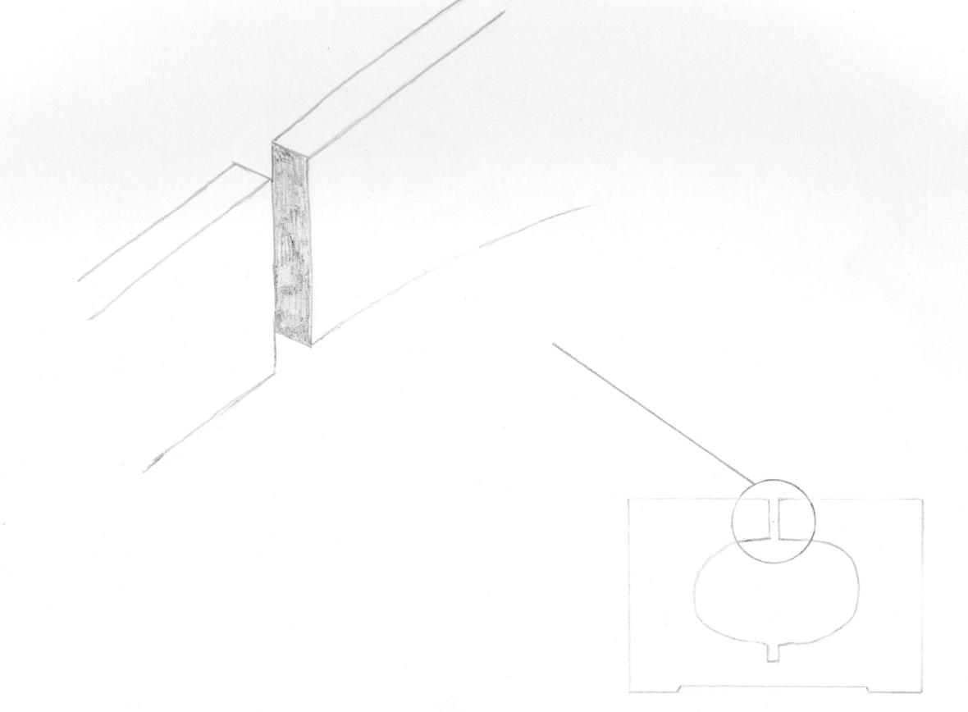
Top Joint Detail

Slide 8
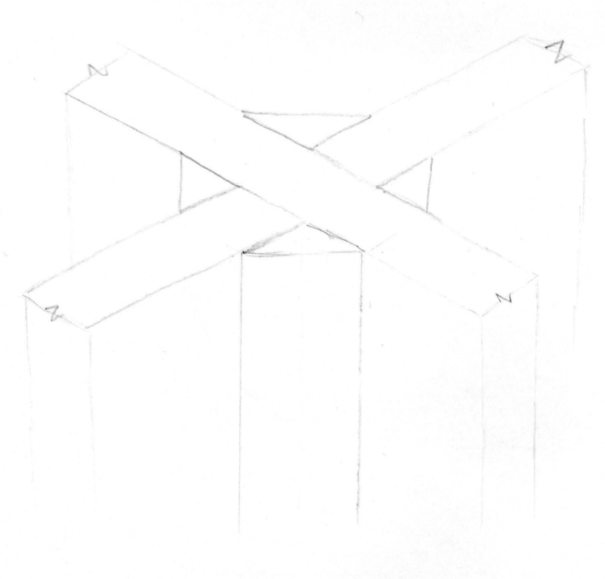
Glue block detail

